Slide 1
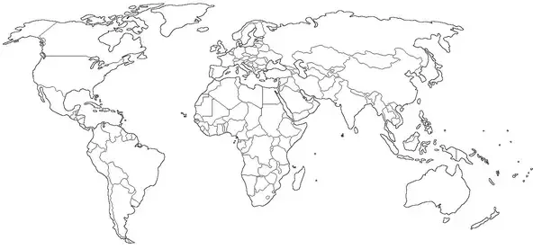
Warm-Up: Monday, October 7, 2019
We are on a short schedule today- Work Fast!
With any color marker, circle in all United States land.

Slide 2
Territories
Did You Know: There are five major U.S. territories. A U.S. territory is a partially self-governing piece of land under the authority of the U.S. government. U.S. territories are not states, but they do have representation in Congress.

Slide 3
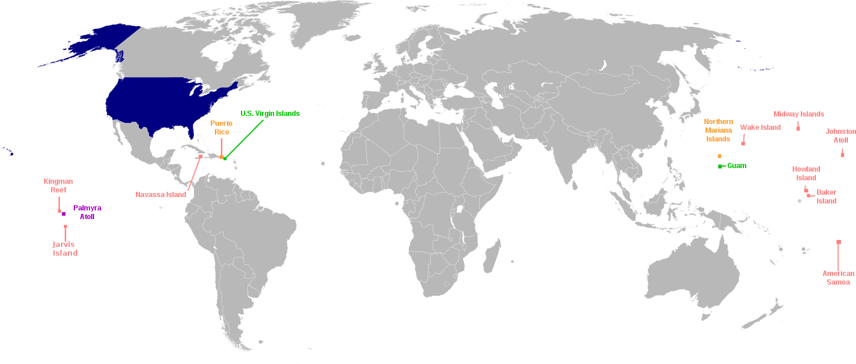
The U.S. has sixteen territories in the Caribbean Sea, the south Pacific Ocean, and the western portion of the north Pacific Ocean.
Five of the territories are permanently inhabited and are classified as unincorporated territories.
The other eleven territories are small islands, atolls, and reefs with no native or permanent population.

Slide 4
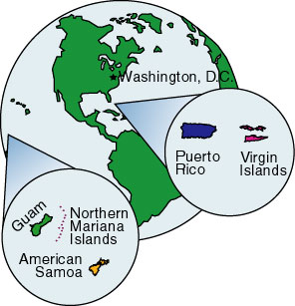
So What Are The Territories?
1. Puerto Rico
-1,995 miles from Houston
2. Guam
-7,420 miles from Houston
3. American Samoa
-5,806 miles from Houston
4. U.S. Virgin Islands
-2,089 miles from Houston
5. Northern Mariana Islands
-7,304 miles from Houston

Slide 5
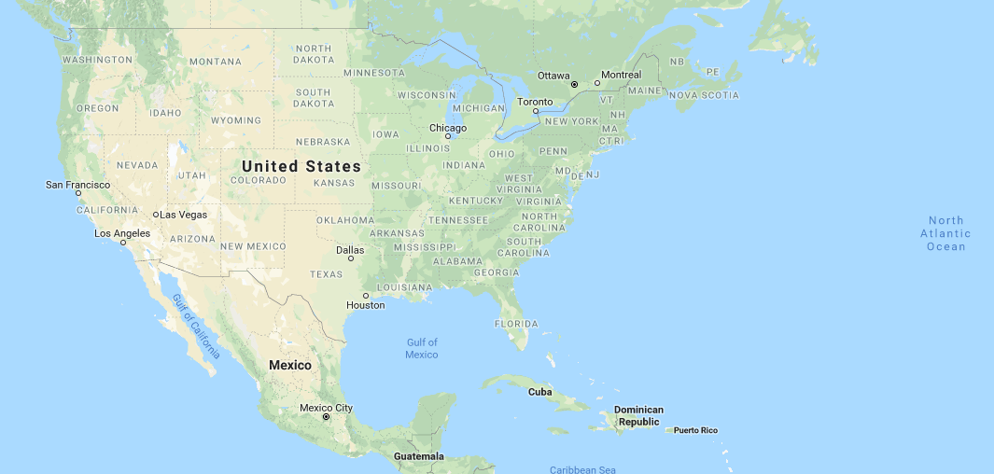
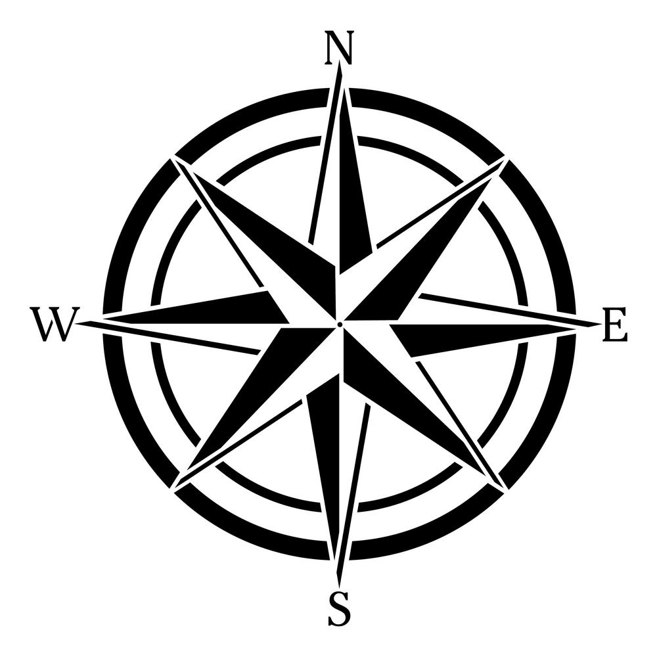
1. Puerto Rico’s Location

Slide 6
Puerto Rico
US Importance:
Strategically Important to the US (keeps a US presence in the Caribbean)
Helps Protect the Panama Canal

Slide 7
Puerto Rico
Puerto Rican Rights Today
They Elect their own Representatives
One Representative in Congress- but they don’t vote.
Cant Vote for President
Do Pay Taxes and Receive Federal Money

Slide 8
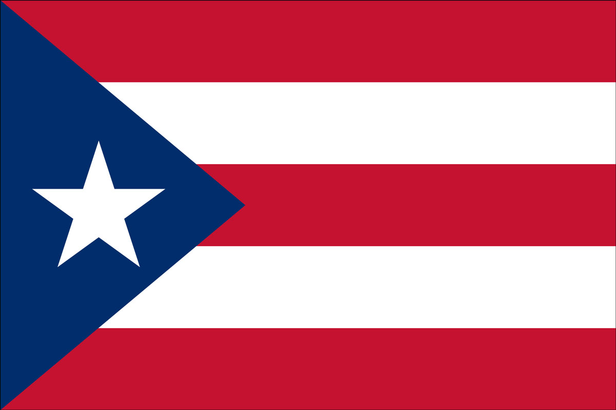
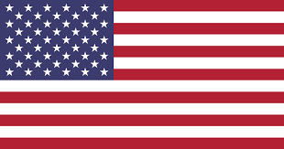
What do you notice about the two flags?

Slide 9
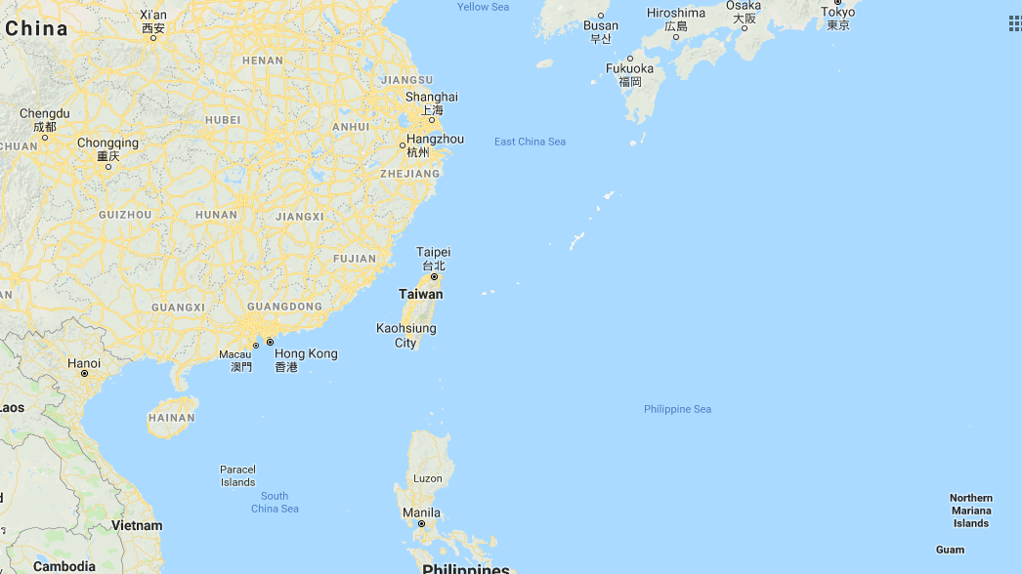
2. Guam’s Location

Slide 10
Guam
US Importance:
Strategically Important to the US (keeps a US presence in the Pacific Ocean)
Needed Naval and Air forceBase in the Pacific after WW2.
Today its our closest base to North Korea
Over 20,000 Active Military Personnel on the island with a population of only 100,000 people.

Slide 11
Guam
Guam’s Rights Today
They Elect their own Representatives
They do not participate in US government
They are US citizens (travel freely from US to Guam)

Slide 12
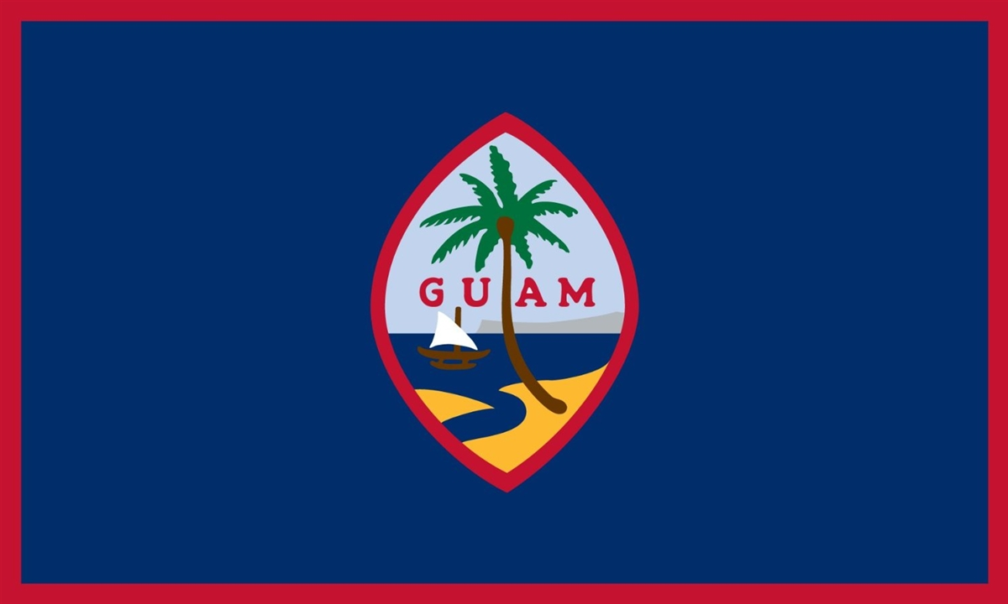
Do you think Guamanians identify as American or Guamanian first? Explain.

Slide 13
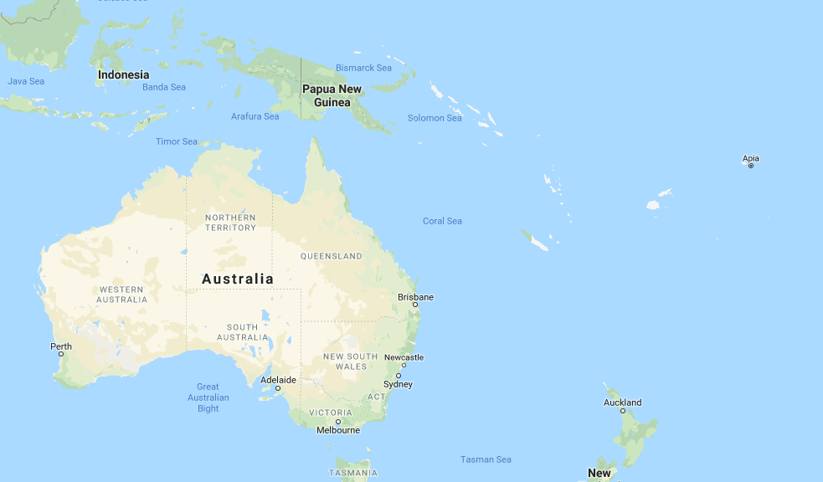
3. American Samoa’s Location

Slide 14
America Samoa
US Importance:
Strategically Important to the US (keeps a US presence in the Pacific Ocean)
Highest percentage of enlisted people in any American land.
Was Ceded (taken) by America in the early 1900’s.

Slide 15
American Samoa
Samoa’s Rights Today
They Elect their own Governer
They have representation in Congress, but cant vote on current issues.
They are NOT US citizens, but you can enlist in the Military and gain citizenship.

Slide 16
Can you figure out why more Samoans are unhappy with their current status?

Slide 17
4. U.S. Virgin Islands’ Location

Slide 18
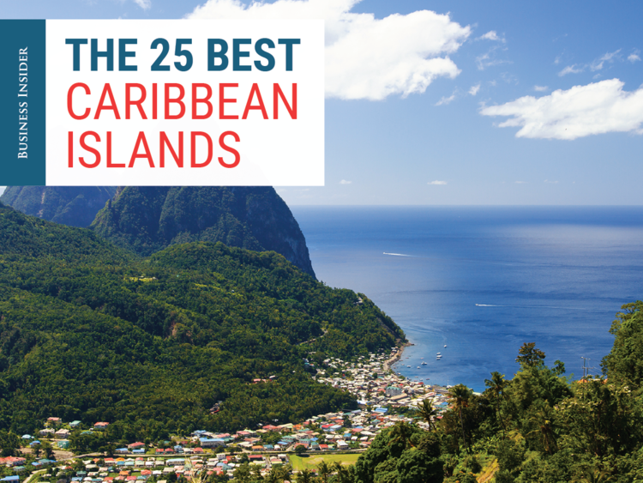
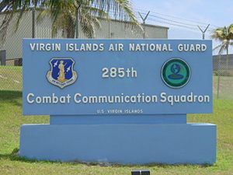
Importance of U.S. Virgin Islands

Slide 19
American US Virgin Islands
US Importance:
Was strategically Importance during colonization, and the 1960’s during the Cuban Missile Crisis.
Today it’s a large tourist destination, brining in Money!
USA and England use the Virgin Islands to share control of the Caribbean.
Home to the largest Caribbean Oil Refinery.

Slide 20
American US Virgin Islands
US Virgin Islands’ Rights Today
They have their own government and constitution.
They are US citizens, who can travel freely to the US.
Can vote in primary elections, but not for president.

Slide 21
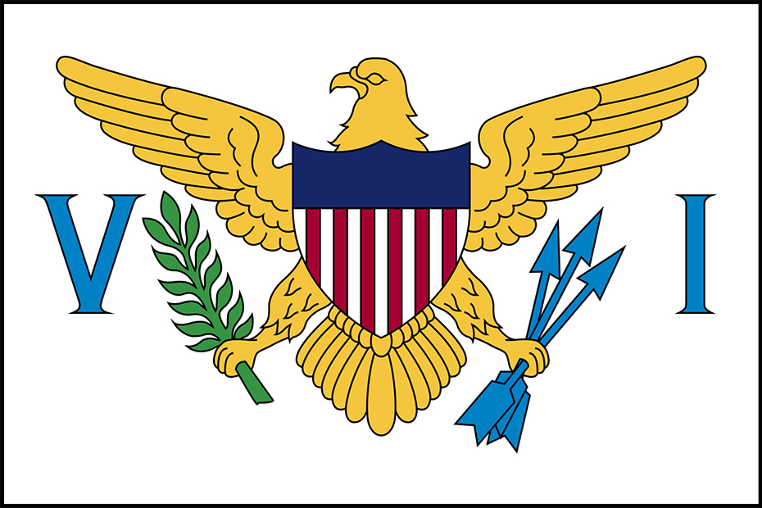
Why do you think the US is so interested in maitaning control of the Virgin Islands?

Slide 22
5. Northern Mariana Islands’ Location

Slide 23
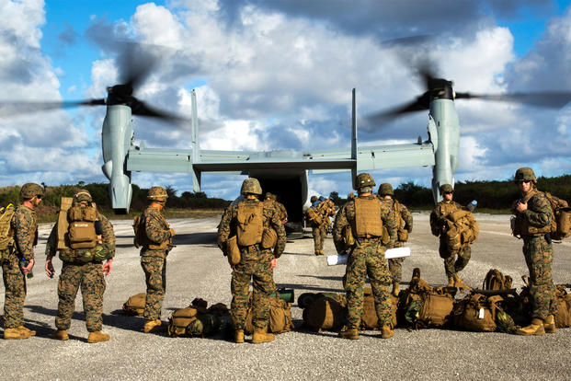
Importance of Northern Mariana Islands

Slide 24
Northern Mariana Islands
US Importance:
Was strategically important to watch the growing Chinese Military from the mid 1940’s.
Today it is used as a military training base
Refueling base for both Airforce and Navy.
Used in conjunction with English, French, and Australian Forces.

Slide 25
Northern Mariana Islands
Northern Mariana Islands’ Rights Today
They are US Citizens, who elect their own governor.
They do not vote in US elections, but do have representation.
US only granted citizenship in 2009 to the people.
Americans have to have a Visa to visit.

Slide 26
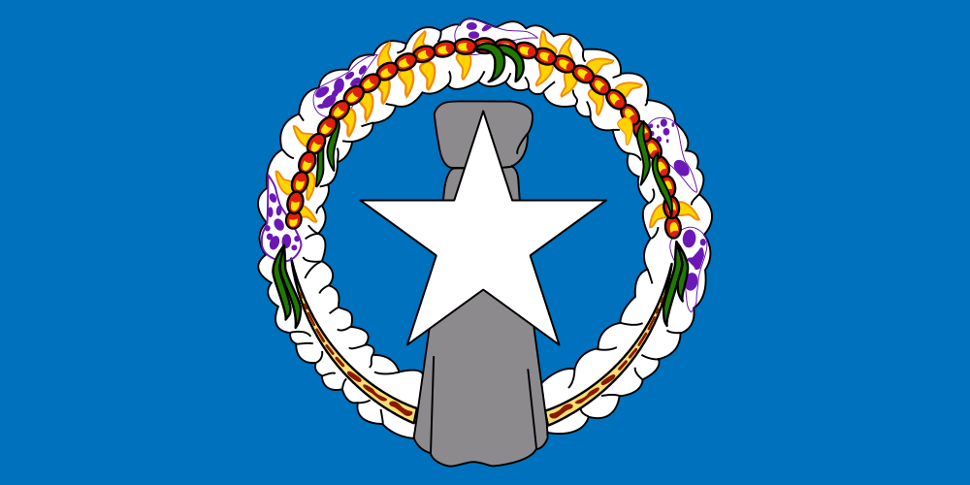
What would cause the flags to be so different?

