Slide 1
Types of Maps
Physical, Political, Thematic

Slide 2
Physical
Show you what the earths surface looks like
Show elevation, water, and topography

Slide 3
Quickly color your Physical Map

Slide 4
Political
Have man made borders
Often do not use realistic colors
Show cities, states, countries, roads, railroads, building

Slide 5
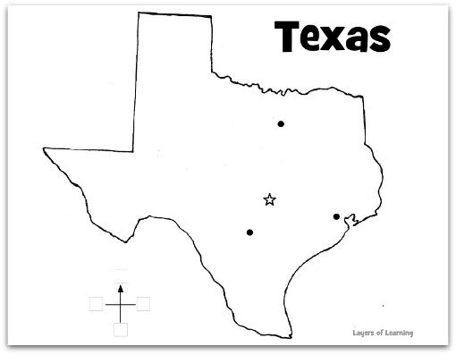
Label your Political Map

Slide 6
Thematic
Used to represent specific information about an area
Are detailed about one or two topics
Can present information over almost any topic

Slide 7
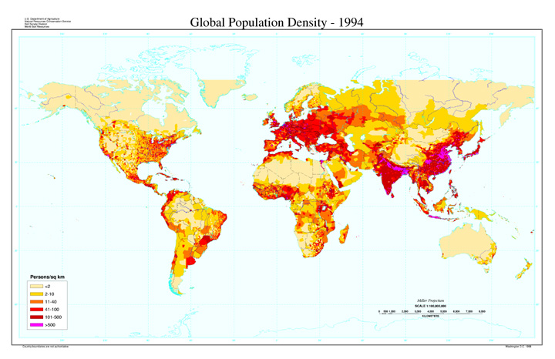
World Population Density

Slide 8
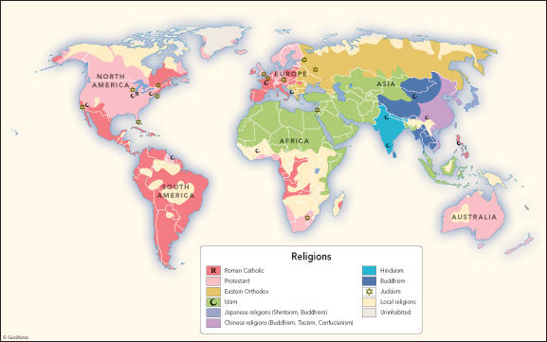
Religions of the World

Slide 9
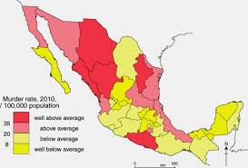
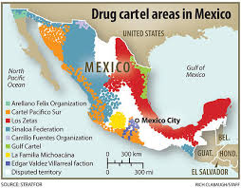

Slide 10
Lets Practice
Using the Atlas, try to answer the following questions. First tell what type of map you would use, then look for the correct answer.

