Slide 1
Surviving South Sudan
Drought, Famine, Education, Oil

Slide 2
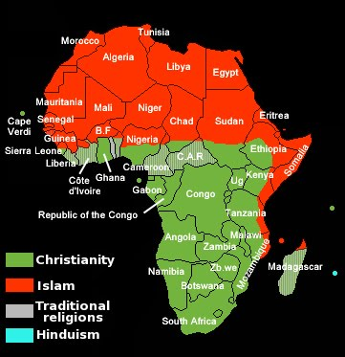
Warm-Up Directions:
Color all Islamic Territories of Sudan1 color.
Color all Christian Territories of South Sudan a different color.

Slide 3
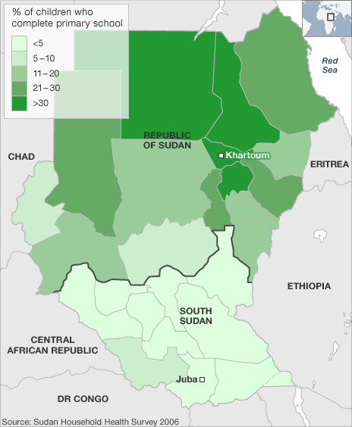
Primary School Completion in Sudan and South Sudan

Slide 4
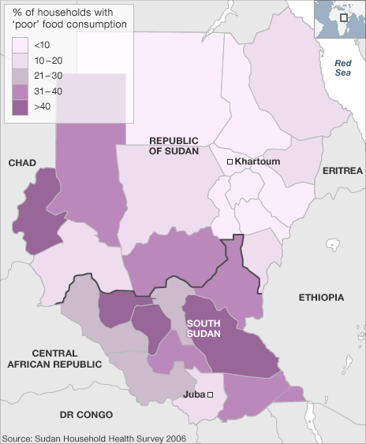
Percent of Households with poor food consumption

Slide 5
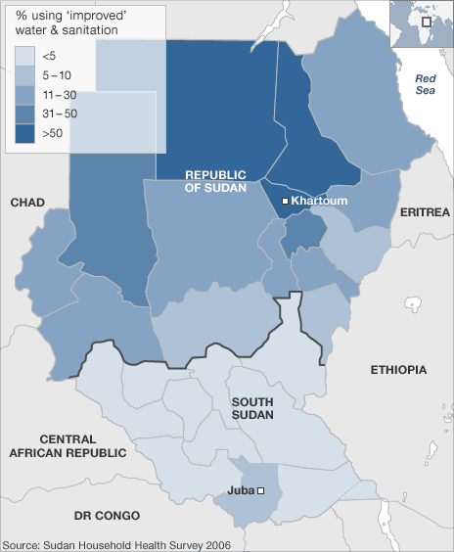
Improved Water and Sanitation

Slide 6
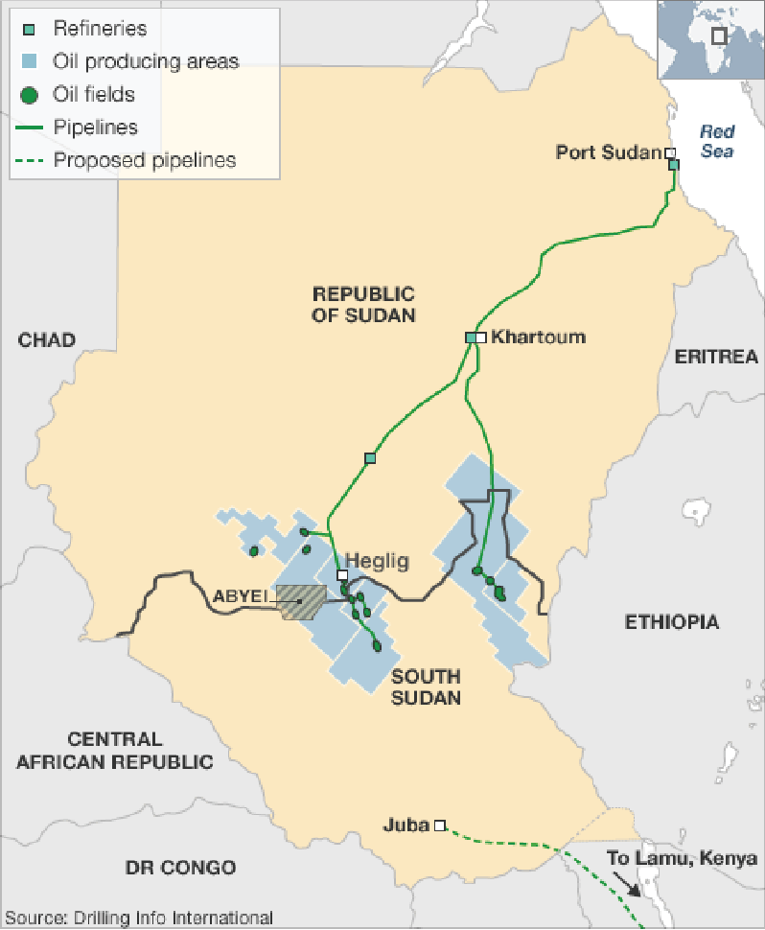
Oil Refineries and Pipelines

