Slide 1
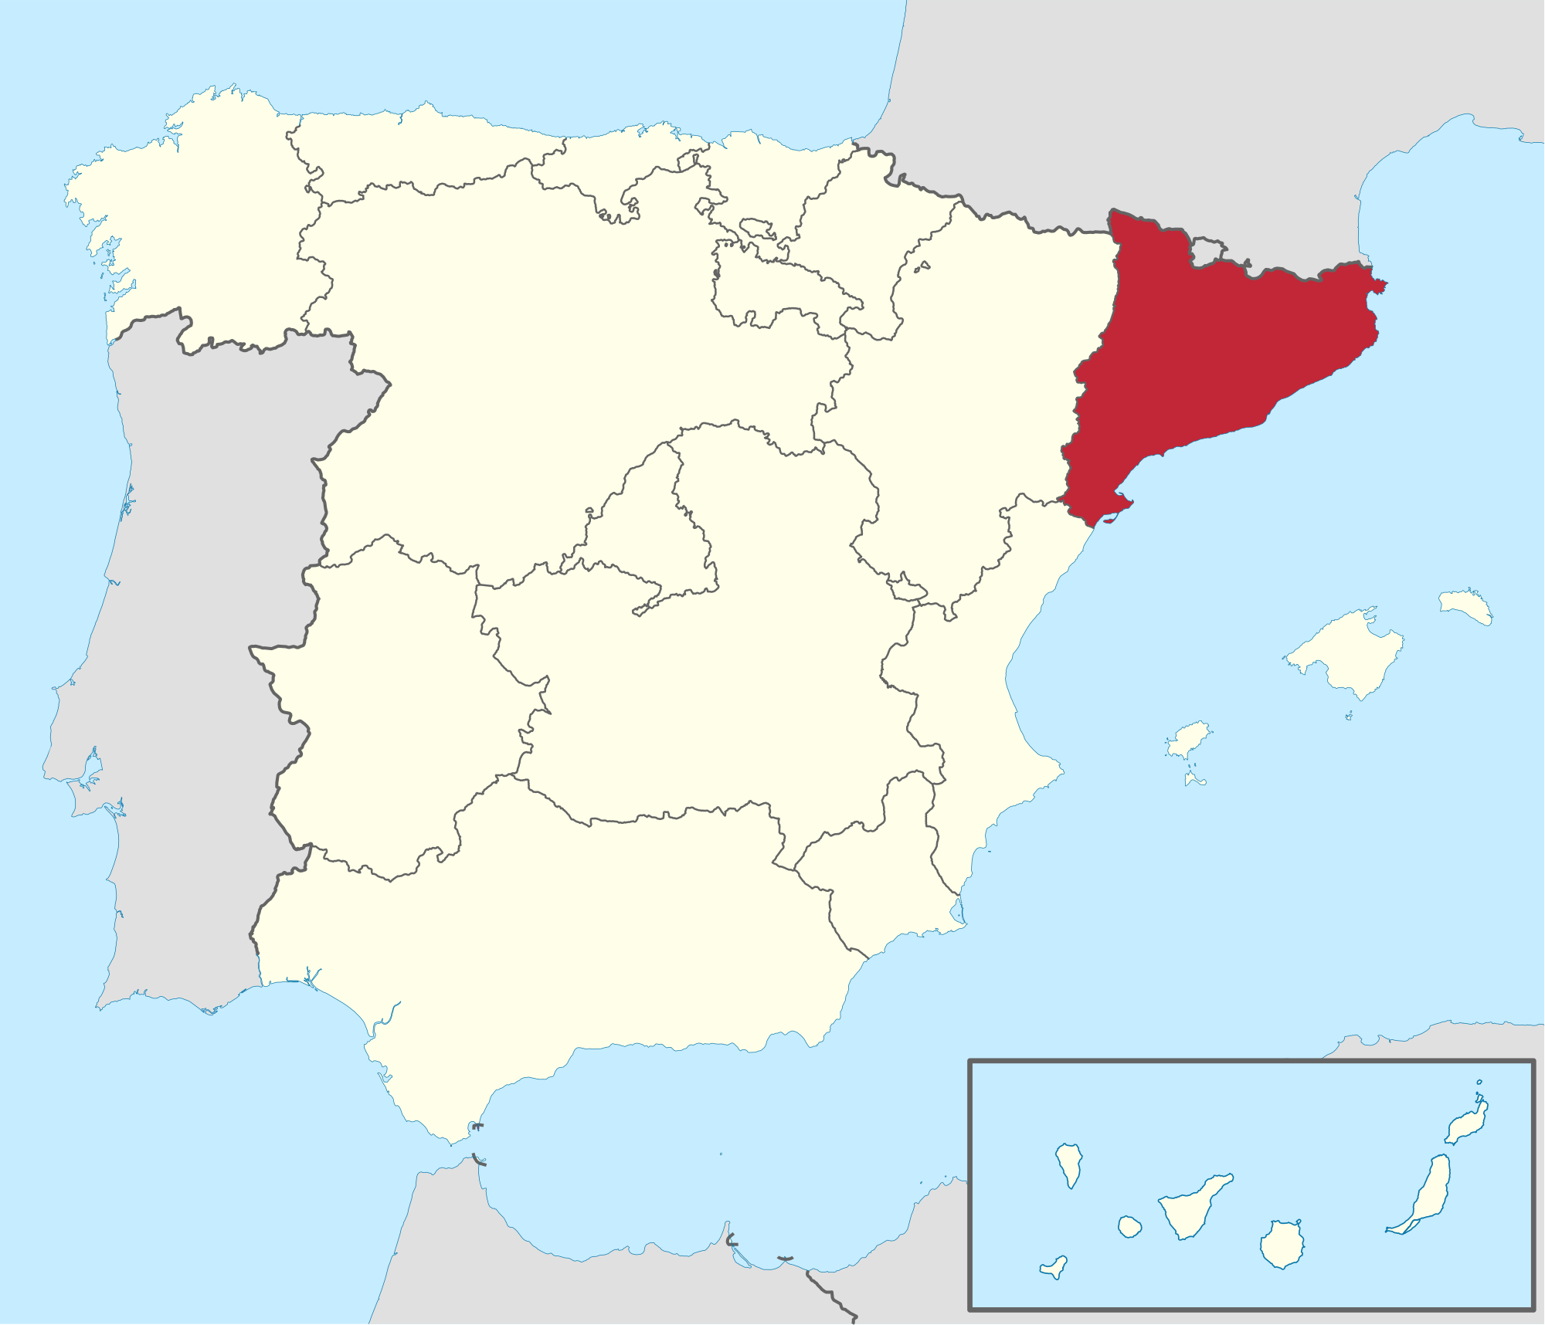
Move for Independence
Catalonia
The map to the left is a map of Spain. The region in red is Catalonia. This region wants independence from Spain.
~Color the Region of Catalonia
~Label Spain
~Label Catalonia
~Label the Mediterranean Sea
~Label Portugal
~Label France
~Label the Atlantic Ocean
France
Spain
Catalonia
Portugal
Mediterranean
Atlantic

Slide 2
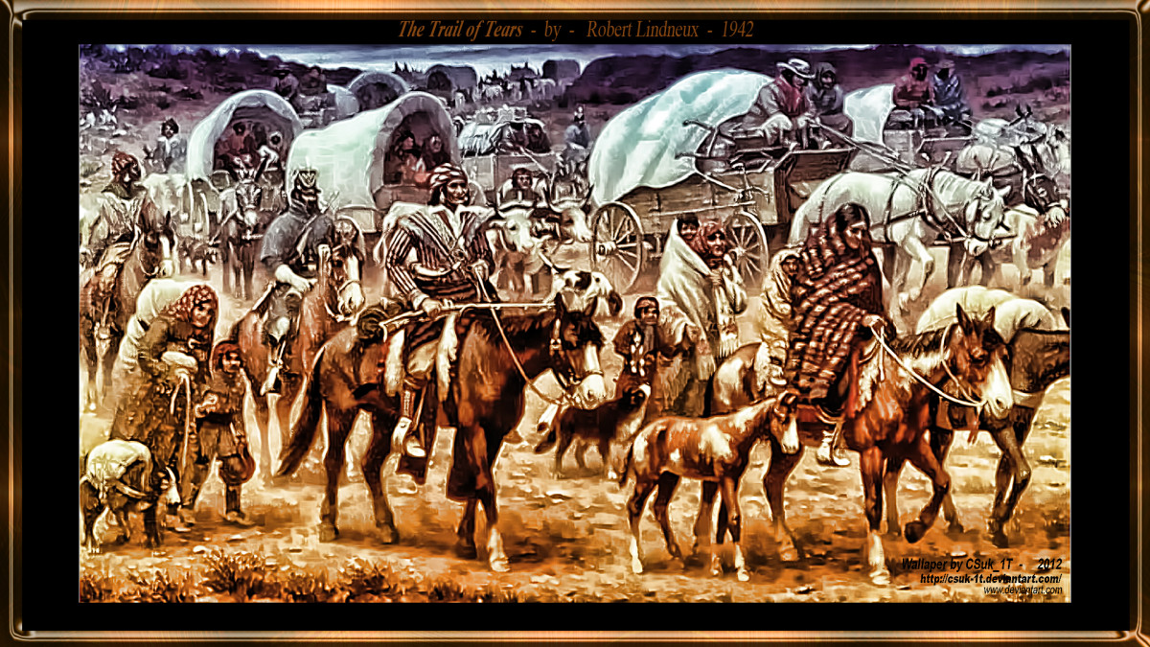
Why do some countries want independence?
The Idea of independence is often fueled by a long history. Some independence movements come from the idea of Nationalism- Ideology that promotes and supports ones own nation over the interests of other nations.

Slide 3
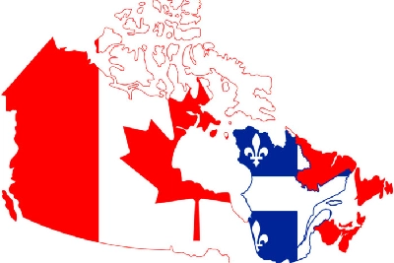
Why do some countries want independence?
Other reasons for independence may include the idea of Separatism- The want to separate from a larger group on the basis of ethnicity, or religion.

Slide 4
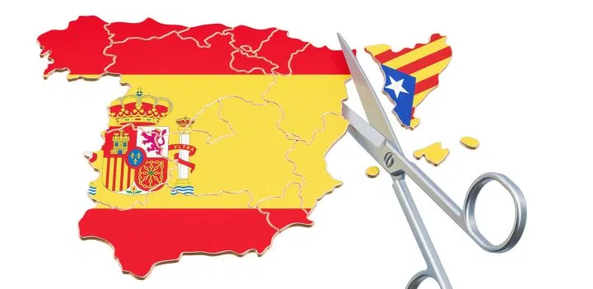
Why do some countries want independence?
Independence is the goal for many groups of people. Independence is especially important to groups of people who want to create their own Nation-State. Or a nation where the majority of people share the same culture or common descent and want political boundaries to match.

Slide 5
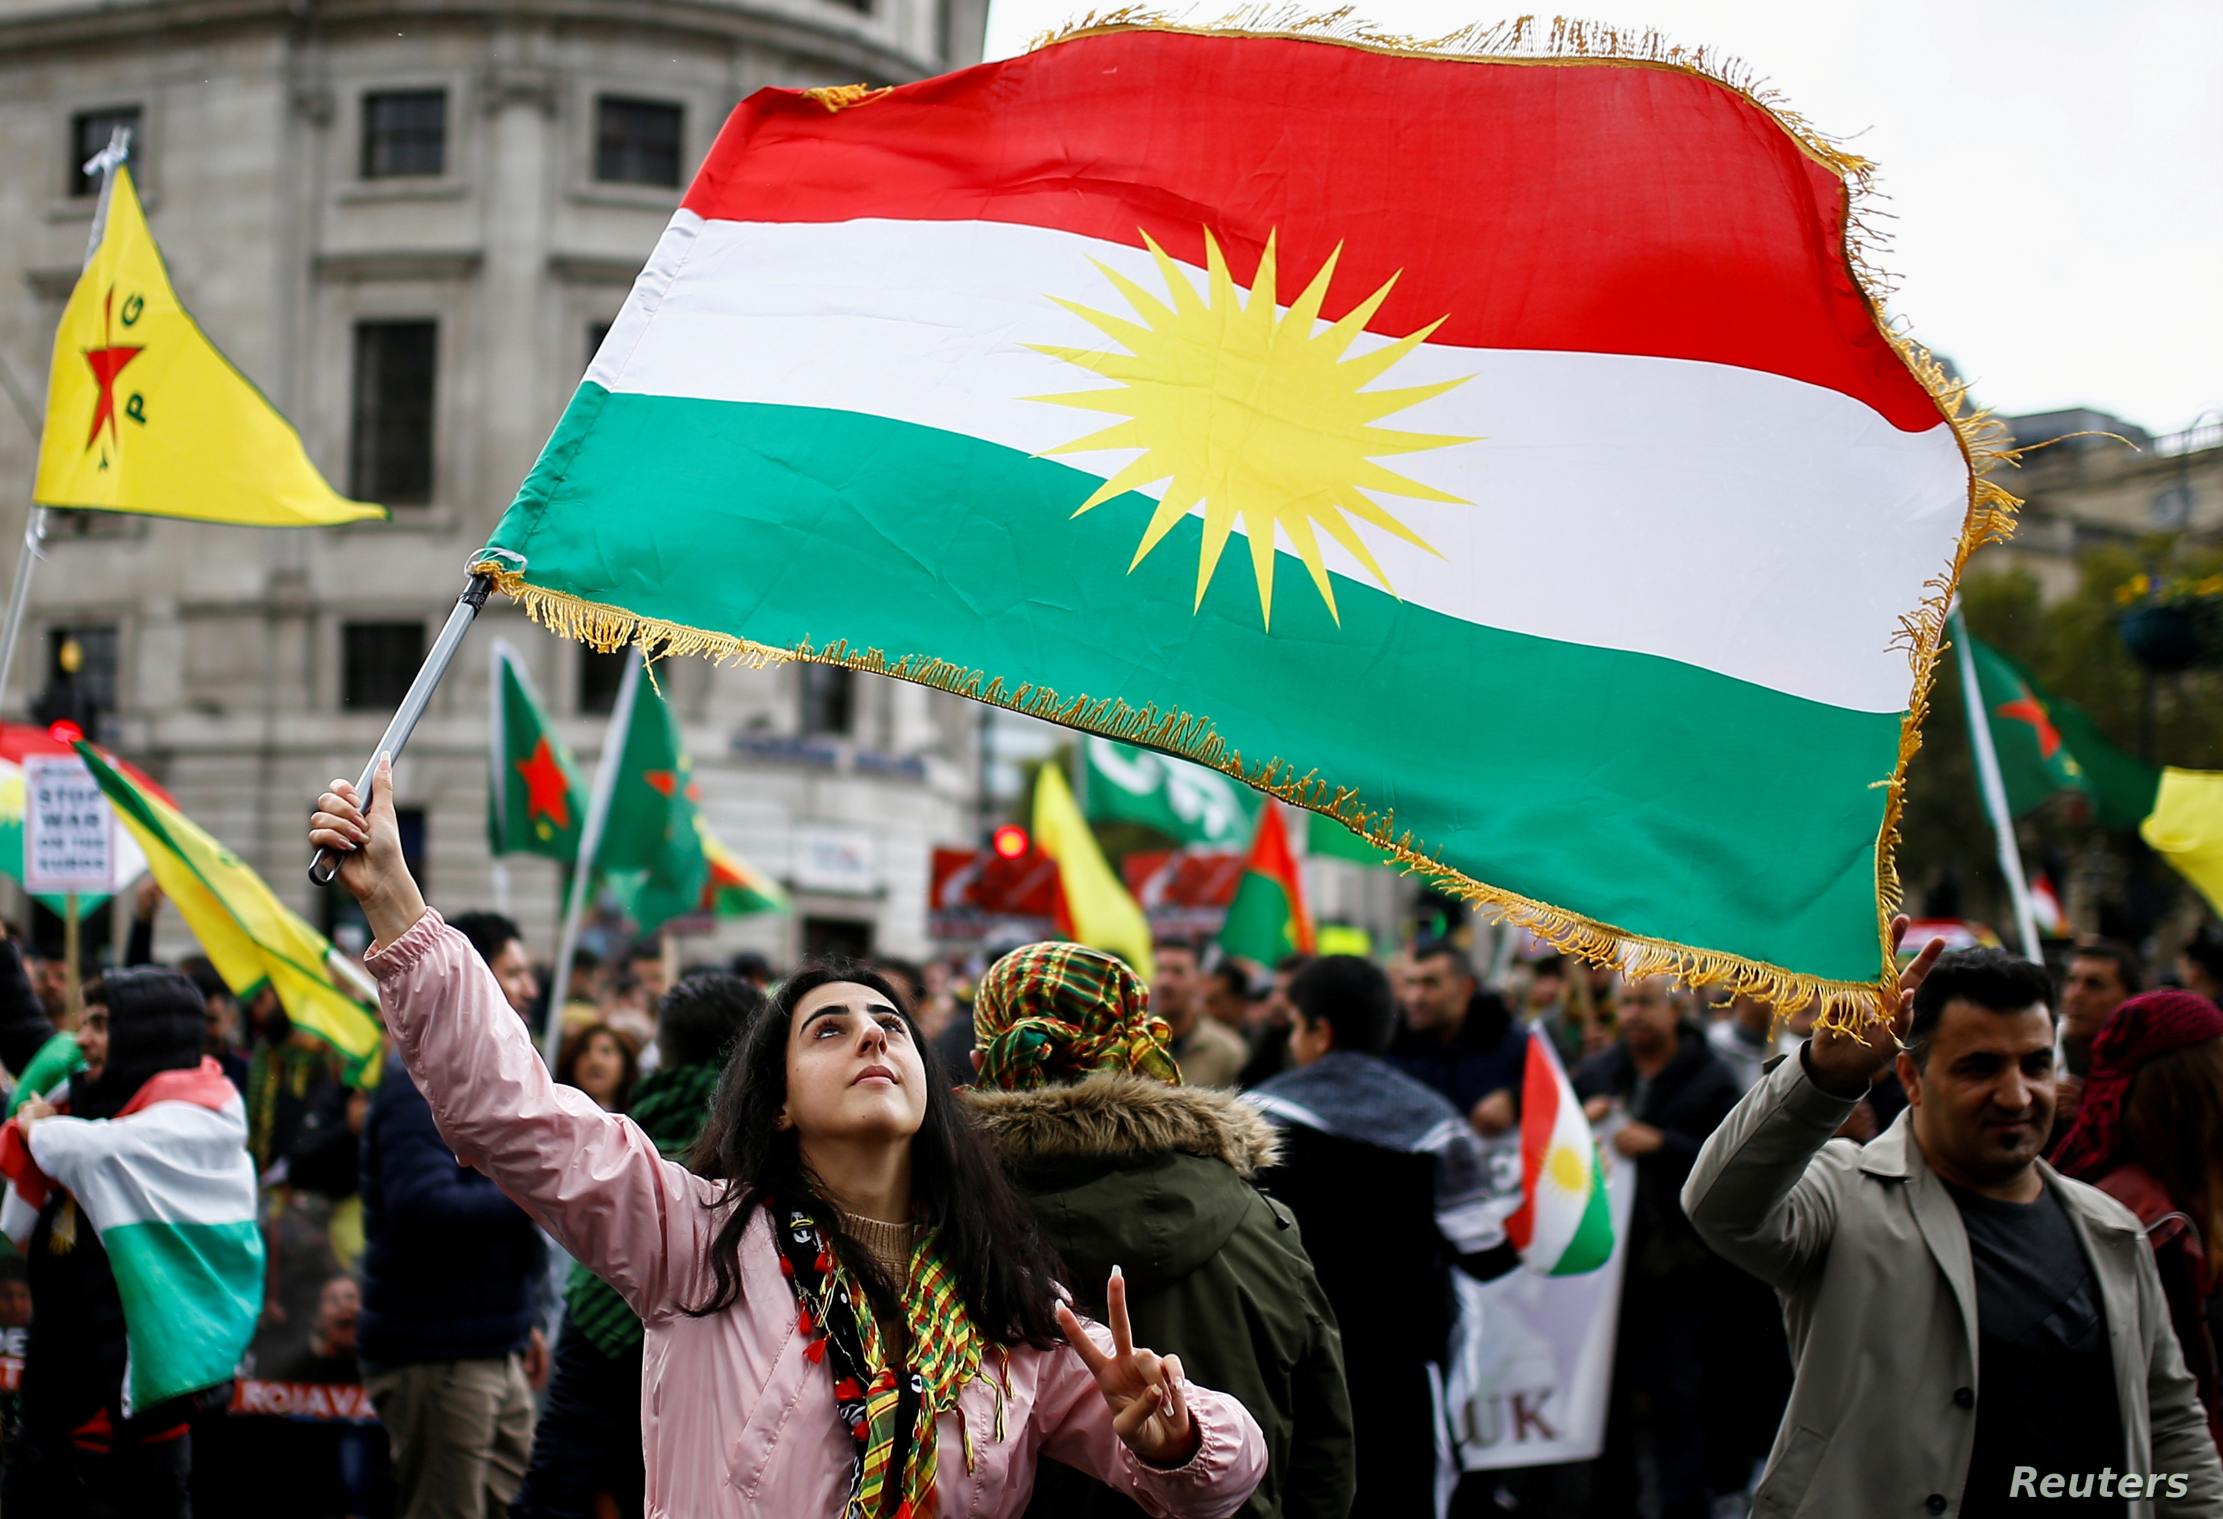
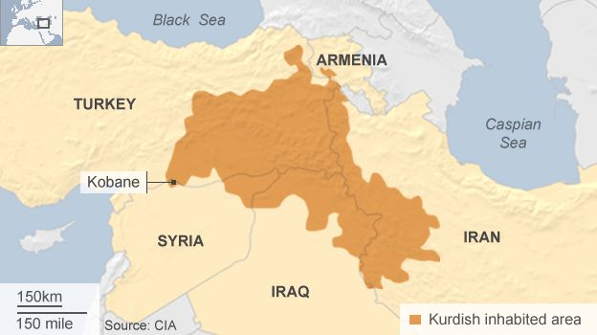
Does independence always work? NO
Areas where an ethnic group doesn’t have its own nation, nor is a majority group in any other nation is referred to as a Stateless Nation so they fight to have a recognized territory.

Slide 6
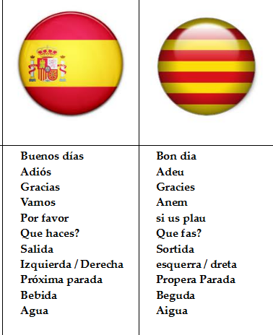
Catalonia
History of Catalonia
People created settlements in the region apart from Spanish Kings and Queens
One of the Wealthiest areas of Spanish Territory
Speak Catalan
Unique culture and traditions
Have their own government and leaders apart from Spain

Slide 7
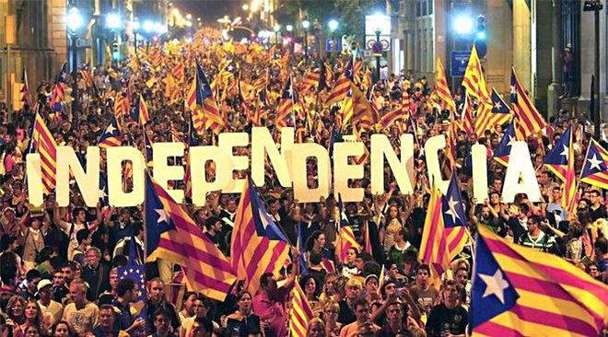
Catalonia
What Do They Want?
To be granted independence from Spain
To be recognized by the EU as a full nation
To have full Separatism

Slide 8
Catalonia
Will They Get What They Want?
In 2016 90% of voters wanted independence (but only 40% showed up)
Madrid, the capital of Spain forbid the election, and when their warnings were ignored they violently suppressed the movement.
People were injured and killed by Spanish Forces.
Spain also worked with the EU to ensure that Catalonia, if it did break, wouldn’t be recognized by the EU.

Slide 9
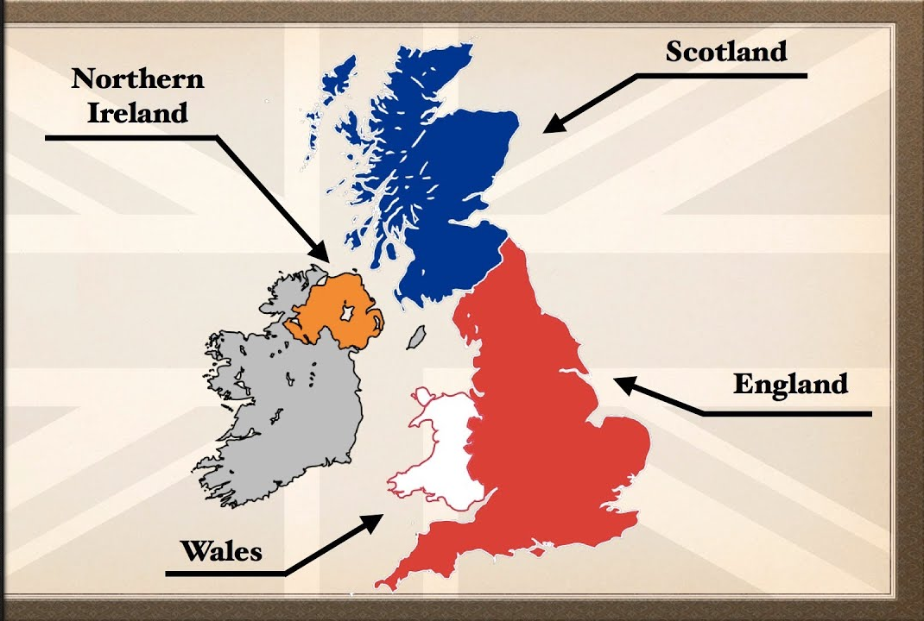
The Map to the Left is a map of the United Kingdom. The Light Blue is the United Kingdom and the Dark Blue is Scotland.
~Label Scotland on your Map
~Color in Scotland on your Map
~Label England on your Map
~Label Northern Ireland on your Map
~Label Wales on your Map

Slide 10
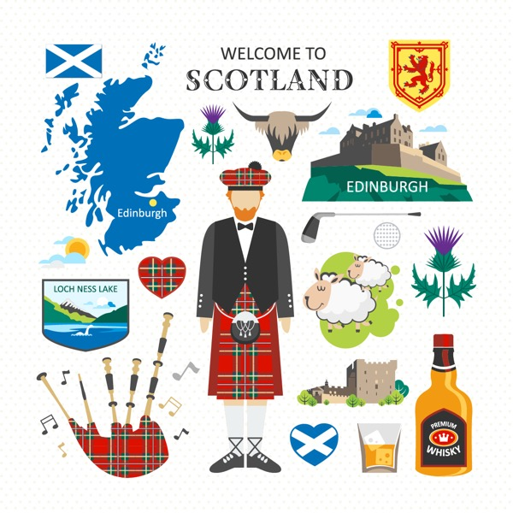
Scotland
History of Scotland
In 1701 Scotland was forced to join Great Britain under military force so the British Empire could expand.
Scotts denied the joining, but were forced to become part of the United Kingdom
The Scottish have distinct accents, cultures, past histories, and are less connected to royal ties (some still do not consider Queen Elizabeth ‘their queen’)

Slide 11
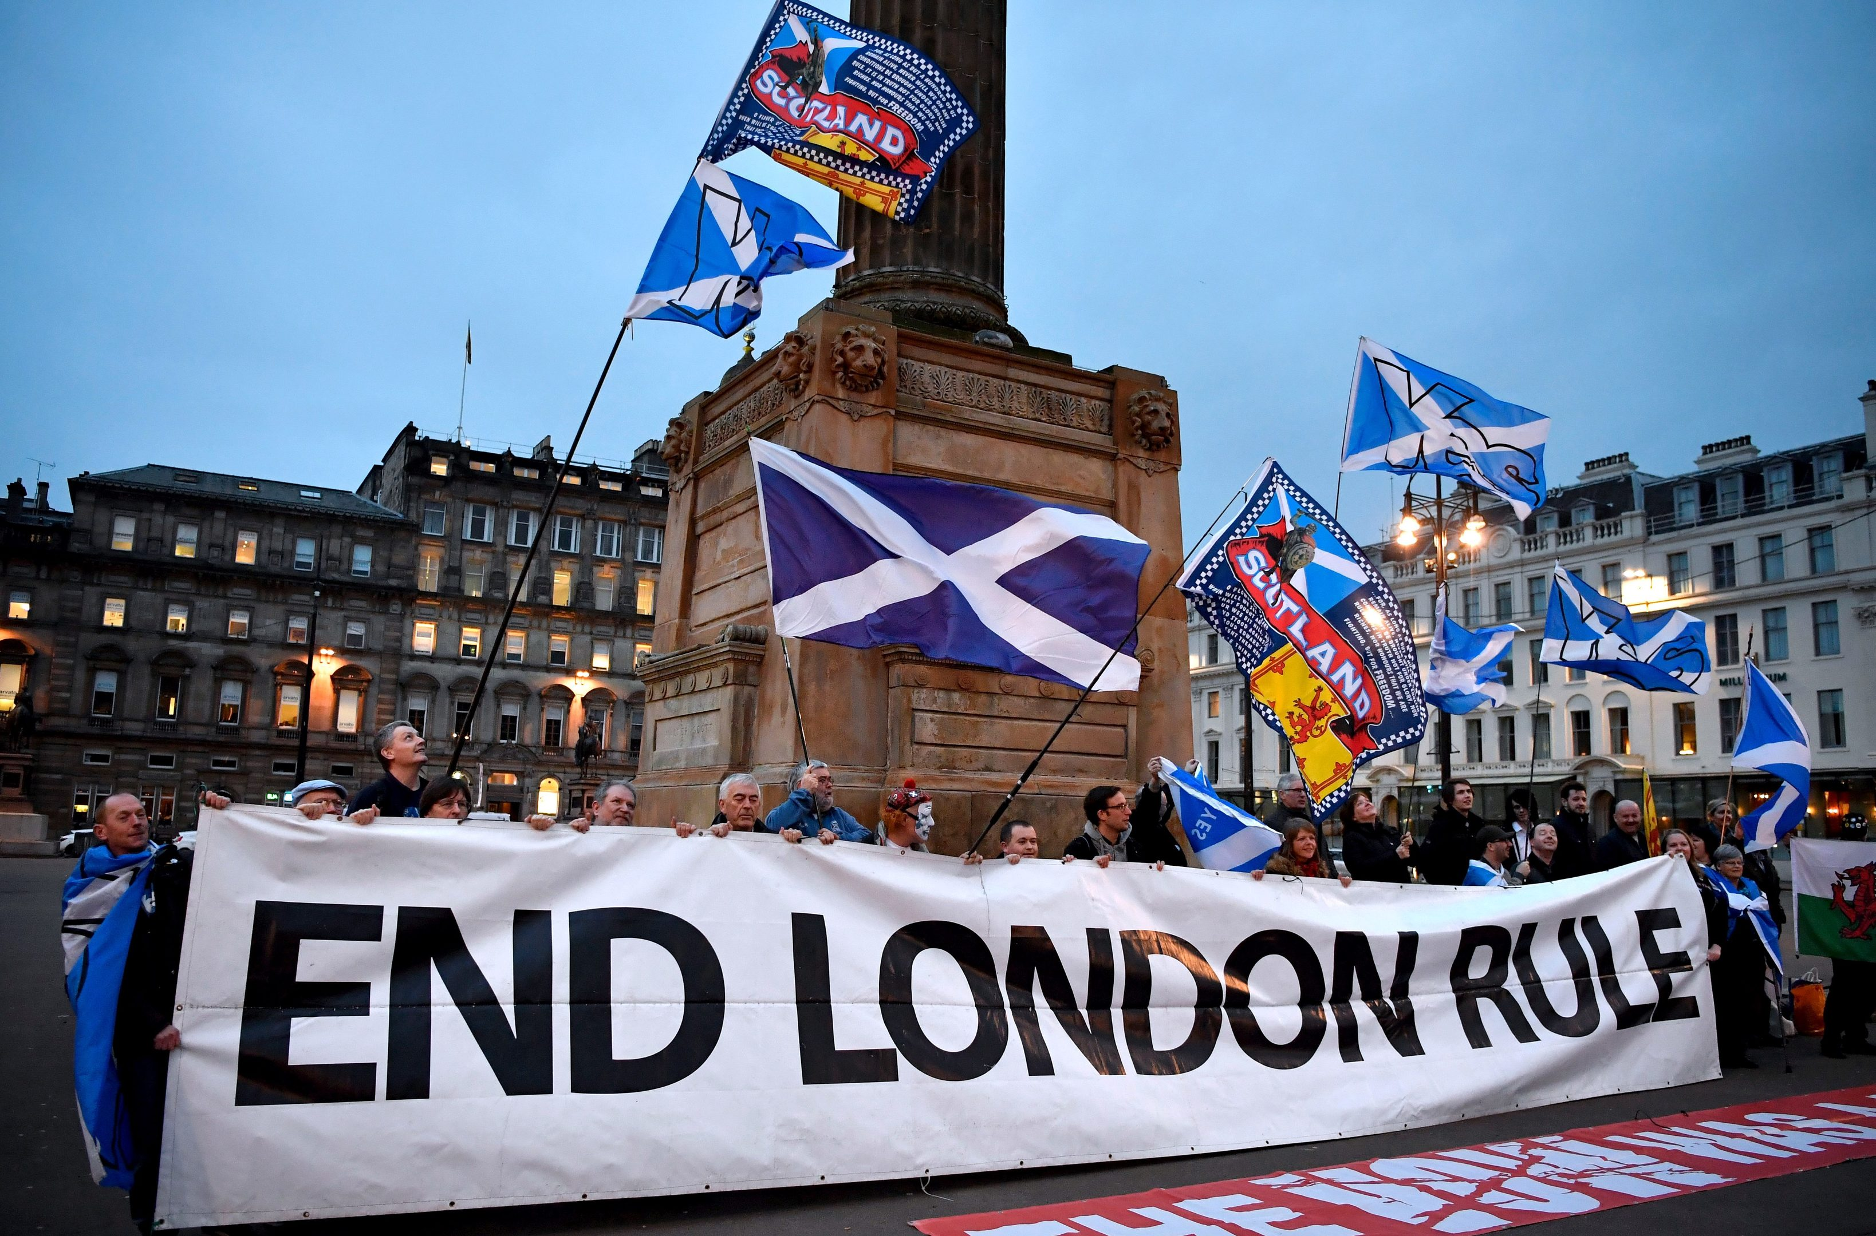
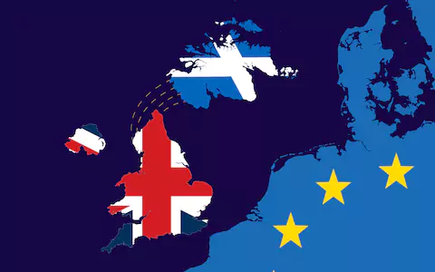
Scotland
What do they want?
Want to be recognized as an independent nation apart from the United Kingdom
Want to have a fully democratic government
Want to be admitted to the European Union

Slide 12
Scotland
Will they get what they want?
In 2014 51% of the Scottish population voted to ‘Remain’ part of the United Kingdom (but this was before England was in the process of leaving the European Union)
Today, it is thought that the majority of the people, if allowed to revote, would clearly ask for Independence.
The United Kingdom isn’t allowing another vote for Scotland to occur.

Slide 13
Video
Catalonia
Scotland

