Slide 1
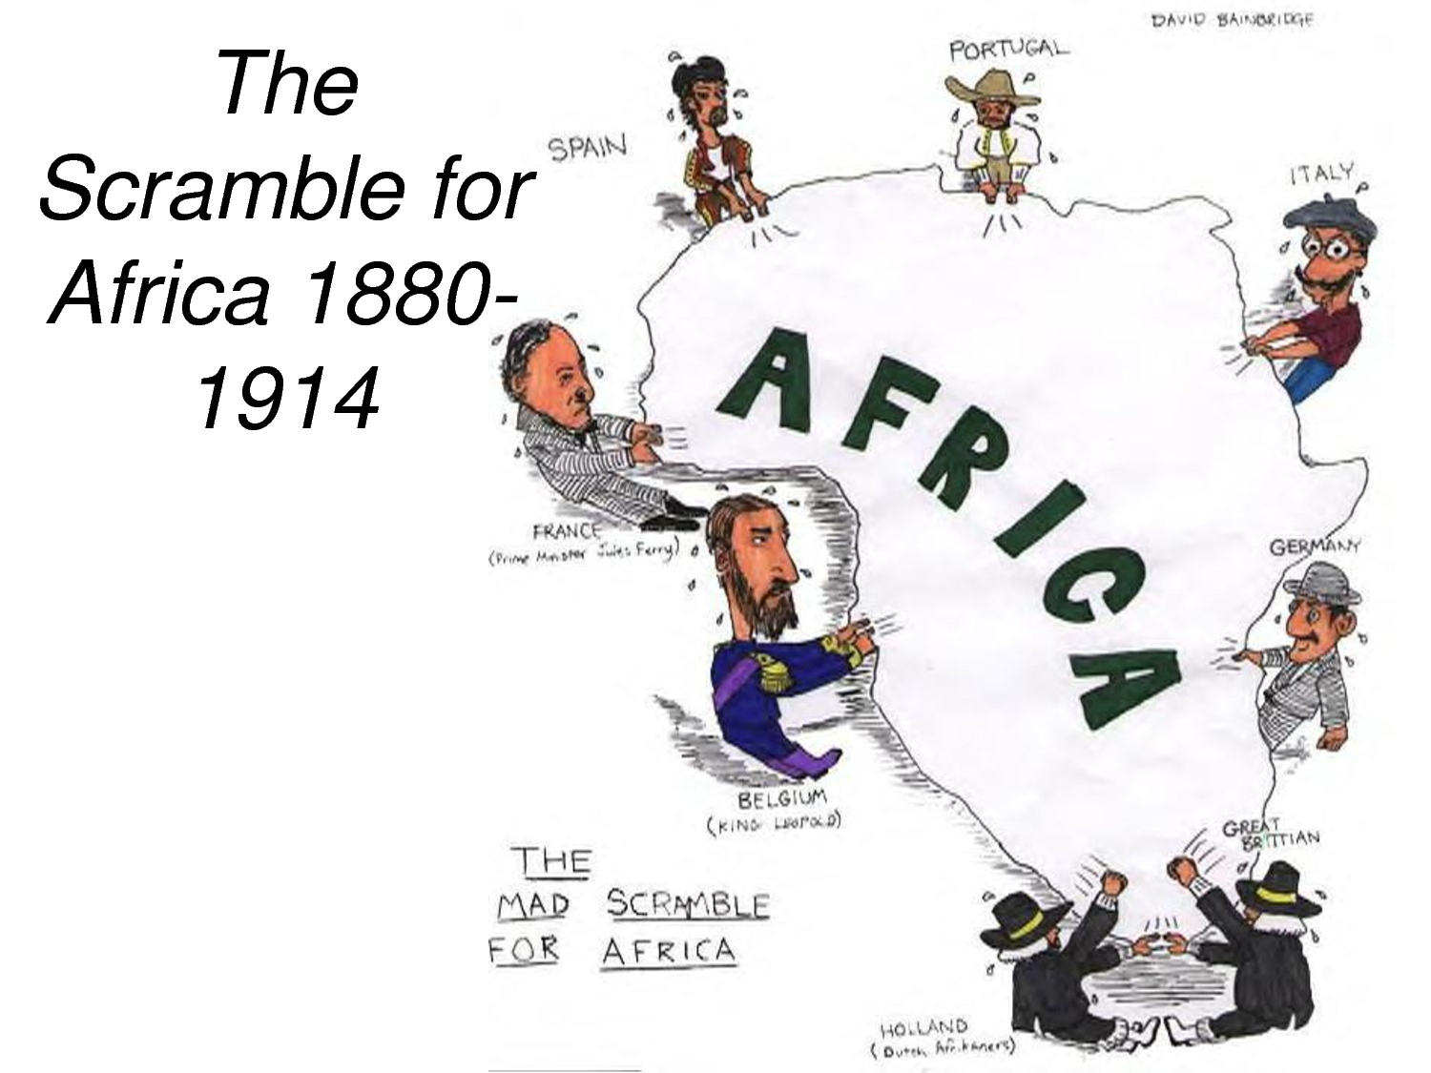
Scramble For Africa
Colonization of the African Continent

Slide 2
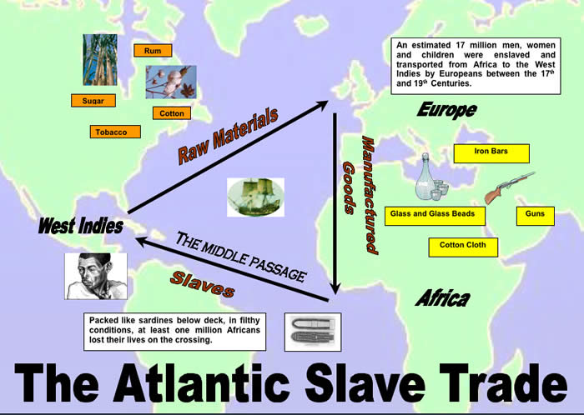
A. Background
1. Africa first peaked European and American interests during the slave trade in the 1700’s.

Slide 3
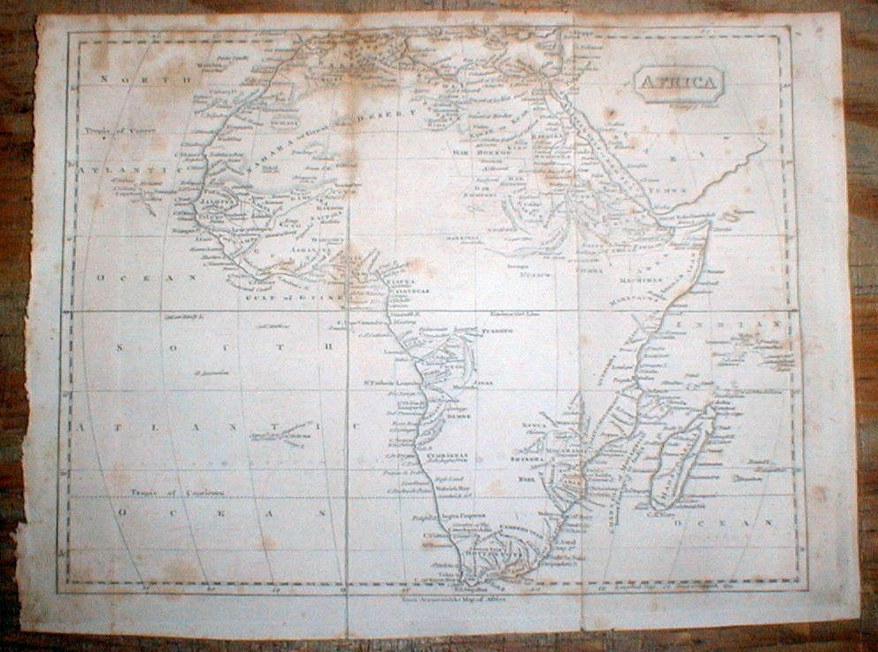
A. Background
2. Not much (if anything) was known about interior Africa.

Slide 4
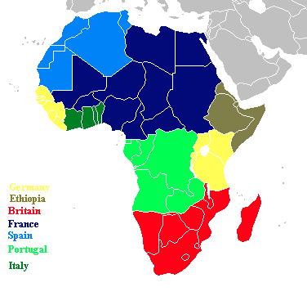
A. Background
3. As European territories became ‘set’, Kings and Queens wanted to expand their control.
Germany
Ethiopia
Britain
Spain Portugal
Italy

Slide 5
A. Background
4. Africa was the obvious choice, as it was near Europe and held many natural resources.
~Europeans did not consider Native Africans as equals, so they saw no problem in taking over their territory

Slide 6
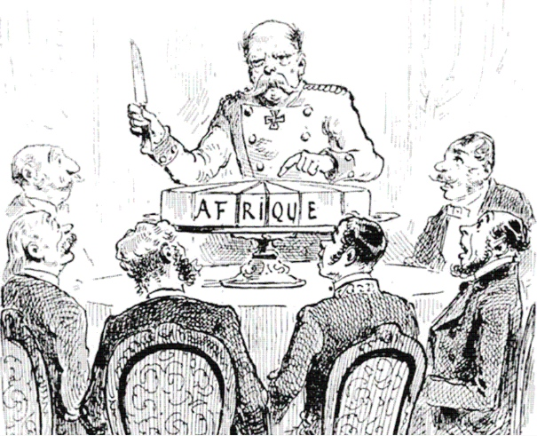
B. Early Colonial Rule
1. In 1884 the major European Powers met to discuss how they would divide Africa.

Slide 7
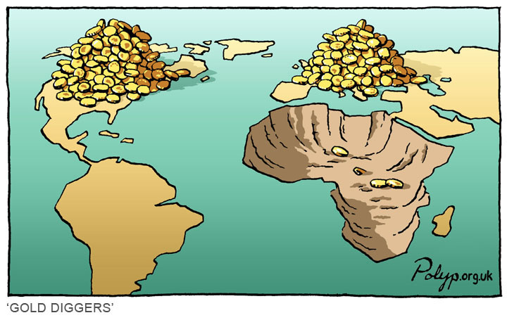
B. Early Colonial Rule
2. This became known as the Berlin Conference of 1884.
~ African Natives were not invited to the conference

Slide 8
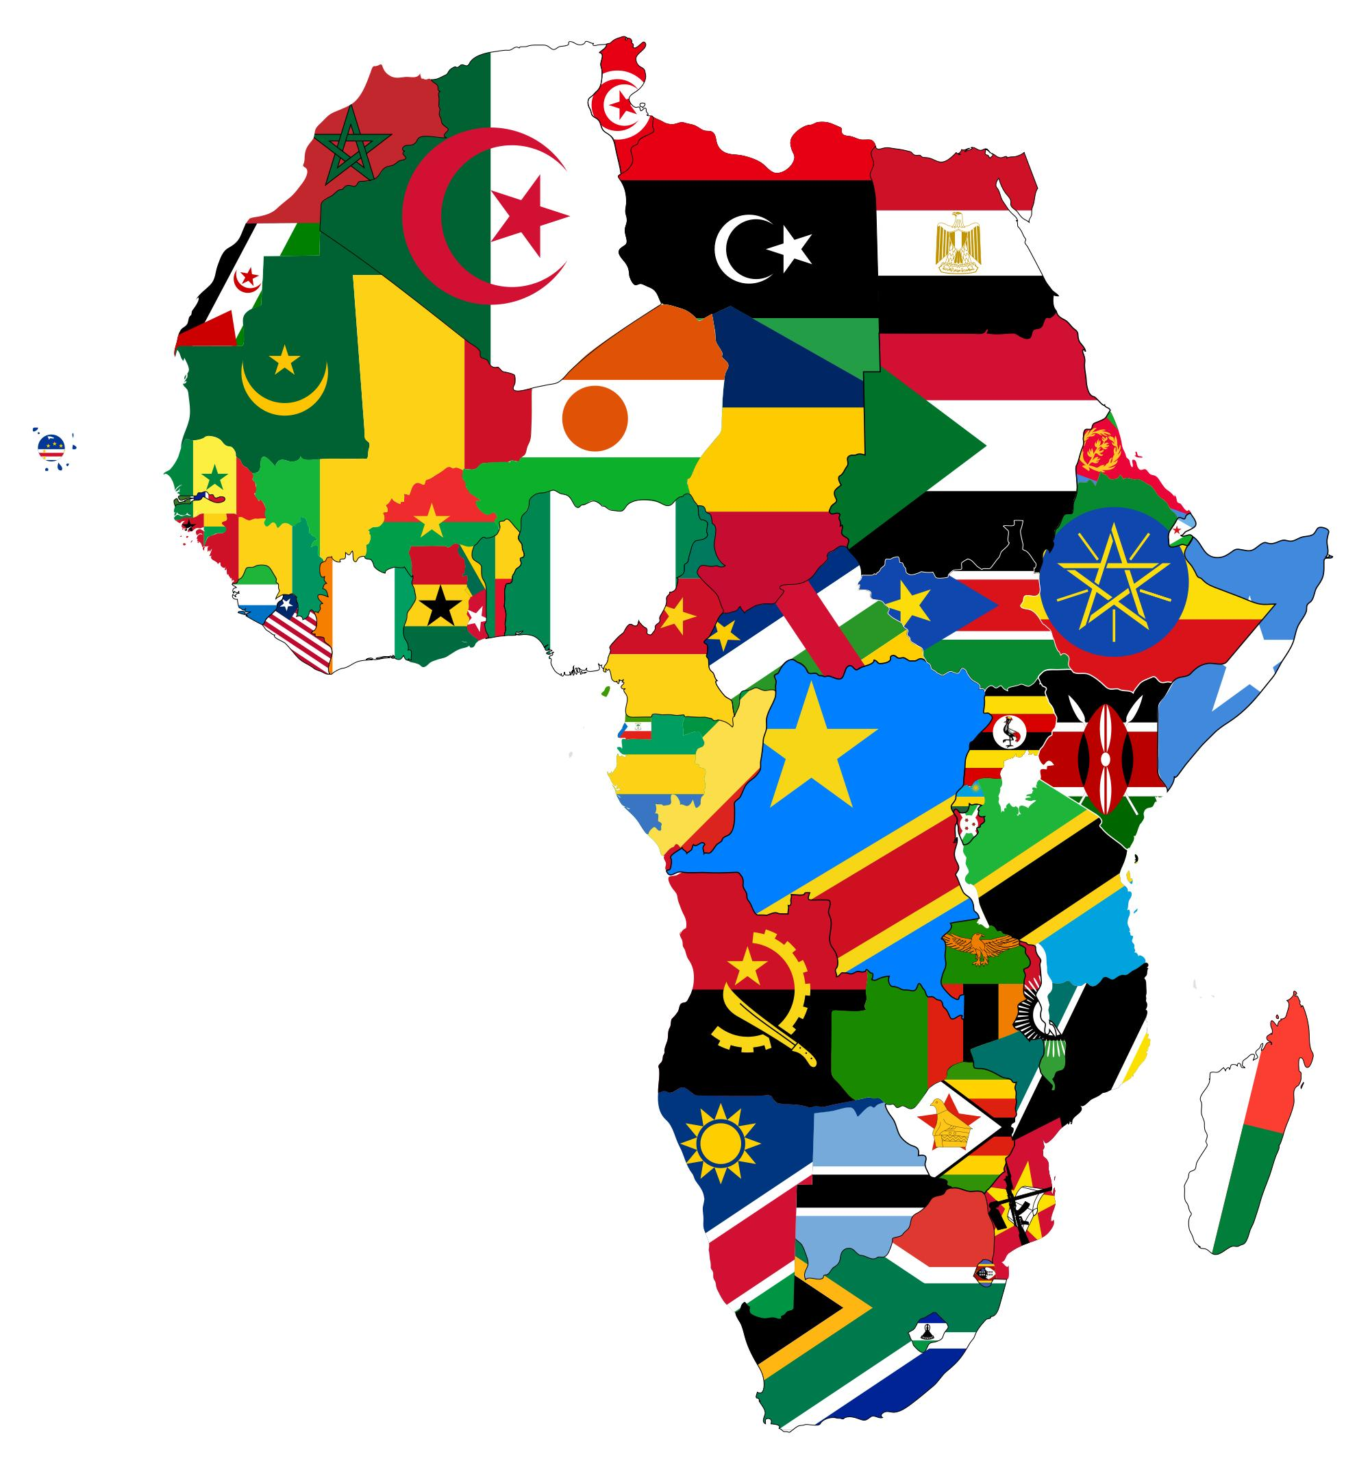
B. Early Colonial Rule
3. The major powers, Britain, France, Portugal, Italy, Belgium, and Germany divided the territory to best serve their own needs.
~These European boundaries often crossed social and cultural boundaries, leading to internal conflict between Natives.

Slide 9
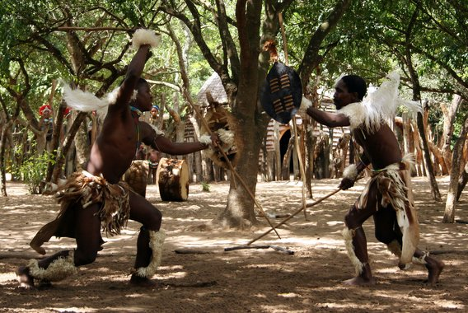
B. Early Colonial Rule
4. As internal conflicts increased amongst native groups, the European powers were able to increase their control and power, taking advantage of weaknesses.

Slide 10
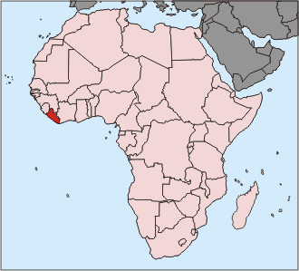
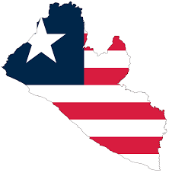
B. Early Colonial Rule
5. By 1895, all of Africa was controlled by European leaders, except Liberia.

Slide 11
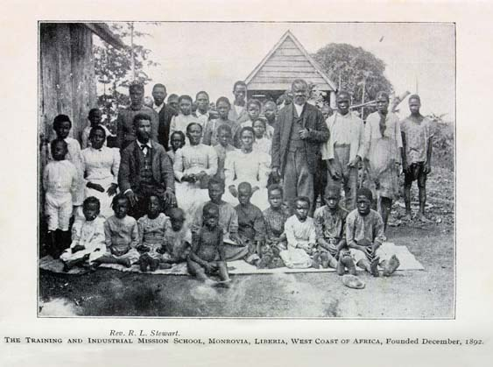
B. Early Colonial Rule
6. Liberia had been purchased by the United States during the Berlin Conference.
~Once slaves were freed in the United States, they had the option to move back to Liberia and be given land to live off

Slide 12
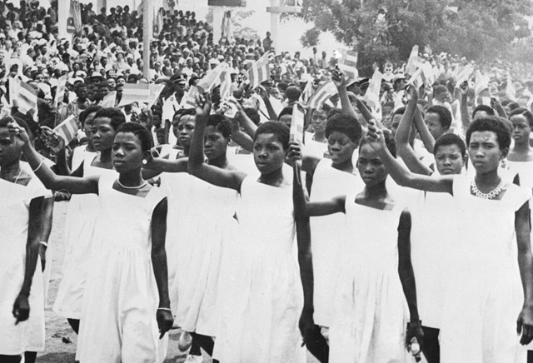
C. End of Colonial Rule
1. Colonial Rule in Africa is short lived.

Slide 13
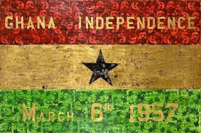
C. End of Colonial Rule
2. By 1950- almost all areas were actively seeking independence from European Powers.
~Some peacefully, others through war

Slide 14
C. End of Colonial Rule
3. The Independence movement brought to light many existing problems in Africa.
~Economies were built around European needs- Not African
~Borders were in dispute (Traditional vs European)
~Civil Wars amongst Natives over who would gain control
~Genocides occurred due to differences in religions, languages, and ideologies

Slide 15
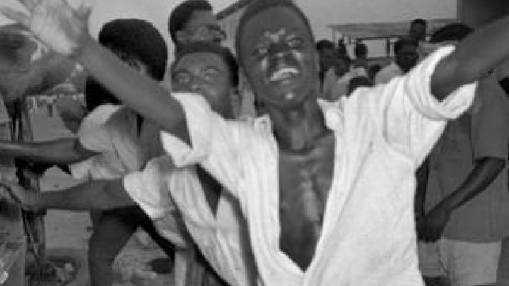
C. End of Colonial Rule
4. 1960 became known as the ‘Year of Independence’, as most countries were granted their freedom.
~Once a few European powers left, economies and safety went down

Slide 16
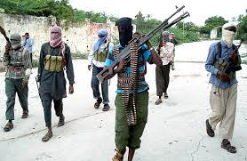
C. End of Colonial Rule
5. Today, Sudan, Nigeria, Ethiopia, and Somalia are still fighting battles due to territory disputes created by Colonial rule.

Slide 17
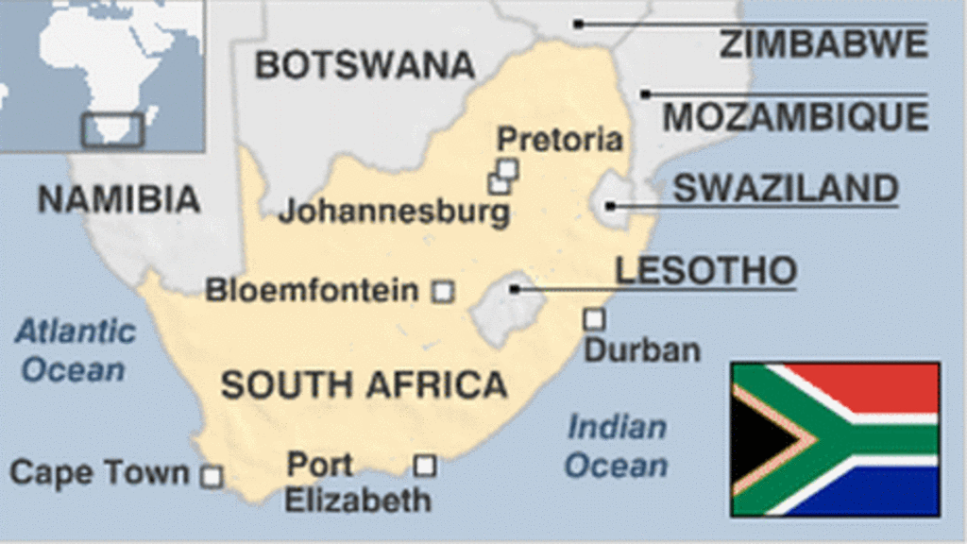
C. End of Colonial Rule
6. The legacy of the colonial rule on Africa has a strong presence.
~Common languages are French and English (due to colonial rule)
~Many names and places have European names

Slide 18
C. End of Colonial Rule
7. Economies of Africa, the United States, and European nations are strongly linked, as Africa is a main exporter of Uranium, Gold, Coal, and Diamonds, which are sold mostly to their old colonial empires, because they have close ties to these countries.

