Slide 2
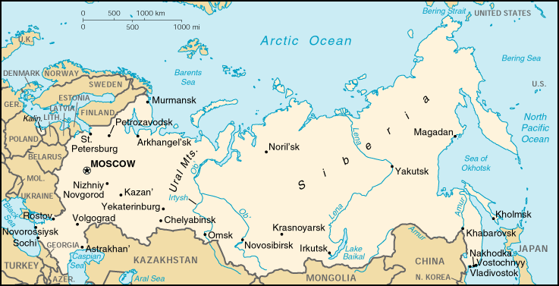
Locate and label and color blue the following bodies of water:
Lake Baikal Caspian Sea
Bering Strait Aral Sea
Black Sea Arctic Ocean
Bering Sea Pacific Ocean
Volga River OB River
**If you cant find these places easily on your map, you can google their locations!

Slide 3
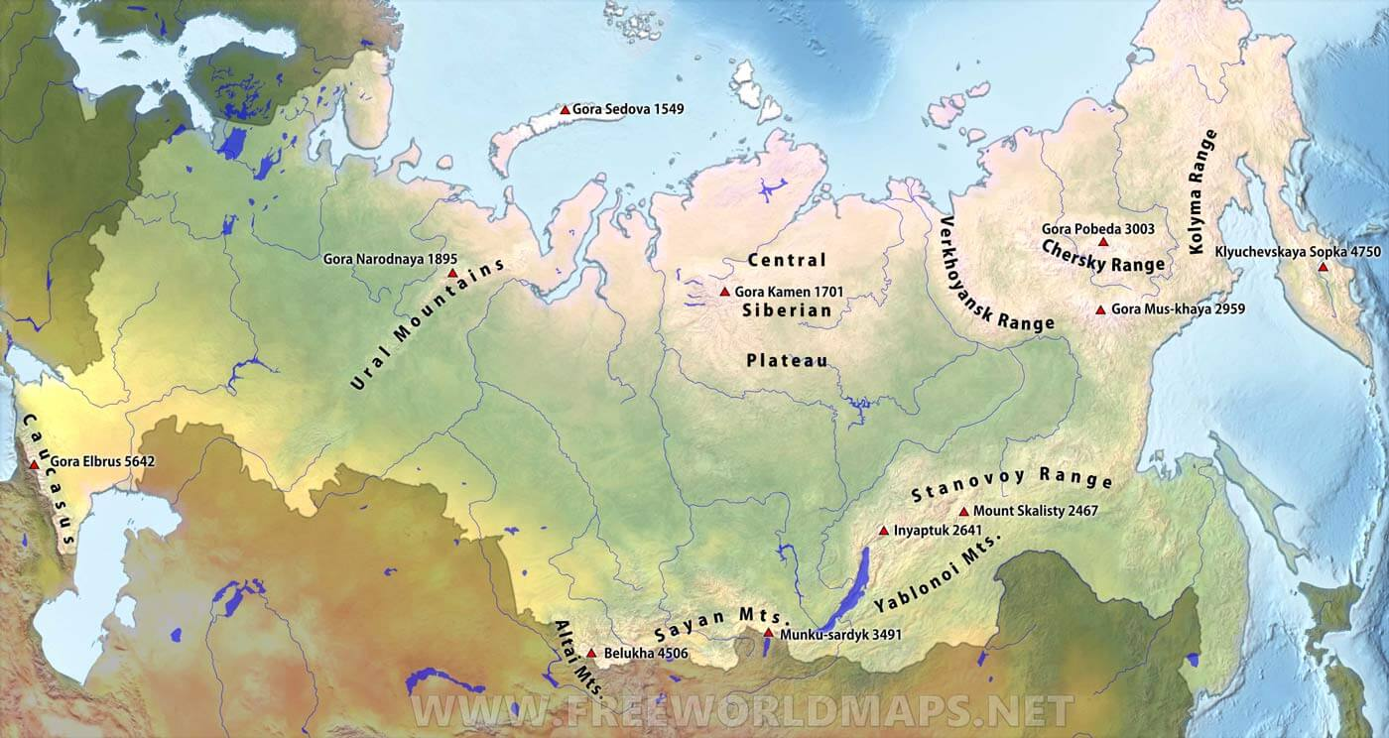
Locate, Label, and color brown the following mountains using this symbol:
Ural Mountains
Altai Mountains Caucasus
Mountains

Slide 4
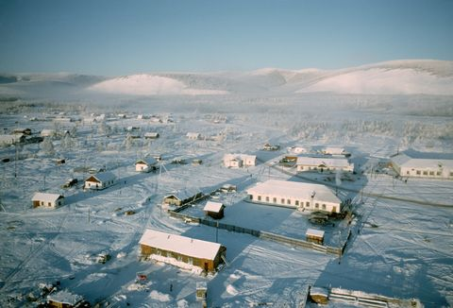
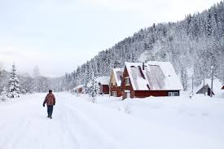
Locate, label and coloring accordingly the following landforms:
Siberian Peninsula – Outline in orange

Slide 5
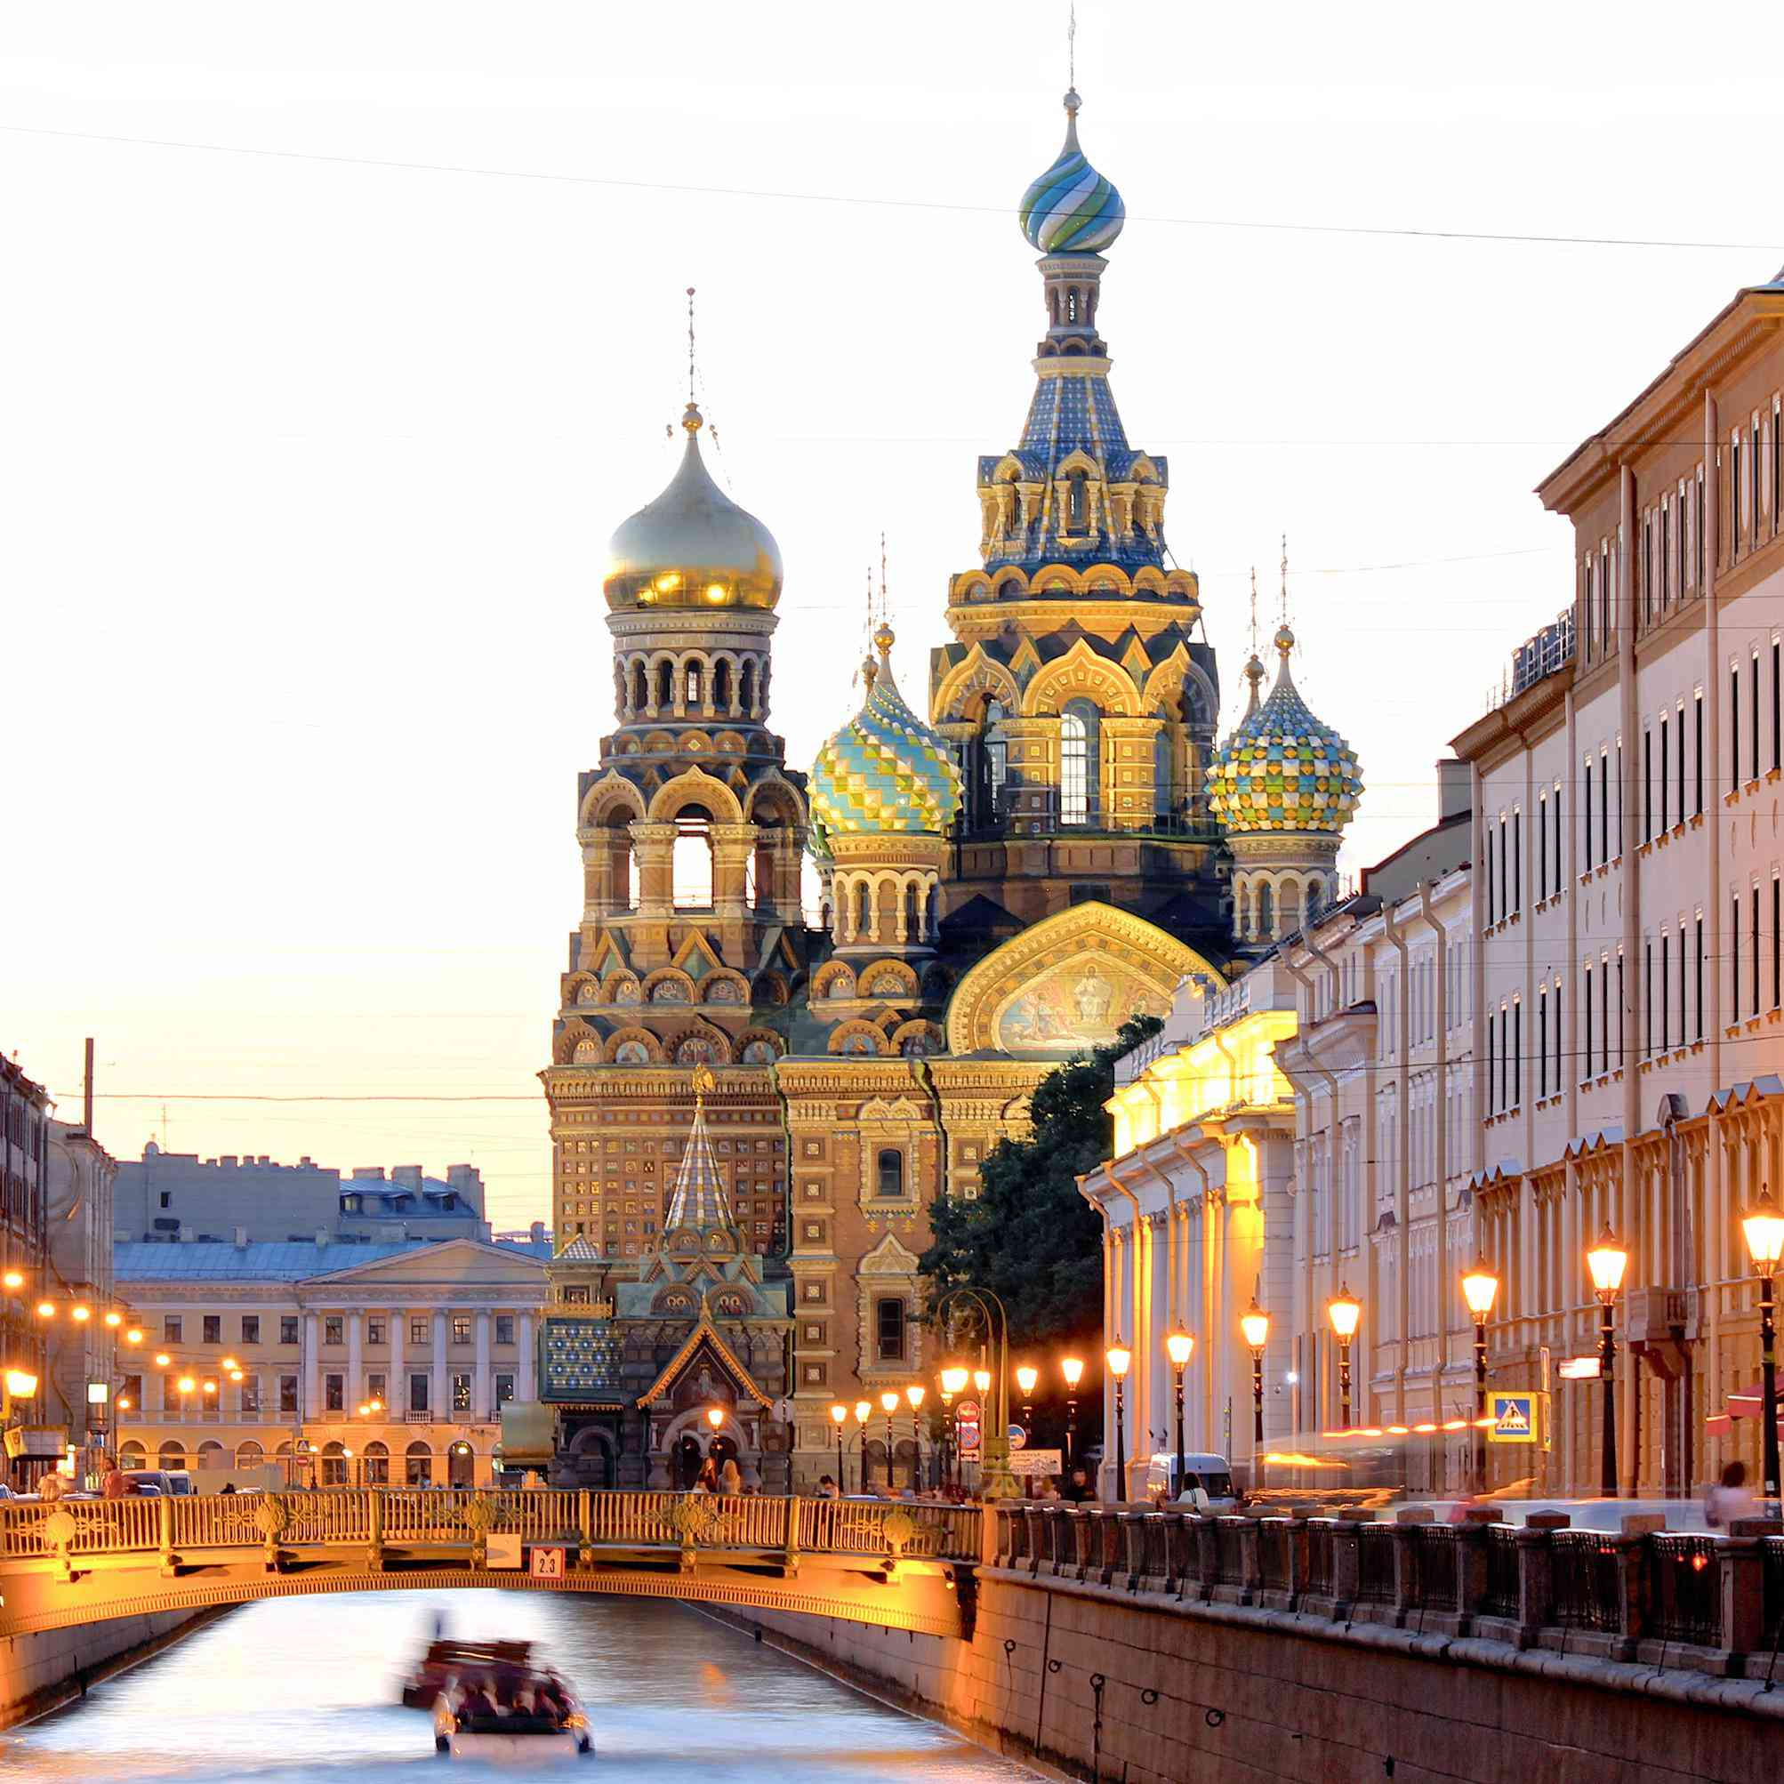
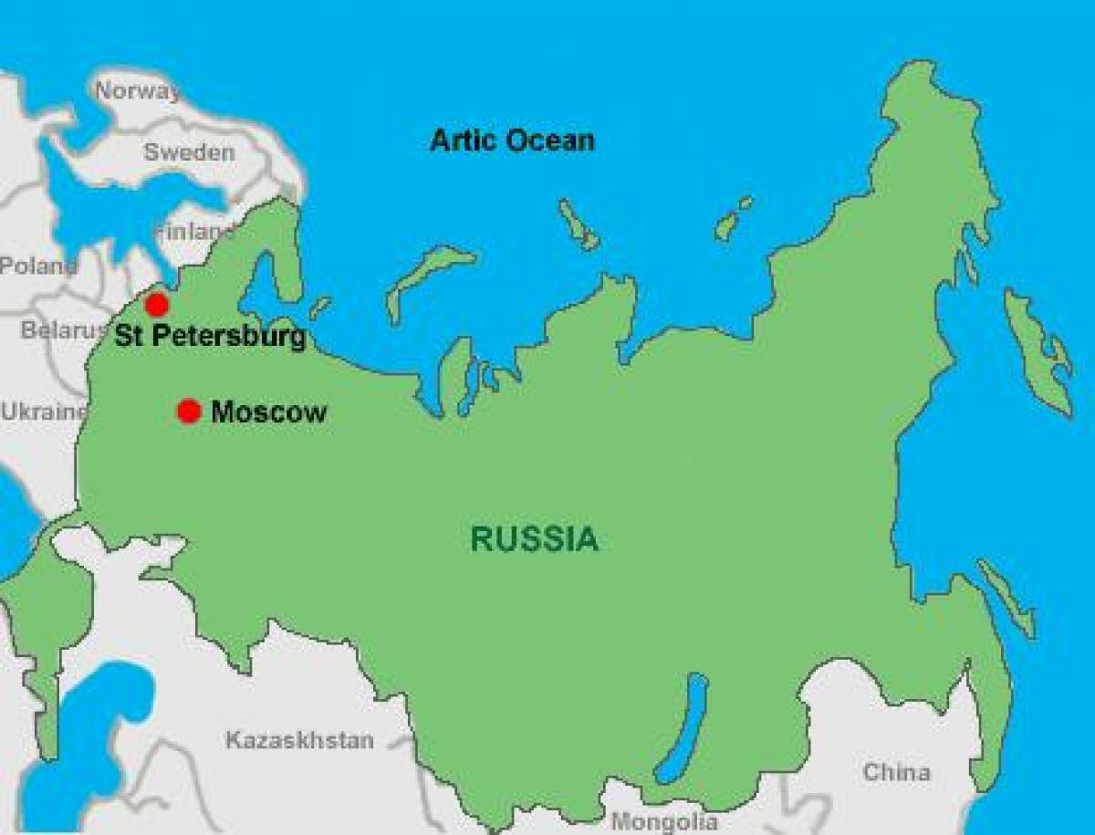
Locate and label the following cities using black dots.
St. Petersburg
Moscow

Slide 6
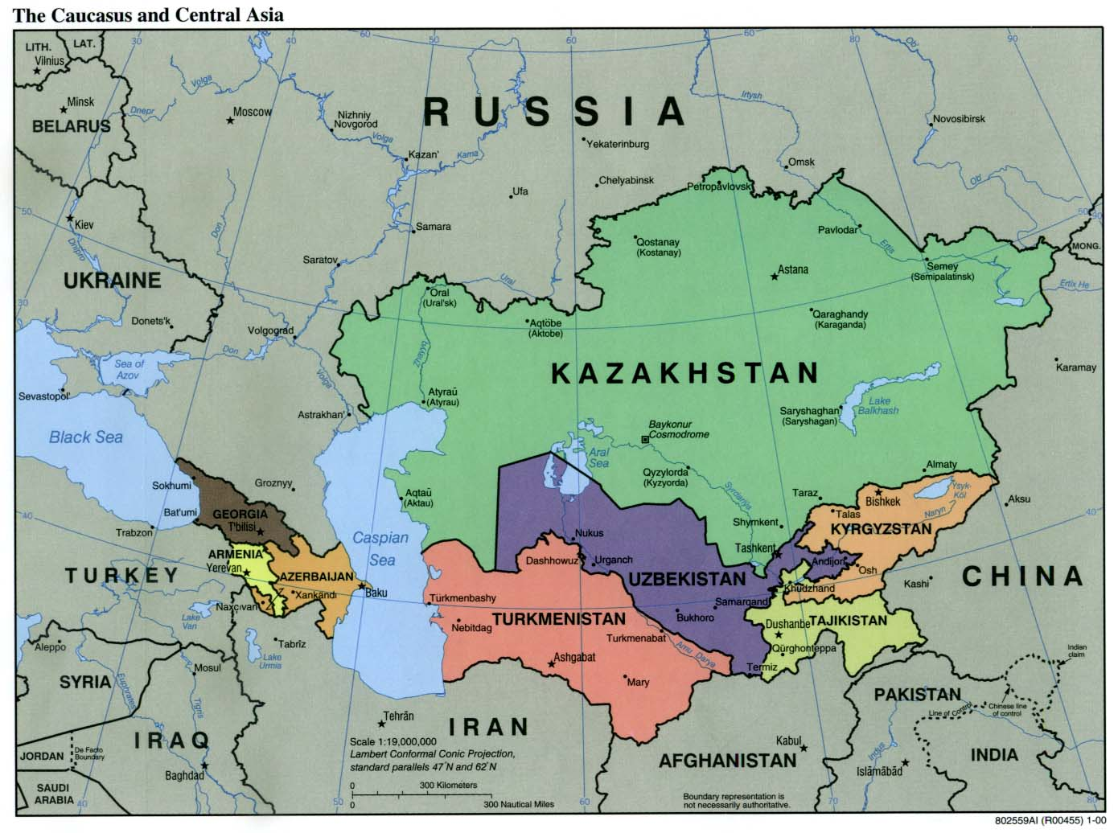
Locate, label and color accordingly the following countries:
Kazakhstan – Green
Chechnya - Purple
Azerbaijan – Yellow
Siberia (region) – Red
Russia - Orange
**If you cant find these places easily on your map, you can google their locations!
Chechnya Disputed Territory

