Slide 1
Warm-up: Thursday, Oct. 3, 2019
Get your Notebooks and update all pages- including the table of contents.

Slide 2
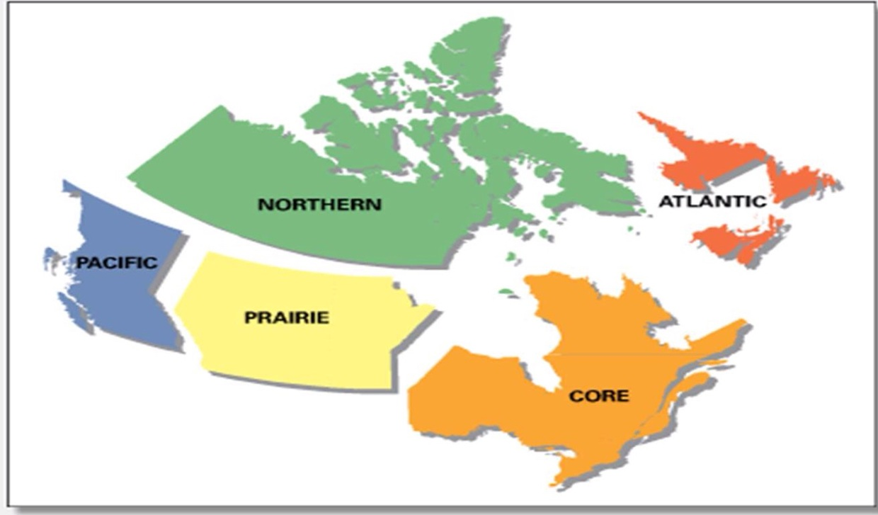
Regions of Canada

Slide 3
Regions of Canada explained

Slide 4
Where do most people live?
Many people in canada live close to the United States.
This is due to the cold climate that the north has.
Also being closer to the United States allows people in canada to access similar resources

Slide 5
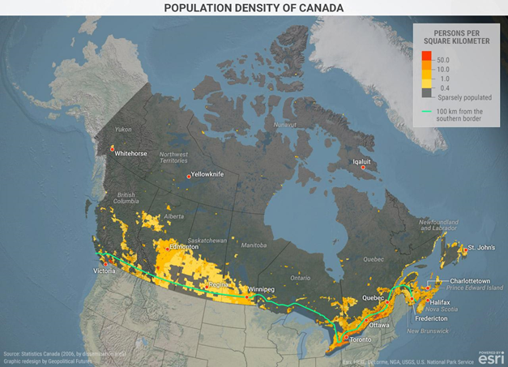

Slide 6
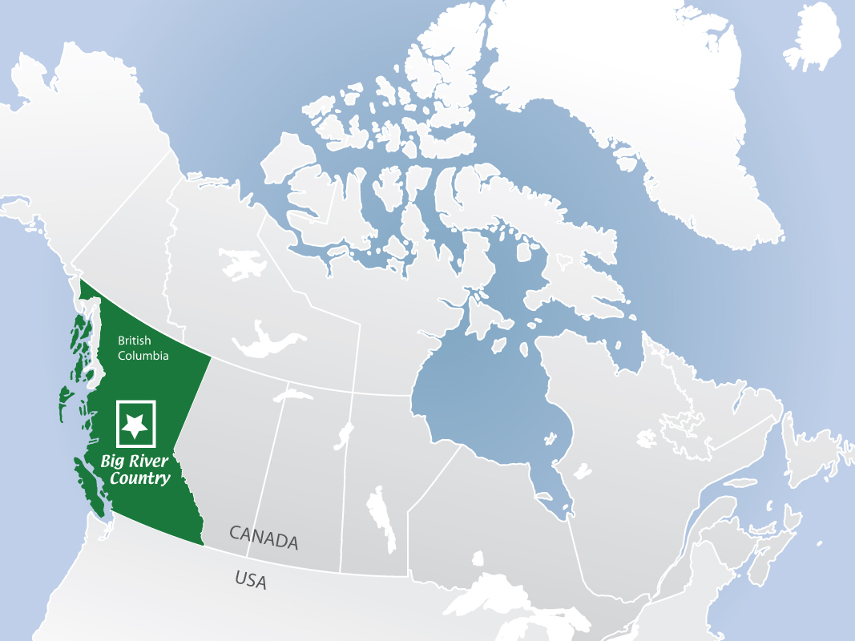
1. Pacific Region
Population: 4 million people
Language: English, Chinese (Asia), & Punjab (India), Tagalog (Philippines)
Climate: Marine West Coast
Economic Activity: Mining for minerals & gold.

Slide 7
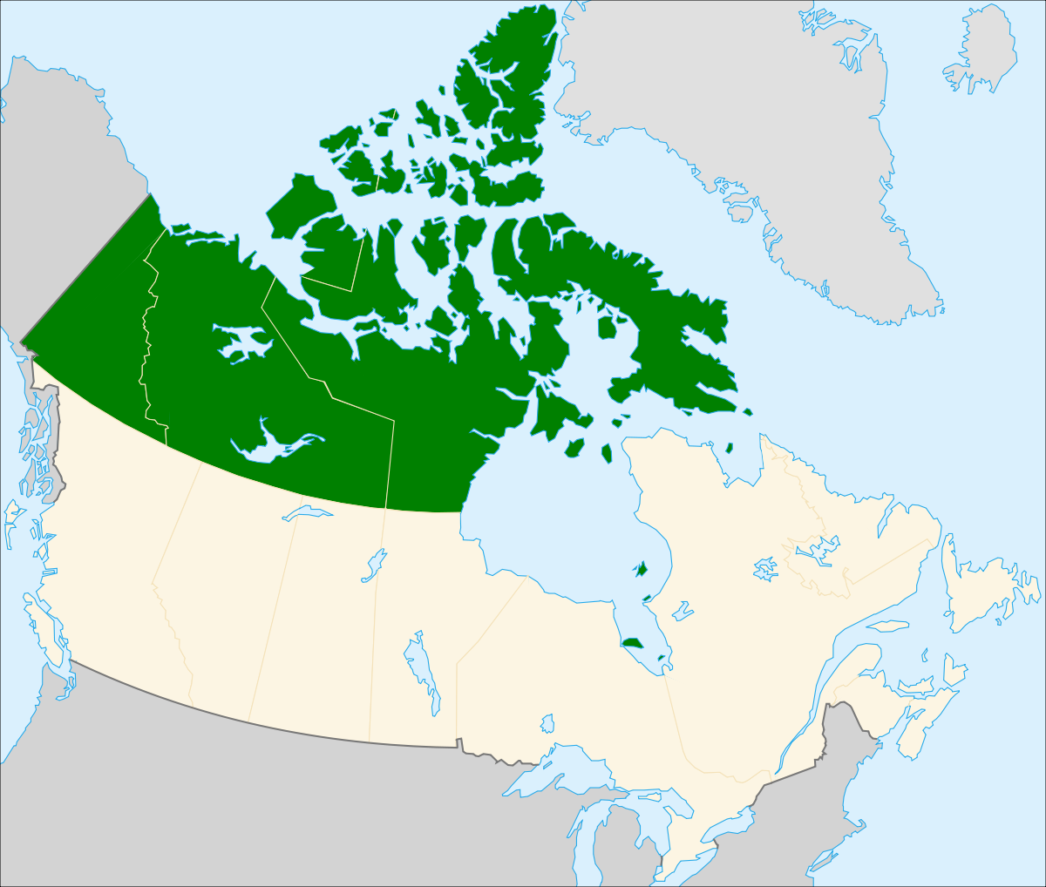
2. Northern Region
Population: 100,000 people
Language: English, Inuktitu (Eskimo people)
Climate: Treeless Tundra & Subarctic
Economic Activity: Uranium (Chemical gathering)

Slide 8
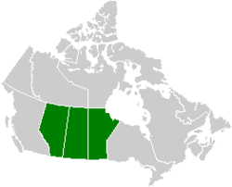
3. Prairie Region
Population: 5 million people live here
Language: English some French, German, Ukrainian.
Climate: Semiarid (South), subarctic (north)
Economic Activity: Farming

Slide 9
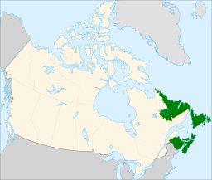
4. Atlantic Region
Population: First Settlement area in Canada with 8 Million People.
Language: Mostly English with some French
Climate: Humid Continental
Economic Activity: Fishing

Slide 10
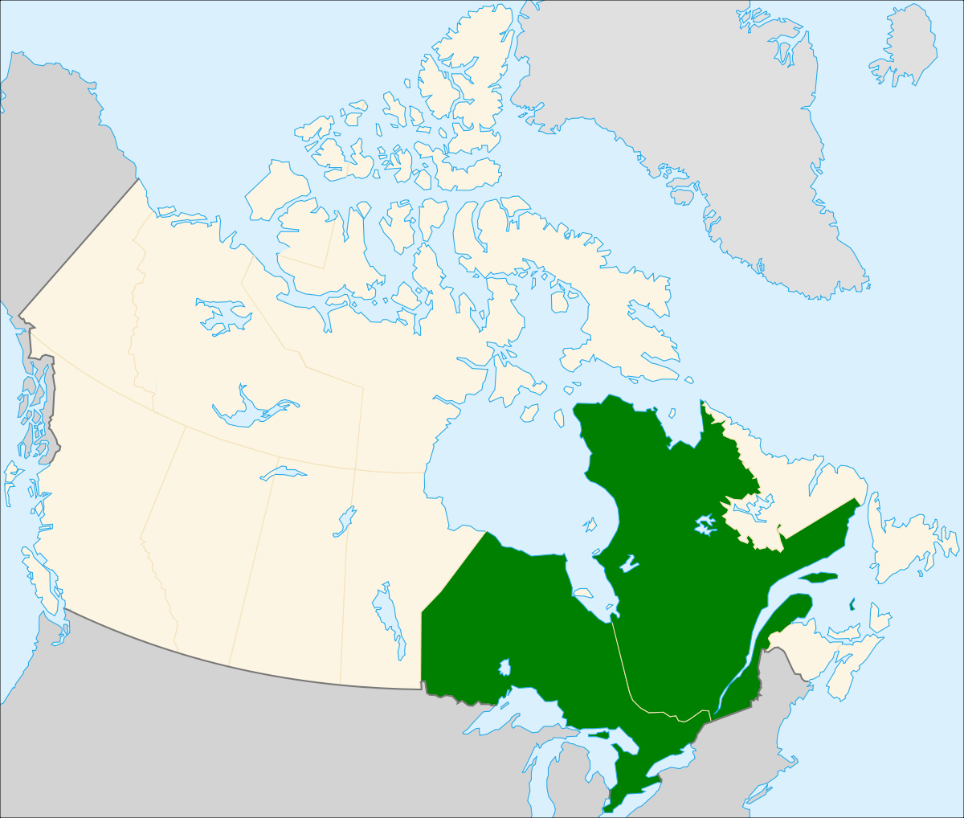
5. Core Region
Population: Most populated part of Canada with about 22 Million People.
Language: English & French
Climate: Humid Continental
Economic Activity: Factories

