Slide 1
Push Pull
Scenarios of Immigration

Slide 2
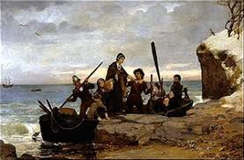
Simon and Sarah 1791
My husband and I are both loyal to the King, but we do not feel safe in our home anymore. Rioters burned down our home and the small shop that we ran. We only want to be Protestant, and have nothing against Catholics. America is our future for religious freedom.

Slide 3
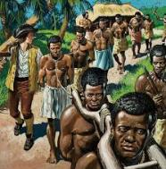
Esiphrom 1817
I was taken from my homeland with my brother and father. We spent 8 weeks on an overcrowded ship, chained to the floor. We were only given enough food to survive, and not all of us did. We were sold in auction at Charleston, South Carolina. I never say my brother or father again.

Slide 4
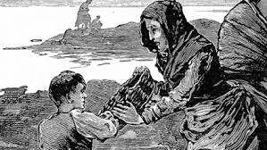
Daire McCormick 1845
I am a potato farmer in Ireland. This past year has been horrible for me and my farm. All of my potatoes were lost to a disease that made them rot. I do not have enough food to feed my family. We must leave so that we will not starve to death this winter.

Slide 5
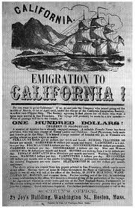
Marcel Durand 1849
I am from Paris, France. I have been reading stories for weeks in the newspaper about how American’s have found gold in the mountains of California. Just image the house I can buy in California with all of my gold!

Slide 6
Santiago Muñoz 1850
I was born in Mexico, but after the Mexican American War, I was told that my hometown was now American land. I was given the choice of staying a Mexican citizen and moving or becoming an American Citizen and staying on my families land. I am now part of the newest American generation!

Slide 7
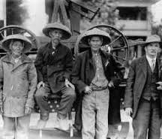
Chou Jing Yi 1881
I came to the United States from China last year to join my husband who has been working on the new railroads all over the West. I am sad that the US Government doesn’t want new Chinese Immigrants, but I am happy to build a new life
here with economic
opportunities.

Slide 8
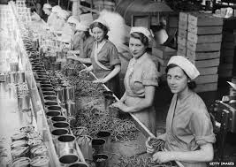
Antonia Souza 1895
My father came to America three years ago. He sent for me on an ocean liner so I can join him. He wants me to go to school in the United States, where women can get an education, and I can be independent while working in a factory. I know I can be so much more than a cook or house cleaner.

Slide 9
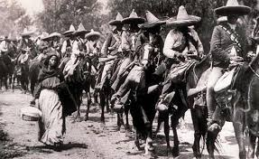
José Ortega 1913
I am from Mexico. My country is in the middle of a war. Both armies are not very careful about who they kill. I know if I stay, I will be in danger. I must leave to South Texas.

Slide 10
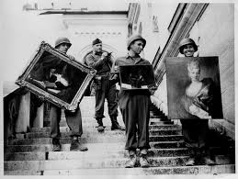
Agnes Rosen 1934
I am an artist working in Berlin, Germany. I want to leave for the United States as soon as I can. Life has been very difficult since Hitler came to power. My paintings have been labeled, “degenerate” by Nazis. I am Jewish. I want to feel safe and have a place where I can again be an artist.

Slide 11
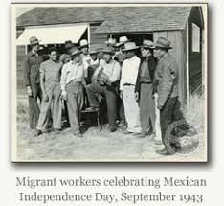
Gabriel Rodríguez 1942
I am a farmworker who came to the US a few month ago. US farms have a shortage of workers to harvest crops because American men are fighting a World War. The pay is better here, but I had to leave my family. I miss them very much.

Slide 12
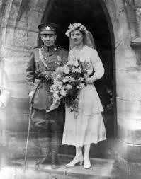
Rose Null 1946
I came to the US after I met my husband Mark, who was a US Marine passing through Australia during the World War. We got married in Sydney. A year later I joined Mark in the US and we started a family. I can’t wait to explore all of the US.

Slide 13
Celia Pérez 1959
I was forced to flee to the US with my family after Fidel Castro new government in Cuba started taking land and private property. My family lost everything. If we hadn’t give up our land, we would have been killed.

Slide 14
Peter Rjenski 1965
I am from Poland. I was one of over 6,000 students to apply world wide to study at Harvard University. I was accepted and will train to work with NASA. I can not wait to learn about space and explore the United States.

Slide 15
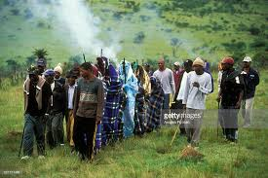
Fikile Nyathi 1981
I am from South Africa. As a black man, I had very little rights. Last year, the government decided that all blacks should belong to a new country, Ciskei, which they invented and made independent. They took away my South African citizenship. I have no home, job, or family in Ciskei. I have decided to leave for America where blacks have equal opportunity.

Slide 16
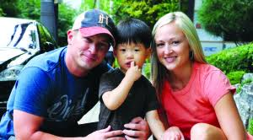
Sun Hi Jackson 1988
I was adopted as a child from South Korea. My parents came for the Seoul Olympics and fell in love with the land, culture, and people. They adopted me the following year. When I am older, I would like to visit South Korea again and see my roots.

Slide 17
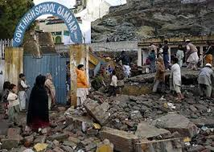
Muhammad Nazari 1996
I sent my daughters and son to school one day. Their school was bombed by a terrorist group. They were all I had left. I was devastated and started to speak out against their wrongdoings. I am being targeted for believing in an education for all. I have to leave to America or I too will die in vain.

Slide 18
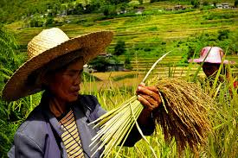
Jomar Carrasco 1999
I am from the Philippines. I came to the US to join my children who have been working in the states here for years. I want to retire and spend time with my grandchildren, whom I have only seen one time before.

Slide 19
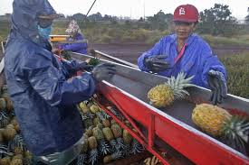
Wirat Kunchai 2007
I am from Thailand. I was brought to the US as a guest worker on a Hawaiian farm. When I arrived, they took my passport and made me live in a filthy, overcrowded house without enough food to eat. Eventually the police found out, arrested my boss, and I was freed. I was given a special visa to stay in the US as a victim of Human Trafficking.

Slide 20
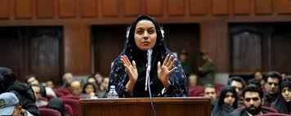
Mona Alizadeh 2010
I am from Iran. I was accused of adultery by a neighbor who never liked me. In court my testimony was only worth half of his, because I am a woman. I was not put to death because my father and uncles supported me in court, but they were shamed and lost their business for doing so. We all must move to stay safe.

Slide 21
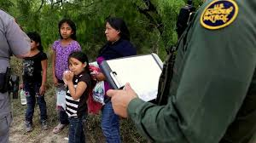
Gloria Juarez 2016
My mom sent me and my baby sister to America. She isn’t healthy enough to make the journey herself. She cried for two weeks before handing me over to the guide. She knows I can’t get an education if I stay. Since I’m only 14, I was able to stay with my baby sister in a home for others like me.

