Slide 1
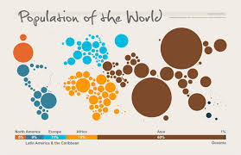
Population Pyramids
What They Mean

Slide 2
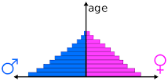
Population Pyramids
What is it?
Graphical illustration that shows the amount of people per age group within a country, and is usually in pyramid form when the population is growing.

Slide 3
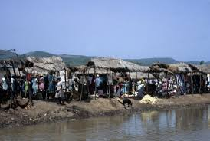
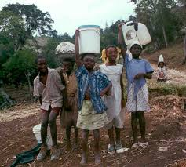
Rapid Growth Populations
Broad Base
Basically even distribution between male and female
High fertility rates
Low average life expectancy
Usually found in under developed or developing nations

Slide 4
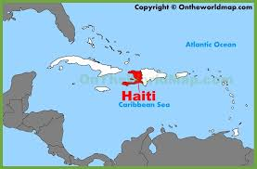
Rapid Growth Populations
Rapid Growth

Slide 5
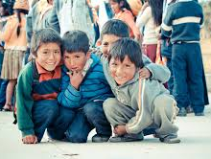
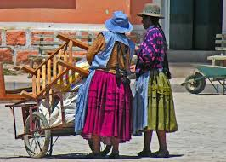
Slow Growth Populations
Pyramid shape, with a smaller base
Can easily fall back into rapid growth
Declining fertility and mortality rates
Beginnings of better education, medical, and working condition

Slide 6
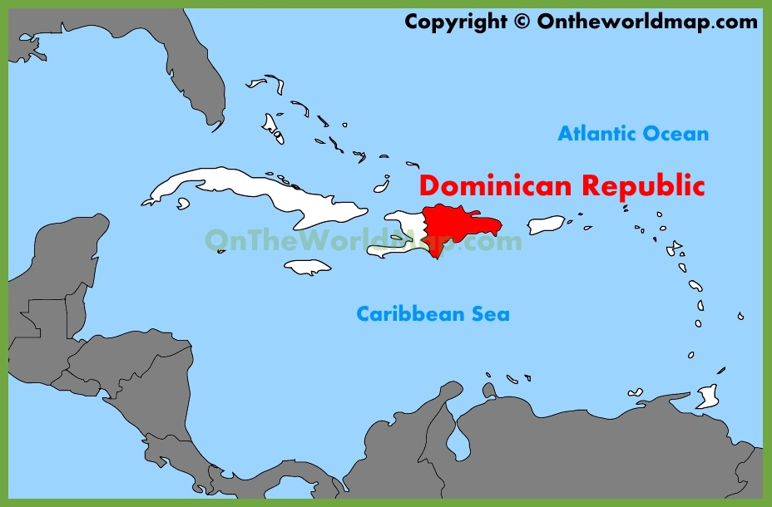
Dominican Republic
Slow Growth

Slide 7
Zero Population Growth
Shape is almost column like
Population that is unchanging (not growing or shrinking)
Birth Rate and Death Rate are equal
Most commonly found in areas that have stable education, health care and government.
Most often a developed country

Slide 8
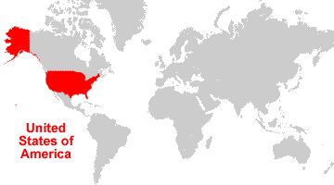
United States 2017
Zero Growth

Slide 9
Negative Population Growth
Often an inverted triangle
More deaths than births
Caring for the elderly is hard
Often ‘self imposed’ by high costs of living
Can be due to natural events like famine or war
Can cause long term problems for countries

Slide 10
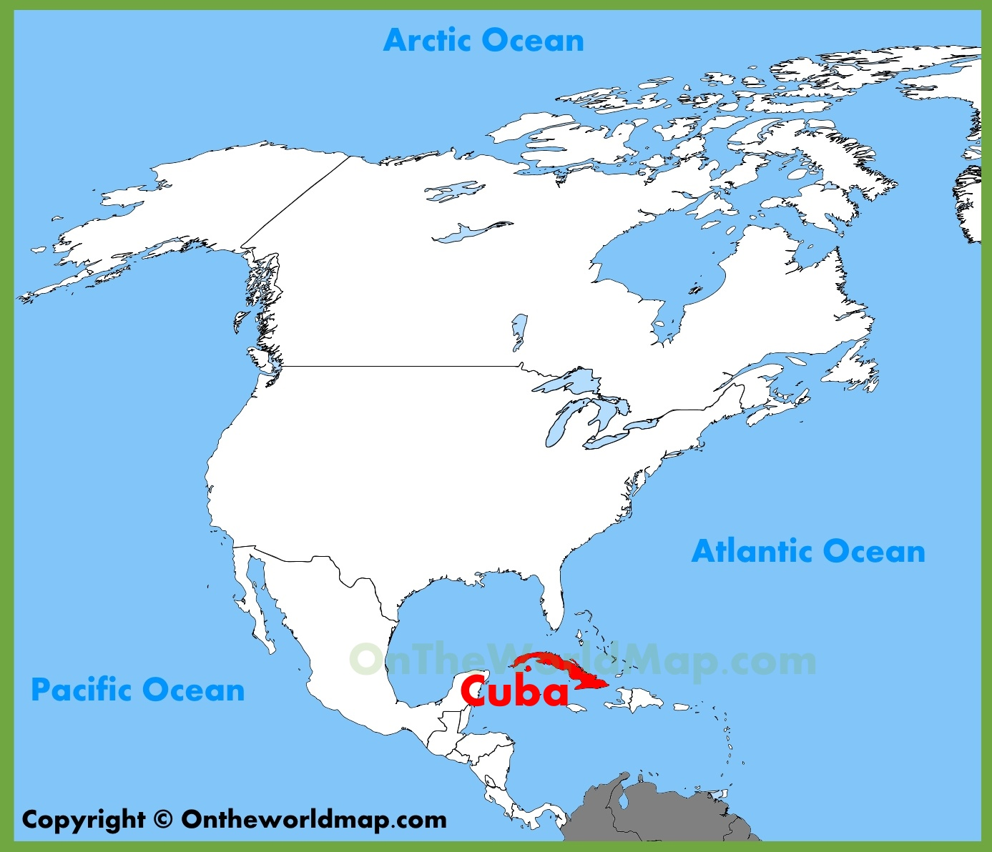
Cuba- 2016
Negative Growth

Slide 11
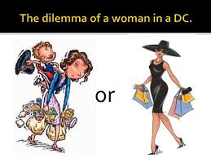
Stages of Population Change
As countries develop, they go from one stage to the next, or even back a step.
Not all countries want a negative population, so they actively seek ways to maintain their healthy populations while not overpopulating.

Slide 12
Stages of Population Change
1. 2.
Rapid Growth Slow Growth
3. 4.
Stable Growth Negative Growth

