Slide 1
Warm-Up
Get the following 5 Colors for your warm-up BEFORE the bell rings! (they are probably on your desks already)
1. Population 2. Oil and Gas Lines 3. Railroads
(Red) (Green) (Brown)
4. Roadways 5. Telecom
(Purple) (Blue)

Slide 2
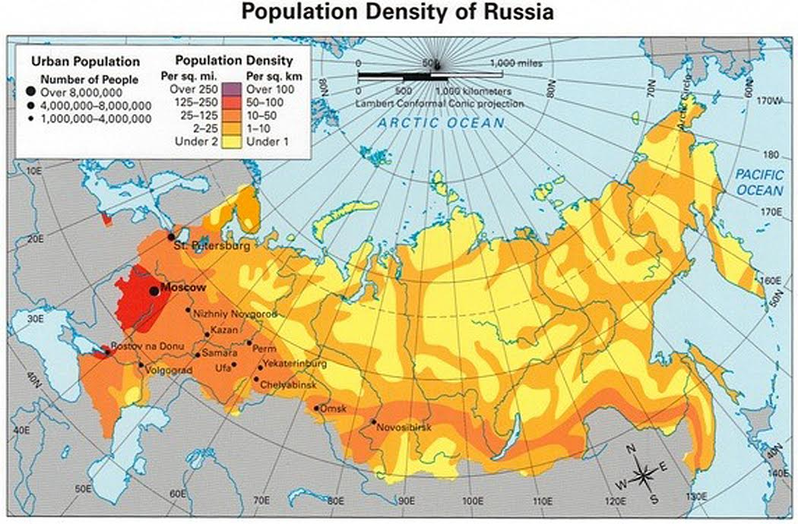
1. Population Density
Circle in red where you think the majority of people live.
77% of Russia’s Population lives in the European part of Russia
23% of Russia’s Population lives in the Asian part of Russia

Slide 3
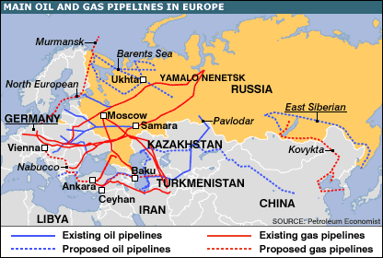
Oil & Gas Pipelines in Russia
In Green, draw in where you think the majority of Oil and Gas Pipelines can be found within Russia.
*Add it to your key

Slide 4
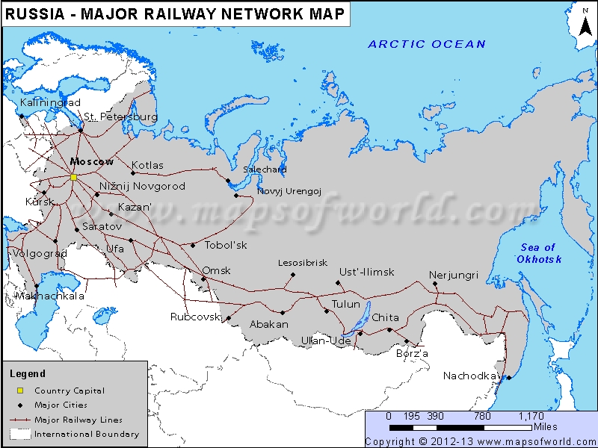
Major Railways in Russia
Using Brown lines, draw in where you think the major Russian Railways are.
*Add it to your key

Slide 5
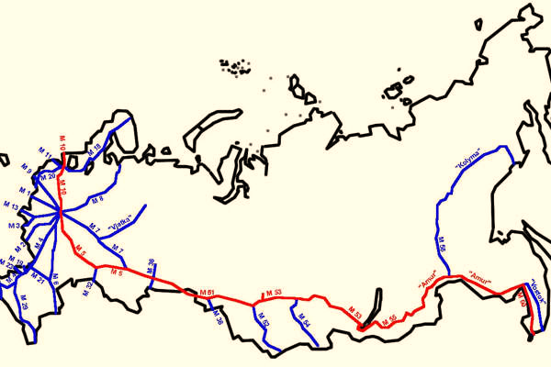
Major Roadways in Russia
Draw in where you think the majority of Russian Roadways would be in PURPLE.
*Add it to your key

Slide 6
Major Telecommunications
Draw in where you think the major internet and phone lines are in Russia in Blue (most of the country still uses hard lines for phones and internet).
*Add it to your key

Slide 7
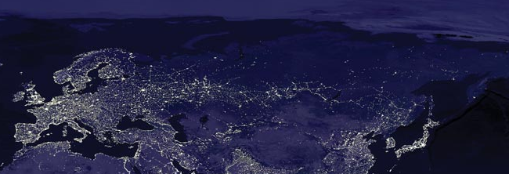
Russia at Night - Satellite Image

Slide 8
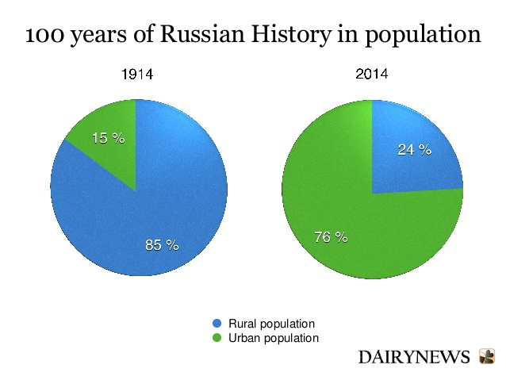
Urban Population in Russia

Slide 9
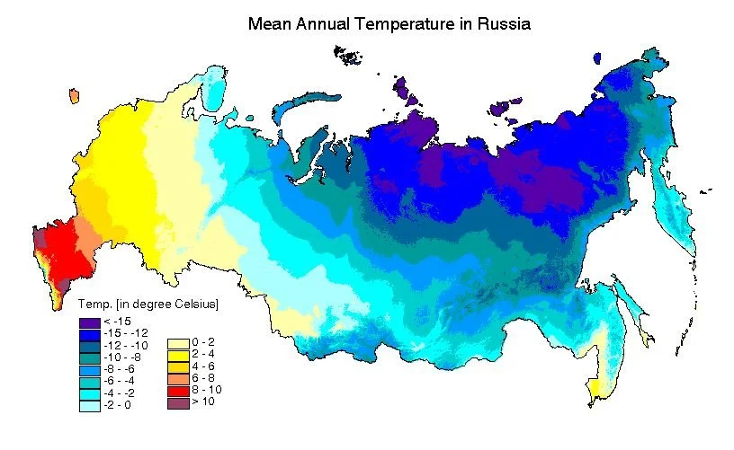
Climate: Siberia

Slide 10
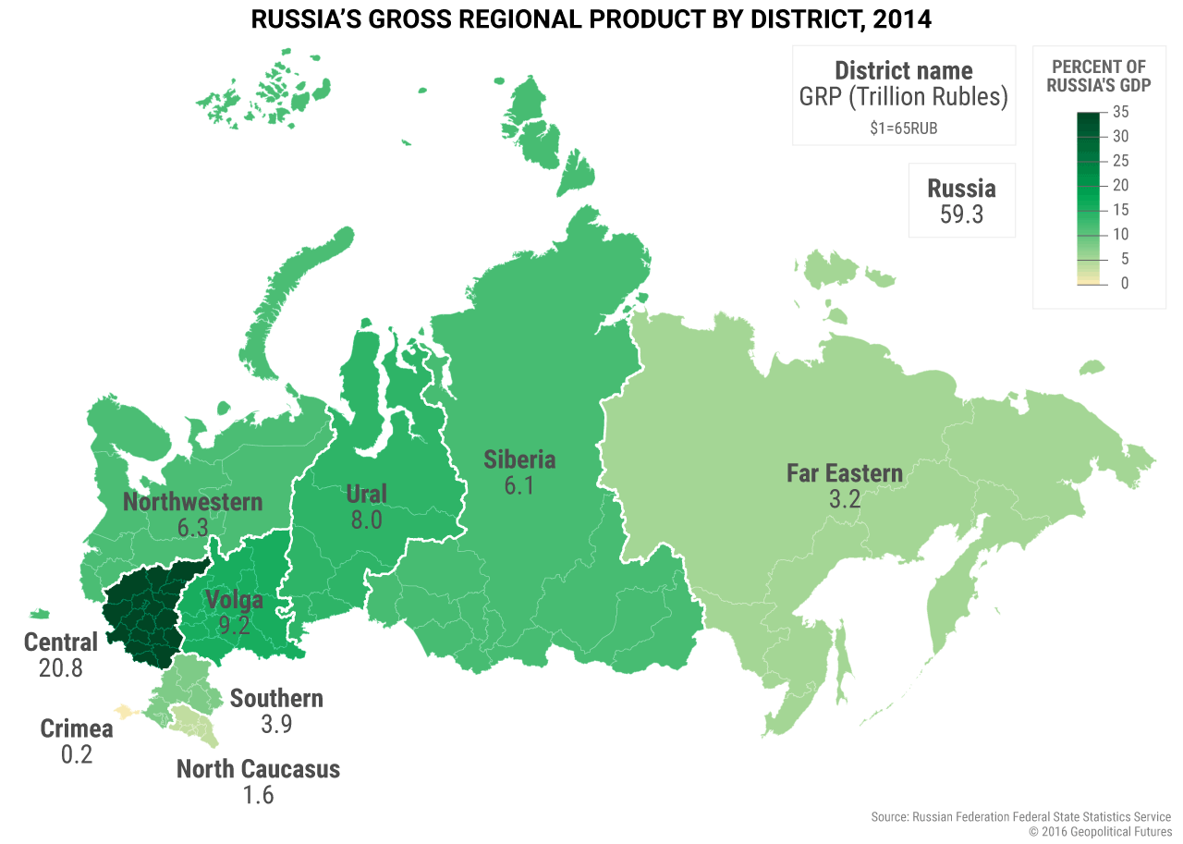
Percentage of Russia’s GDP by Region

Slide 11
Population Pyramids / HDI
Individually:
Analyze the Population Pyramids and HDI Information for the country on your page and answer the questions on the back of your page that match your country.
With your Partner:
Explain and discuss the similarities and differences between the two Population Pyramids and sets of HDI Information.
As your partner and you discuss, answer the questions about the country your partner had.
Individually:
Once both you and your partner finished discussing and answering the questions about the similarities and differences between both countries answer the mini-essay question.

Slide 12
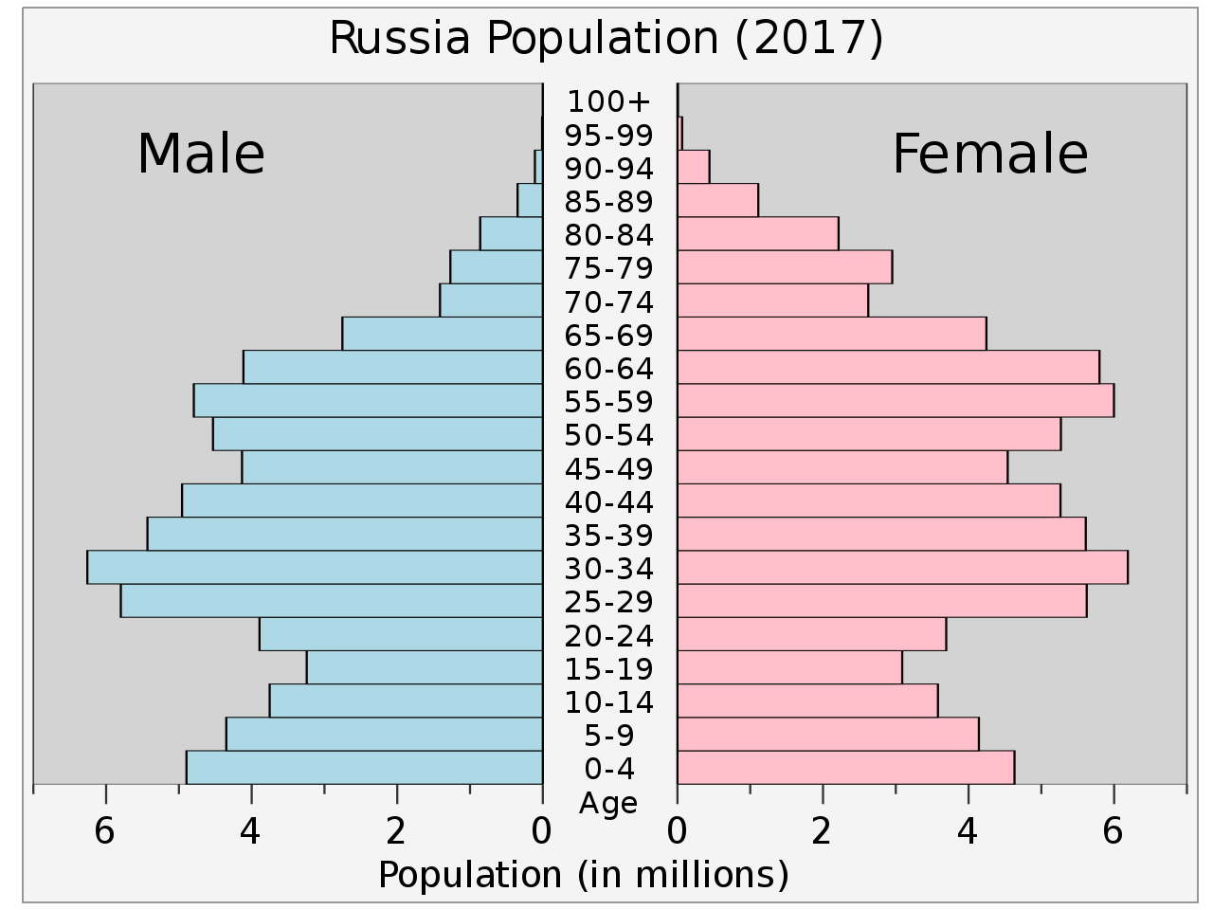
Population Pyramid - Russia

Slide 13
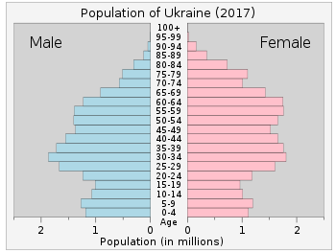
Population Pyramid - Ukraine

Slide 14
HDI Information in Eastern Europe
Country | GDP per capita | Life Expectancy | Infant Mortality Rate | Literacy Rate
USA | $65,112 | 78.6 years | 5.9 per every 1,000 live births | 99.0%
Ukraine | $9,287 | 71.6 years | 7.4 per every 1,000 live births | 99.8%

Slide 15
http://www.arcgis.com/home/webmap/viewer.html?webmap=3b73e30bee2548db805739b8e69695cf

