Slide 1
What Do You See?
Thoughts, Reflections, Interpretations

Slide 2
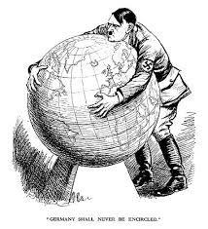
Germany Shall Never Be Encircled

Slide 3
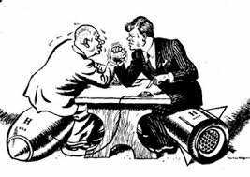
POWER STRUGGLE

Slide 4
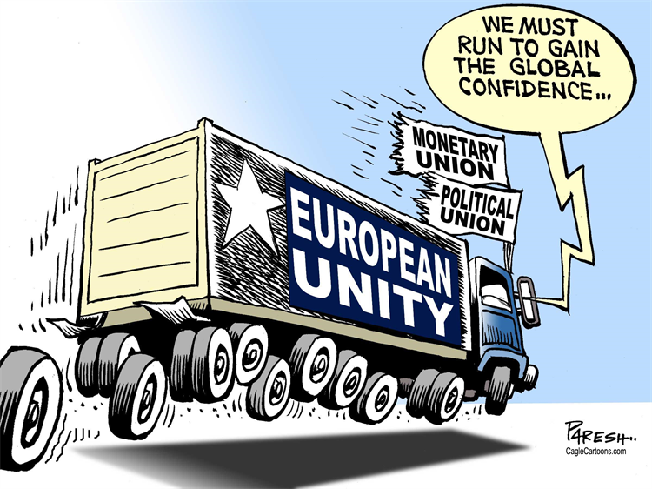
European Union

Slide 5
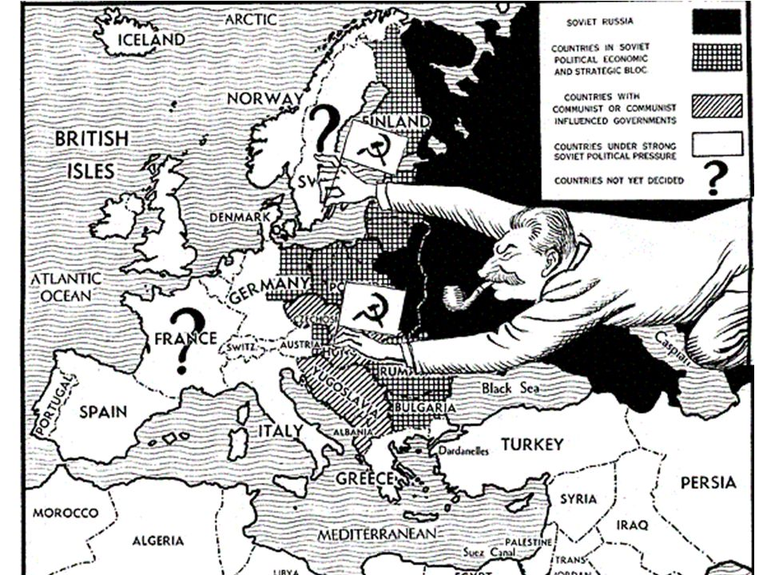
Soviet Crawl

Slide 6
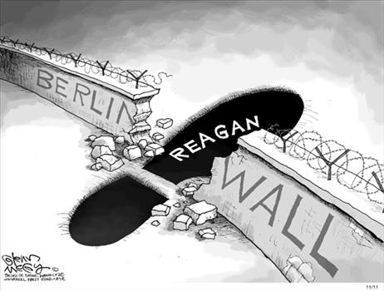
Tear Down this wall

Slide 7
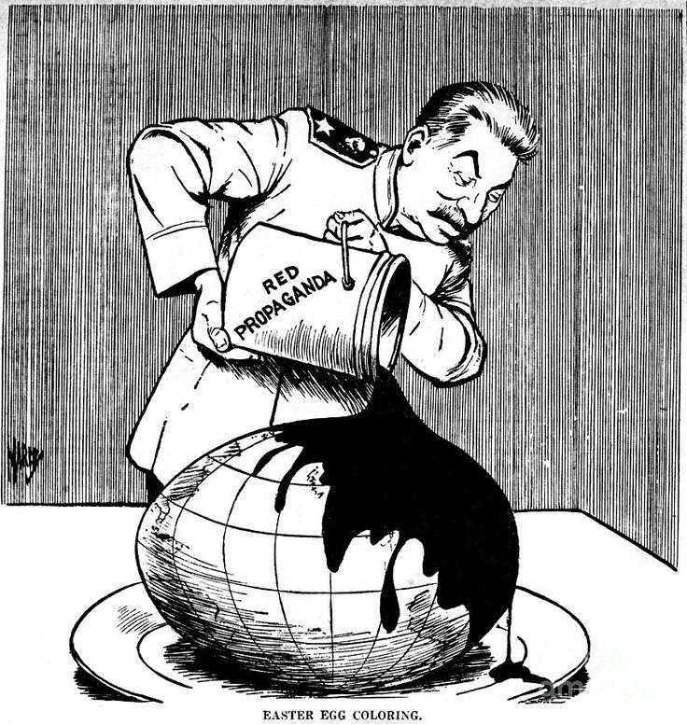
EASTER EGG PAINTING

Slide 8
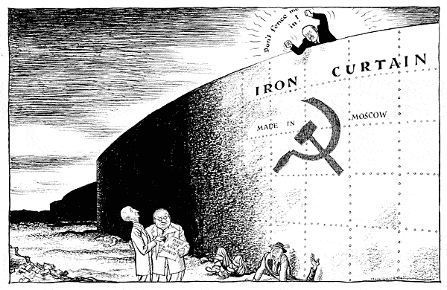
The Iron curtain

