Slide 1
Latitude and Longitude
Finding Absolute Location

Slide 2
Latitude
Imaginary lines that run East and West
Measures North and South of the Equator
Equator is a Zero Degrees (splits the earth into two equal parts)

Slide 3
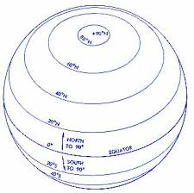
Latitude

Slide 4
Longitude
Imaginary lines that Run North and South
Measures East and West of the Prime Meridian
Prime Meridian is a Zero Degrees (Splits the earth into two equal parts)

Slide 5
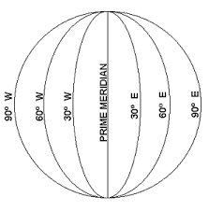
Longitude

Slide 6
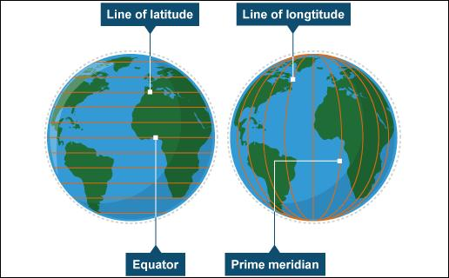
Imaginary Lines

Slide 7
Location
Absolute Location- Any exact point on earth's surface based on latitude and longitude.
~Exact and Scientific
~GPS
Relative Location- A general location based on something that you are familiar with.
~Chick-fil-a by the mall
~Two doors down

