Slide 1
Human Environment Interaction
Depend, Adapt, Modify

Slide 2
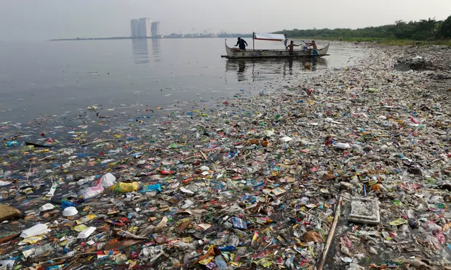
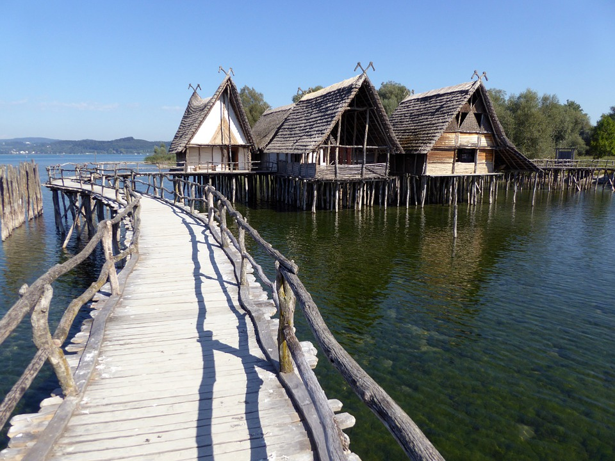
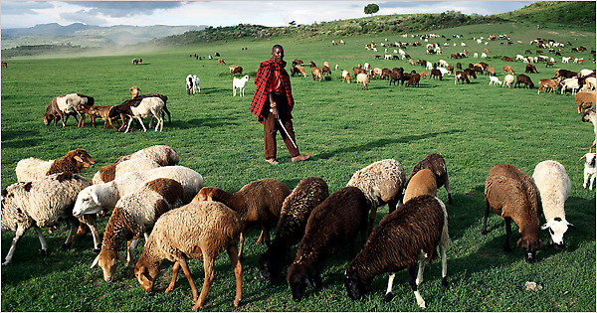
Warm-Up: Using COMPLETE sentences describe what you think is going on in the images below.
1
3
2

Slide 3
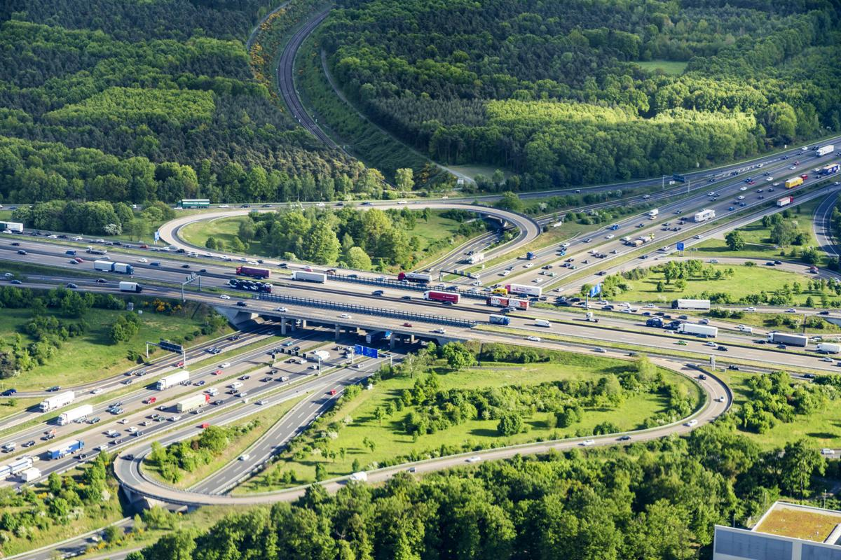
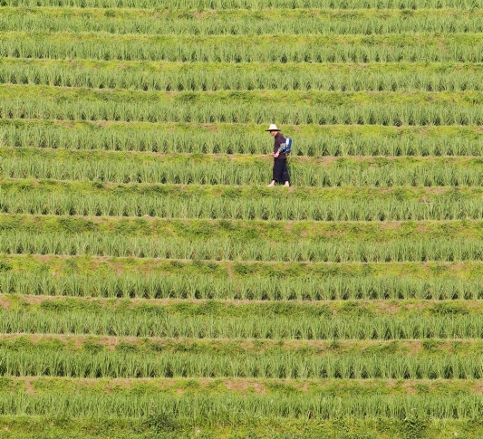
Human Environment Interaction
HEI, or Human Environment Interaction is a phenomenon which describes how human beings interact with the environment to obtain their needs from it, and how the environment, in turn, responds to this interaction.
It indicates how humans themselves have to depend on, adapt to, and modify the environment to ensure their survival.
The acronym DAM (Depend-Adapt-Modify) is used in HEI.

Slide 4
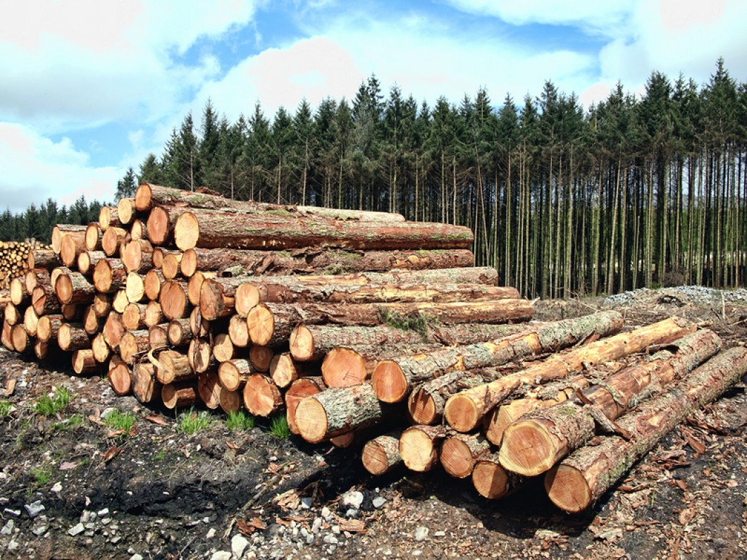
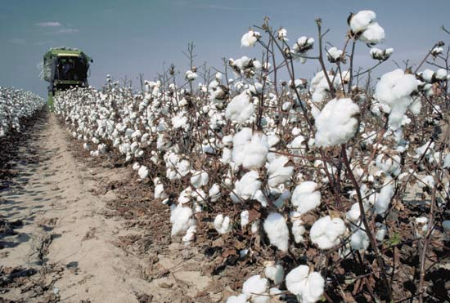
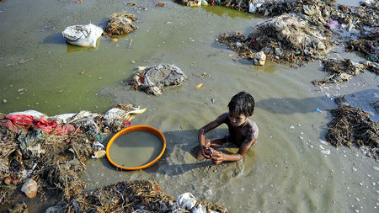
Humans Depend On Their Environment
Humans depend on the environment to obtain resources for their survival as well as development of their civilization.
~food, clean drinking water, timber for construction, fiber for clothing, coal and natural gas for industries and energy are all depended upon for survival.

Slide 5
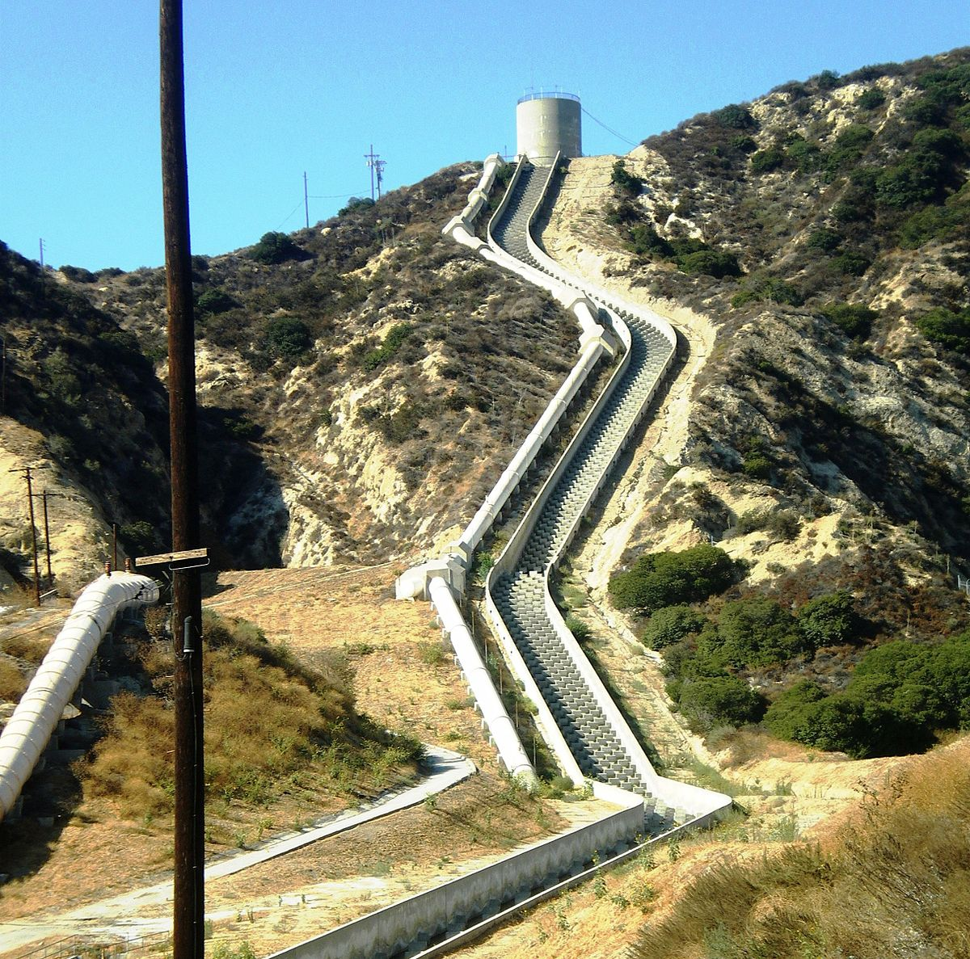
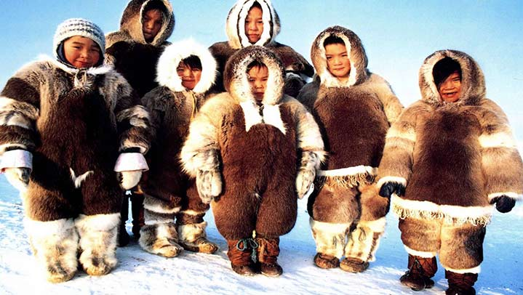
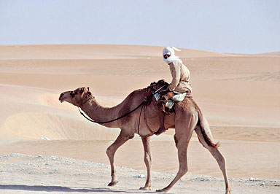
Humans Adapt to Their Environment
Humans have to adapt to those conditions in the environment which they cannot modify, to ensure survival.
Examples of HEI through adaptations are: building houses on higher ground in flood-prone areas, using the natural slope of the land to transport water for irrigation, wearing warm clothes in colder climates…

Slide 6
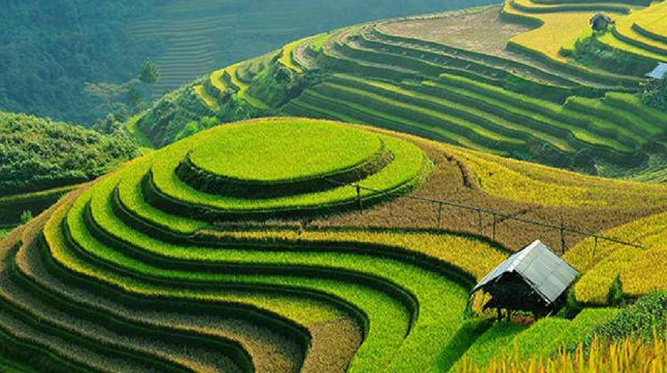
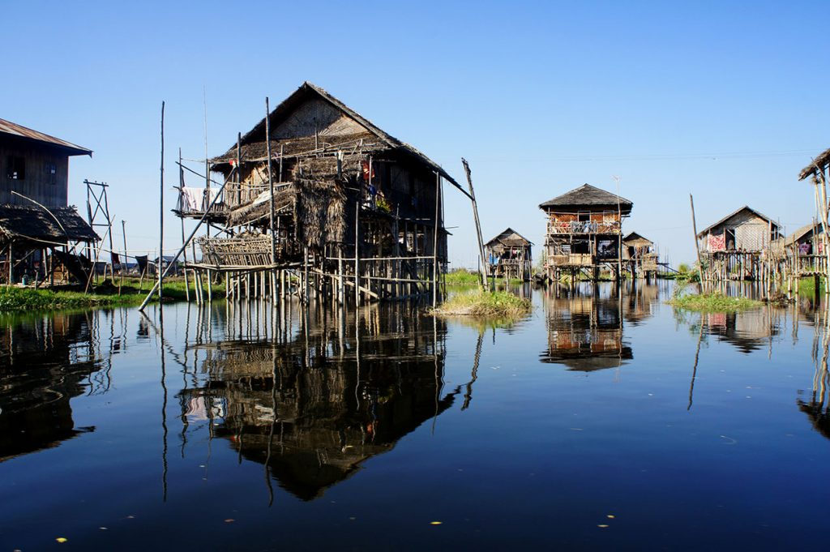
Humans Modify Their Environment
Humans can modify the environment to make it easier to extract resources, so that their needs are fulfilled in a better way.
Modifications allow people to not only survive, but thrive.
Such modifications can include drilling holes in the ground for oil extraction, building dams for water storage and flood control, farming on terraces to increase crop production for a large population…

Slide 7
Types of Human Environment Interactions
Human environment interactions mostly produce positive effects for society (the people), but they also have far-reaching consequences on the environment, that are all too often negative.
A few of these interactions may be beneficial or have no consequences on the environment. Examples of such consequences are the recreational use of mountainous regions for skiing or hiking, or ecotourism.

Slide 8
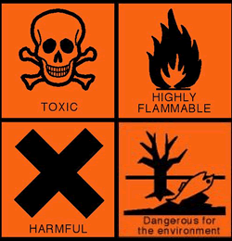
Types of Human Environment Interactions
In most cases though, the environment ends up being harmed. Human activities have ended up polluting the air, water, and soil.
This has led to increasing surface temperatures of the Earth (global warming), which has placed coastal towns around the world at risk of being submerged.
The destruction of forests for cultivation and timber production has endangered many species of plants and animals, putting entire ecosystems under threat.

Slide 9
HEI: Positive and Negative
Positive (or neutral)
Hiking
Eco Tourism
Recycling
Reusing Rain Water
Planting Trees
Negative
Use of Fossil Fuels
Deforestation
Pollution
Industrialization
Loss of Habitat

Slide 10
