Slide 1
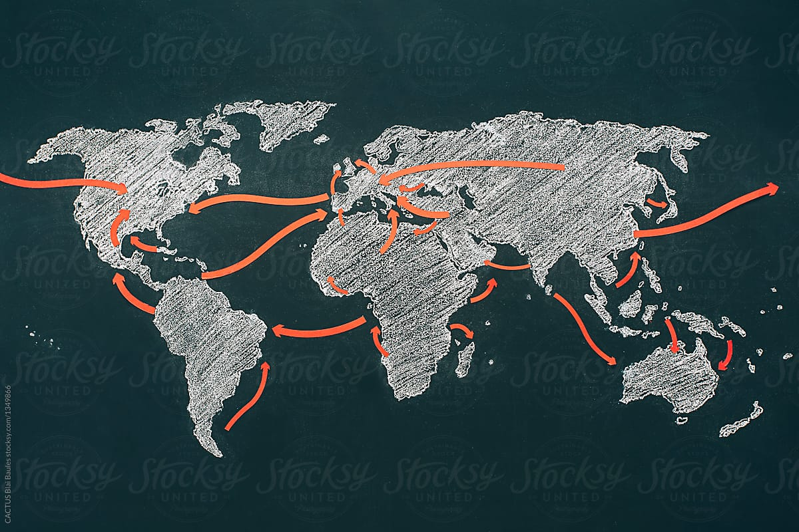
Historic Migrations
Where are people and how did we get there?

Slide 2
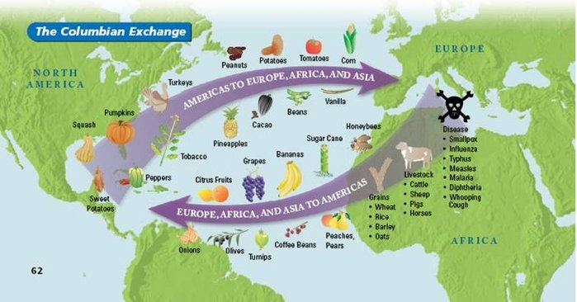
1. Columbian Exchange
Exchange of goods, people, ideas, diseases, foods and animals from the old world to the new world.

Slide 3
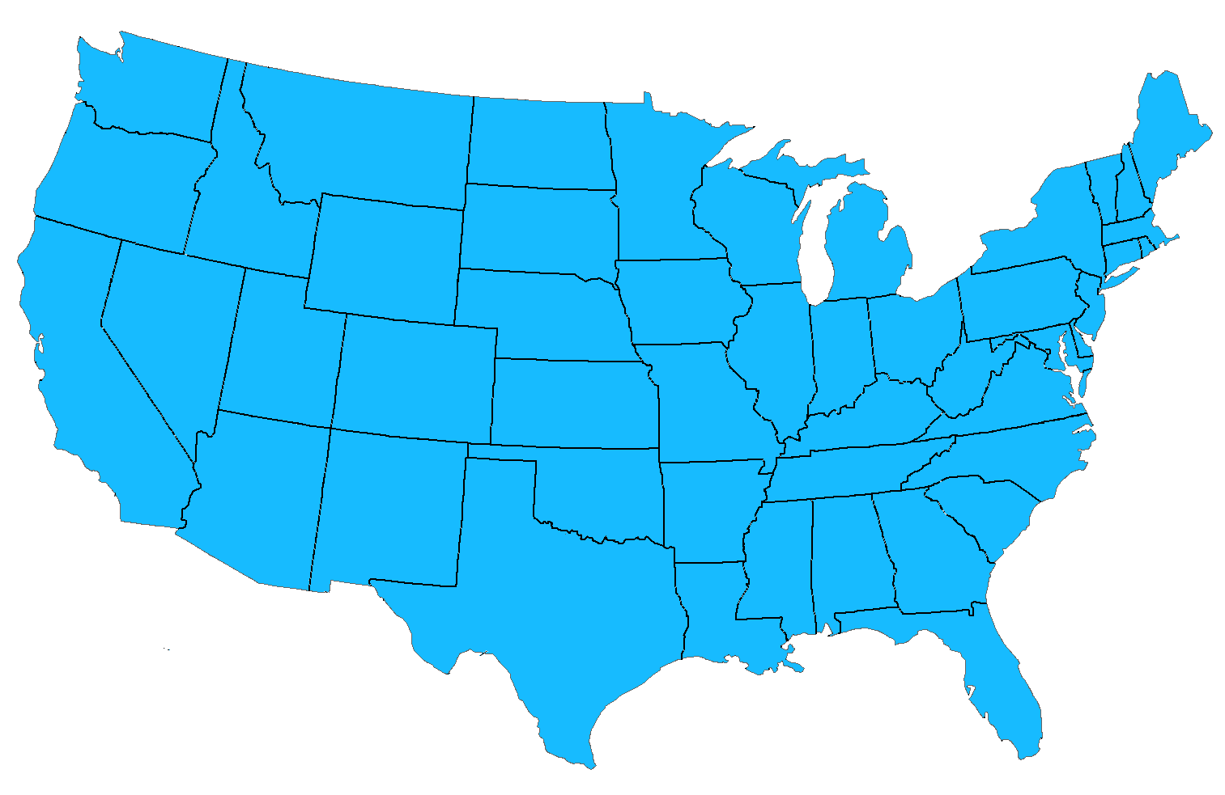
2. Atlantic Slave Trade (1619-1808)
FORCED migration
Africans captured & forced into labor throughout N & S America

Slide 4
3. The Trail of Tears (1830s)
FORCED migration
Native Americans forced to move to “Indian Territory” west of Mississippi River

Slide 5
4. Chinese Migration to West Coast (1850s-1860s)
The Gold Rush and jobs building the Transcontinental Railroad caused increase in Chinese migrating to the US

Slide 6
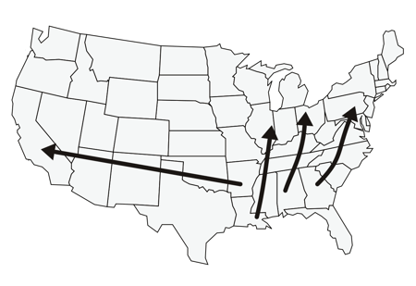
5. The Great Migration (1916-1970)
Southern African Americans left to get away from segregationist laws & find factory jobs

Slide 7
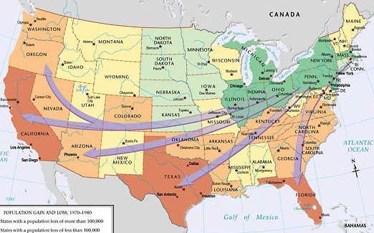
6. Rust Belt to the Sun Belt (1950s-1970s)
Labor costs caused many northern factories to close or move to less expensive South
People migrated to follow the jobs.

Slide 8
7. Latin American Migration (1970s-2000)
In 1965, quotas ended & relatives were given preference so migration from Latin America increased greatly

