Slide 1
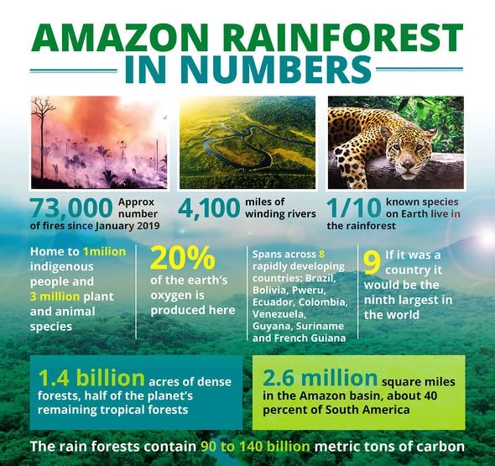
HEI of Latin America
Human Environment Interaction

Slide 2
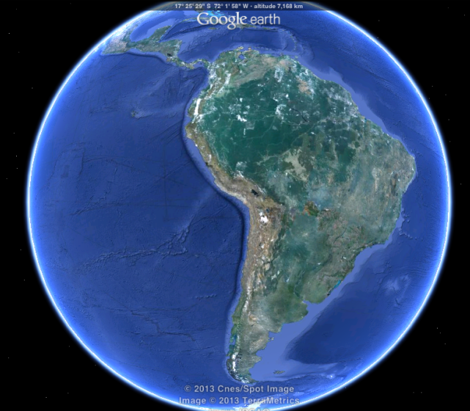
What is Human Environment Interaction?
HEI is how people change the environment in both positive and negative ways to make life easier/better (for people).

Slide 3
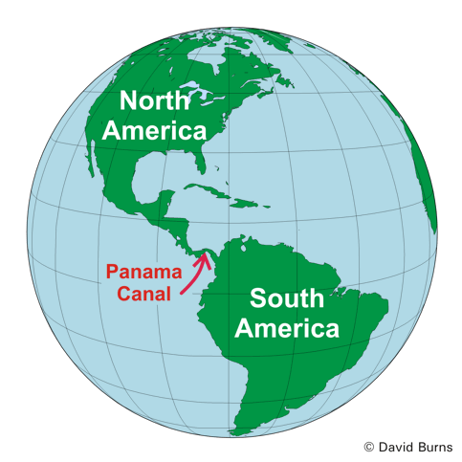
Panama Canal
Connects the Atlantic and Pacific Oceans
Cuts through the country of Panama
Creates a shorter and safer shipping routes
Boosted Panama’s economy
Destroyed much of the natural landscapes and changed many natural waterways.
Draw the Panama Canal on your Map in RED. Trace the panama Canal box in RED.

Slide 4
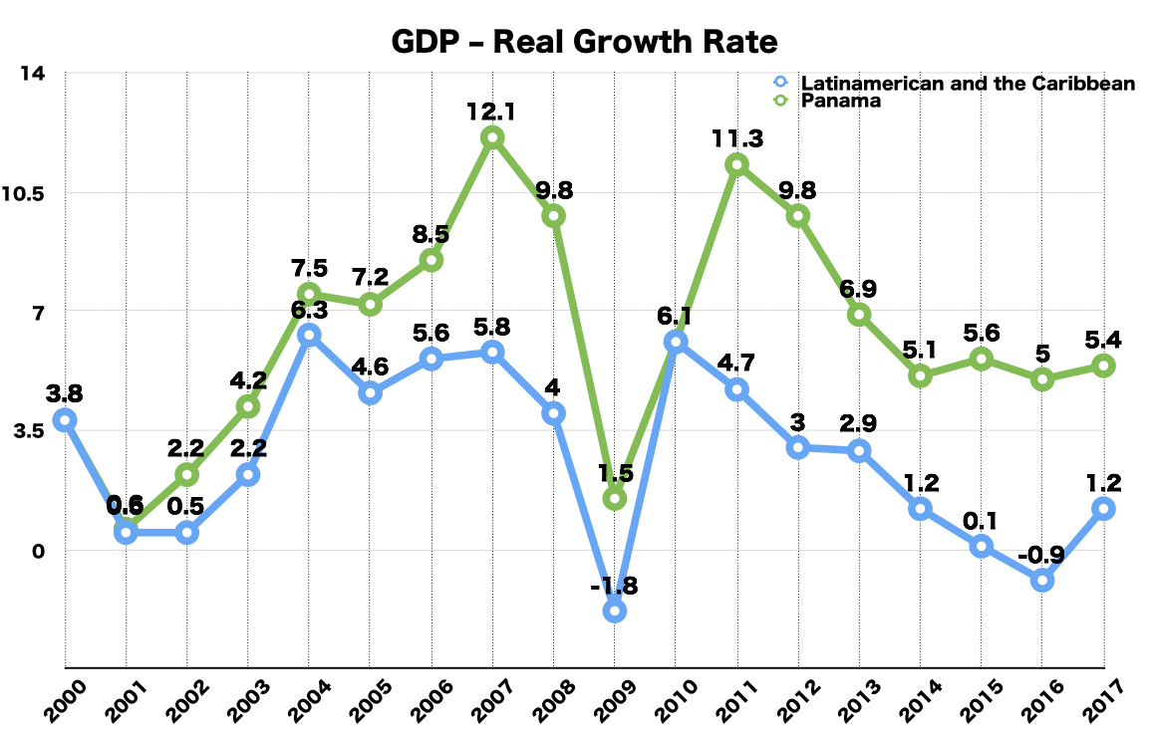
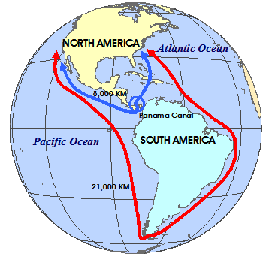
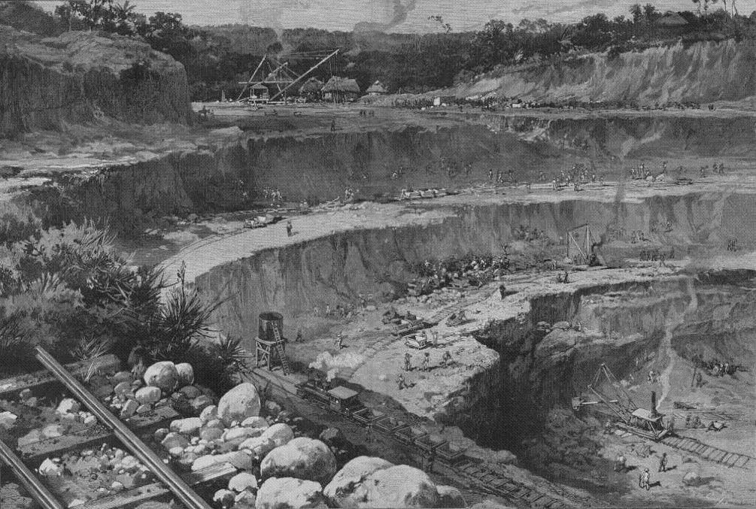
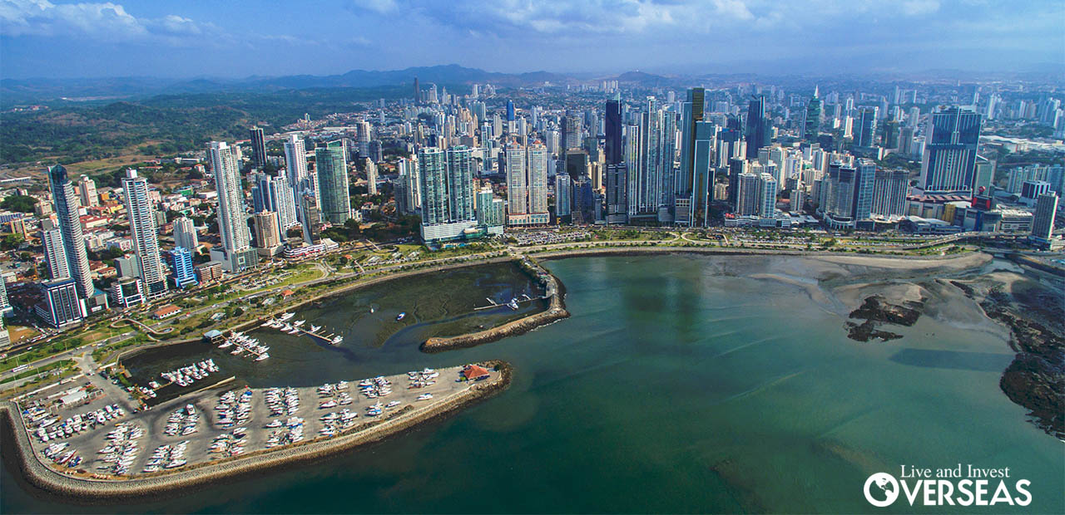
Positive Or Negative? You Decide!

Slide 5
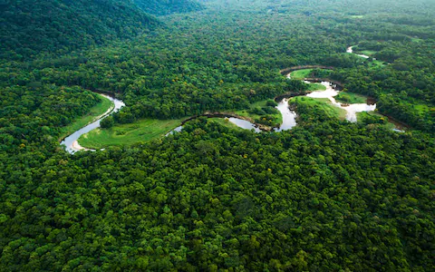
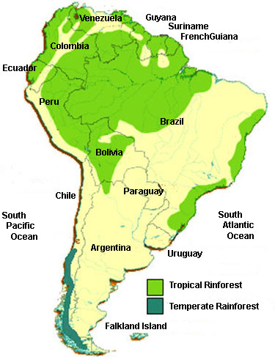
Amazon Rainforest Deforestation
Amazon is home to over 2 Million Square miles of forests.
Roughly 20,000 Miles of forests are lost each year (20% total has been lost)
Loss of habitat for animals and plant specie
Soil is lacks nutrients and isn’t suitable for long term farming, causing more deforestation
Timber exports help the GDP of South America
Draw the Amazon Rainforest on your map in GREEN. Trace the rainforest box in Green.

Slide 6
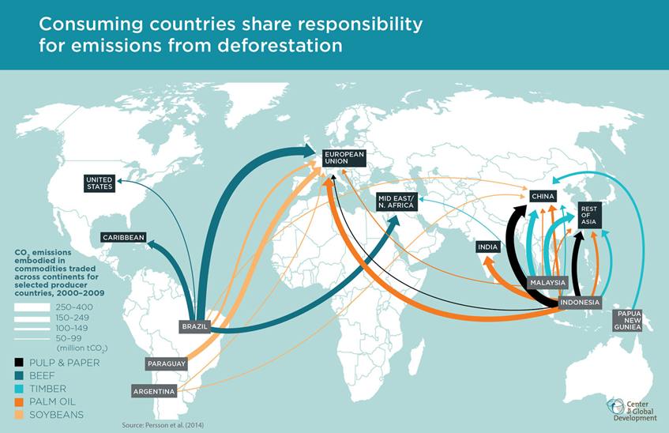
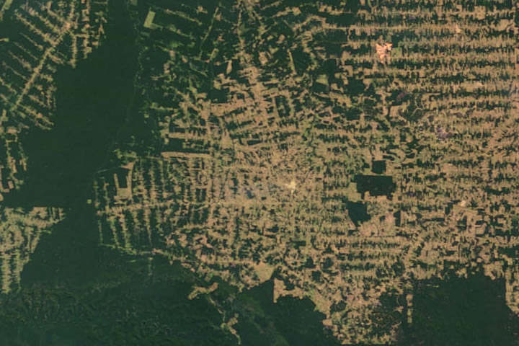
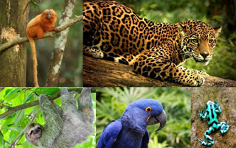
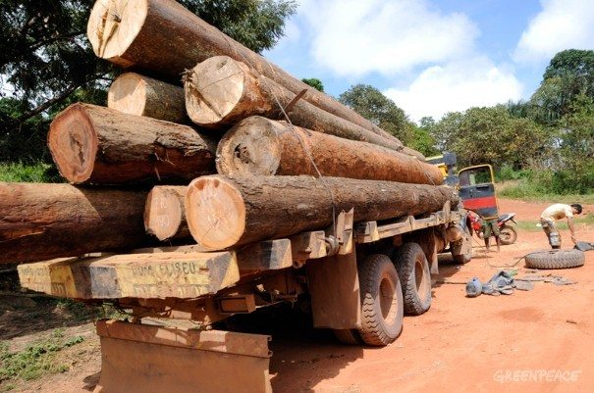
Positive Or Negative? You Decide!

Slide 7
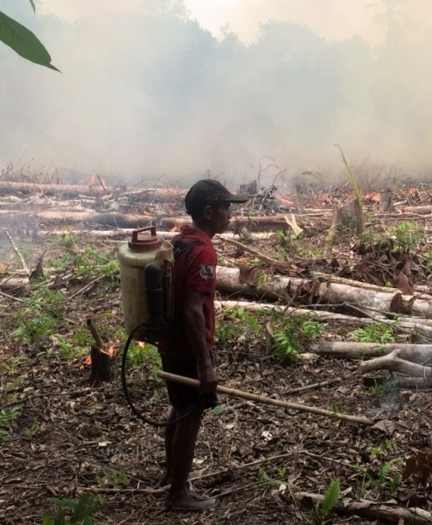
Slash and Burn Farming
Farming technique used to quickly clear land by burning it
Removes all plant life
Often causes out of control fires (over 73,000 in 2019 alone)
Leaves behind nutrient poor soil
Creates a lively hood for subsistence farming for thousands of South Americans
Color the areas affected by Slash and Burn in Orange. Outline the Slash and Burn box in Orange.

Slide 8
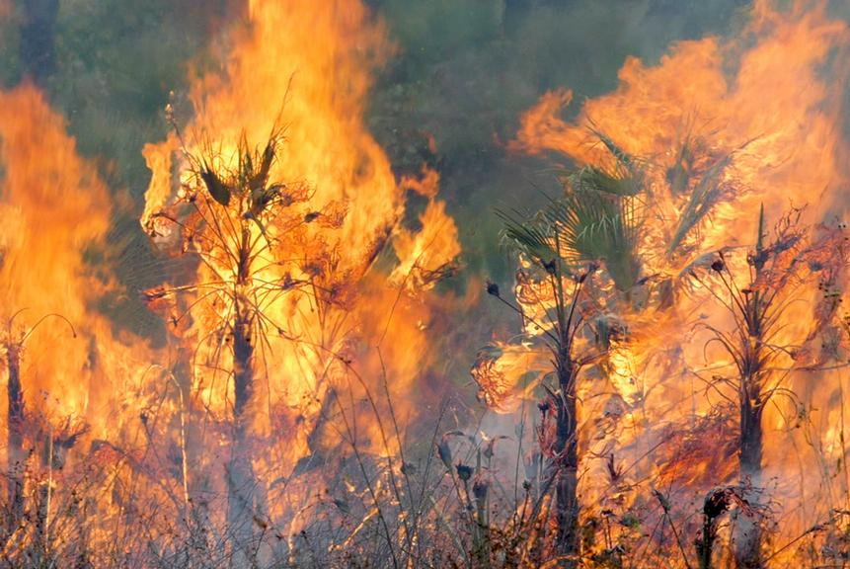
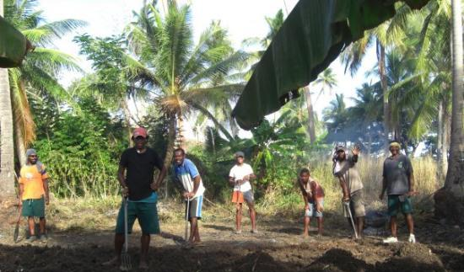
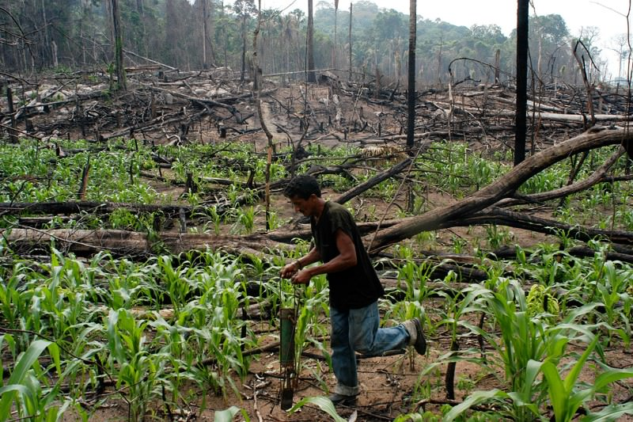
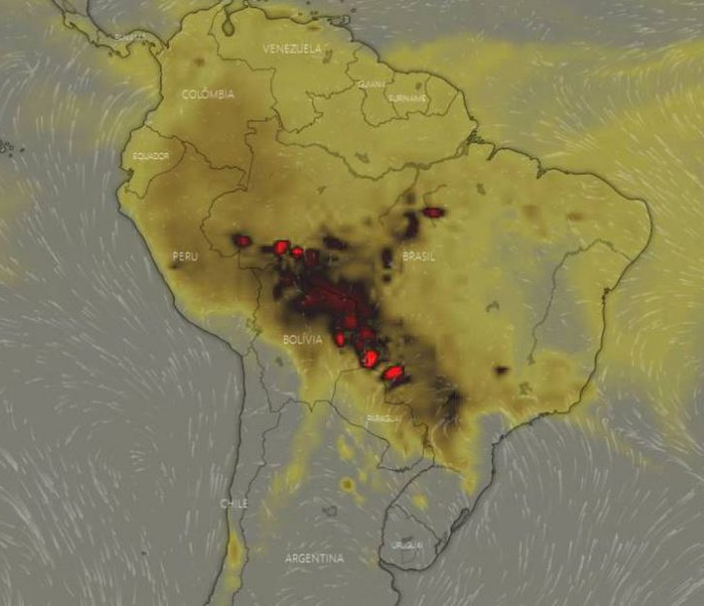
Positive Or Negative? You Decide!

Slide 9
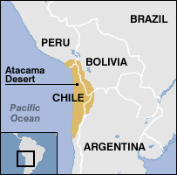
Atacama Desert
Dry, cold terrain due to the Mountain Barriers from the Andes.
One of the driest places on earth (dryer than the polar deserts)
Over 1 Million people call the Atacama home and use it for dry crop farming (olives, tomatoes, cucumbers)
Alpaca farming is also very common, since this is their normal terrain.
Mining Coper is also very common in the Atacama Desert.
Draw in the Atacama in Yellow. Outline the Atacama box in Yellow.

Slide 10
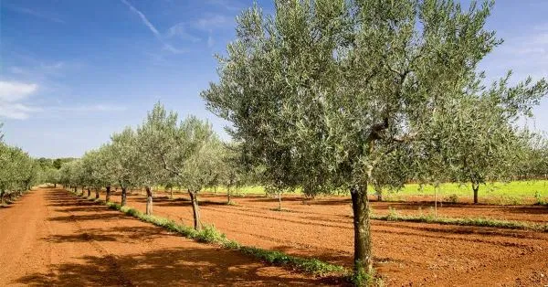
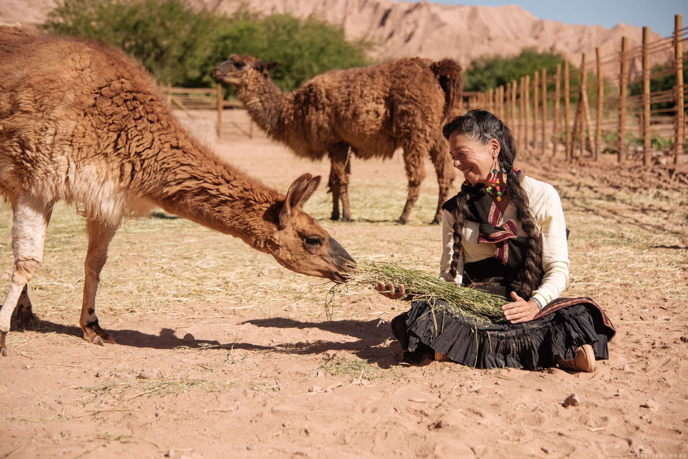
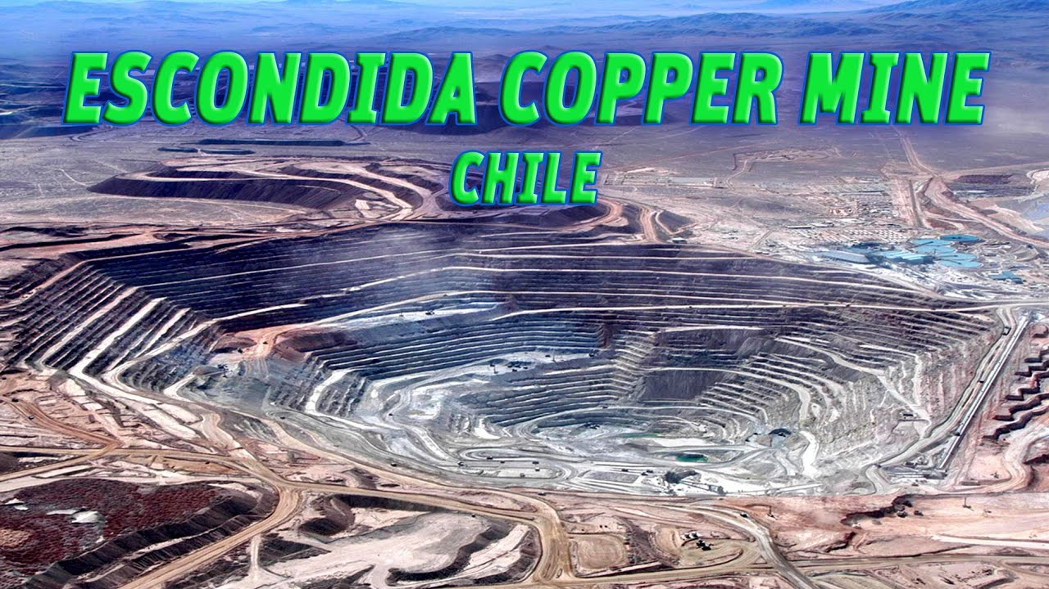
Positive Or Negative? You Decide!

Slide 11
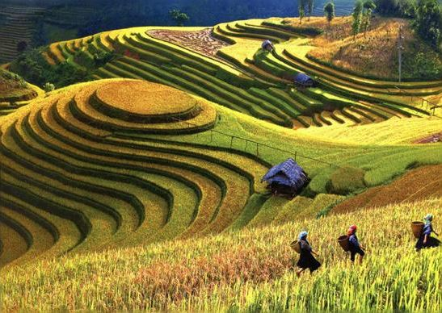
Terrace Farming
Draw in the areas known for Terrace farming in in Purple.
Outline the box for Terrace Farming in Purple.
Used in areas with high mountain sides
Creates more surface area for farming
Prevents water and soil runoff.
Enables millions of people throughout the Andes to farm and survive with various crop productions.

Slide 12
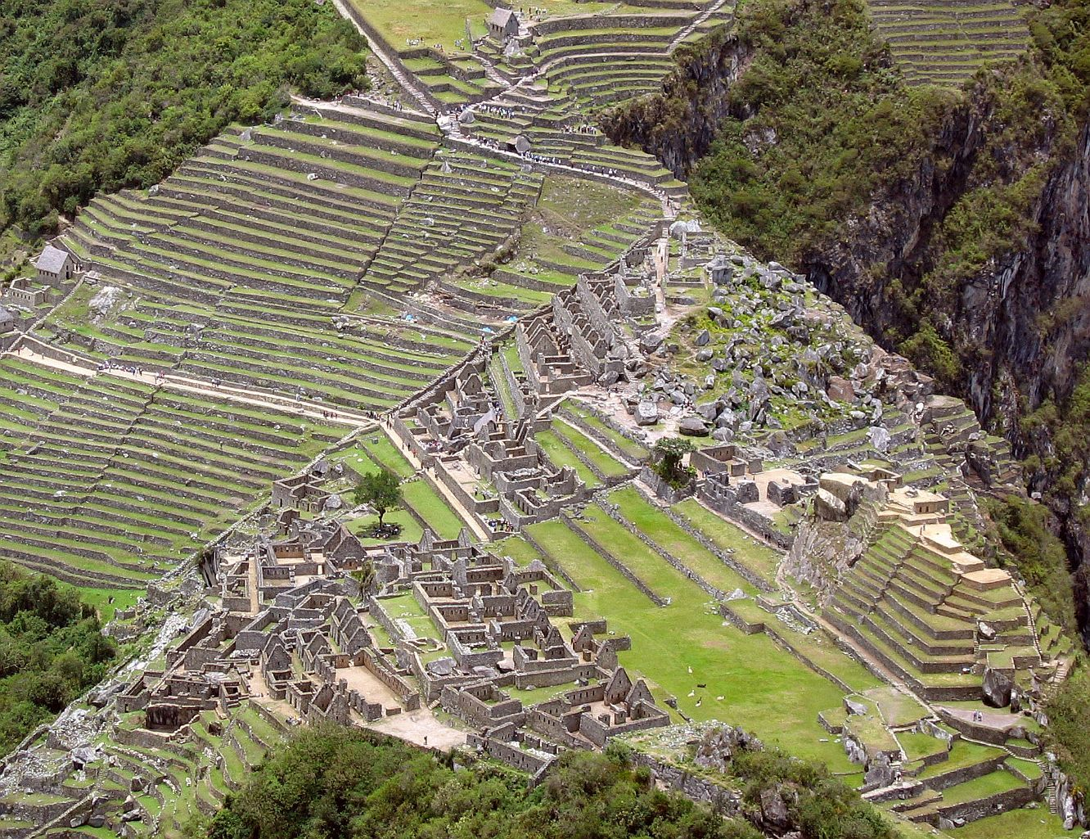
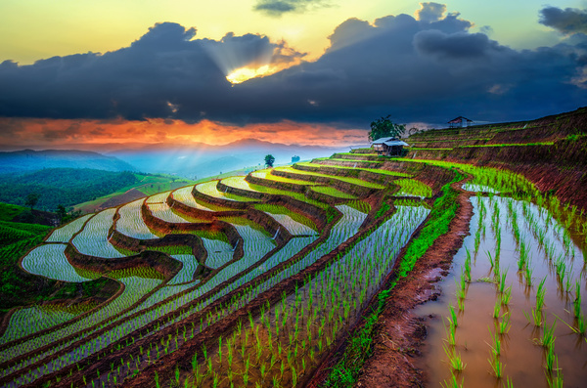
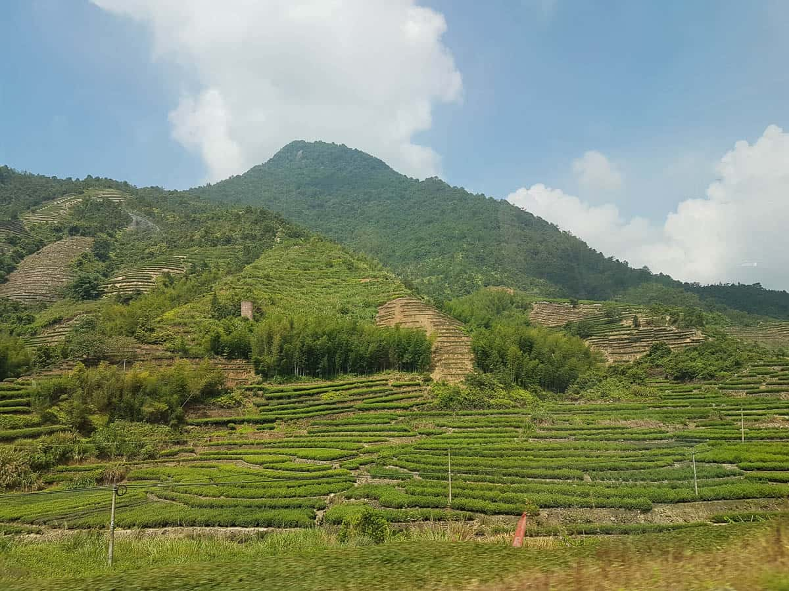
Positive Or Negative? You Decide!

Slide 13
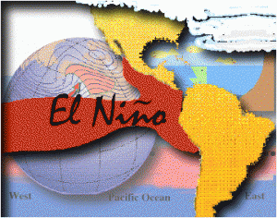
El Nino
Warm Water currents from the Pacific increase sea temperatures.
Fish and wildlife are killed due to the increase in temperature
Economies of the regions are hurt.
Areas on land also see a decrease in rainfall, causing droughts.
Draw in the El Nino effect in Brown. Outline the El Nino box in Brown.

Slide 14
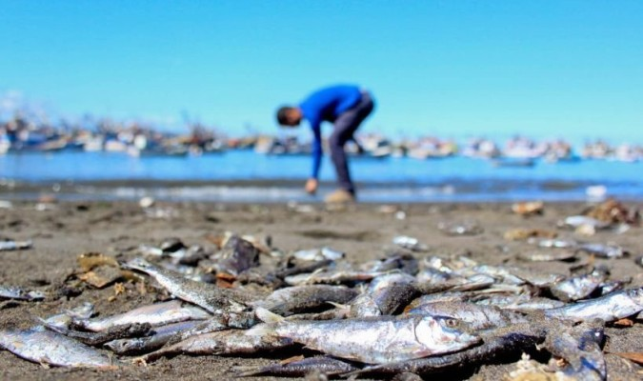
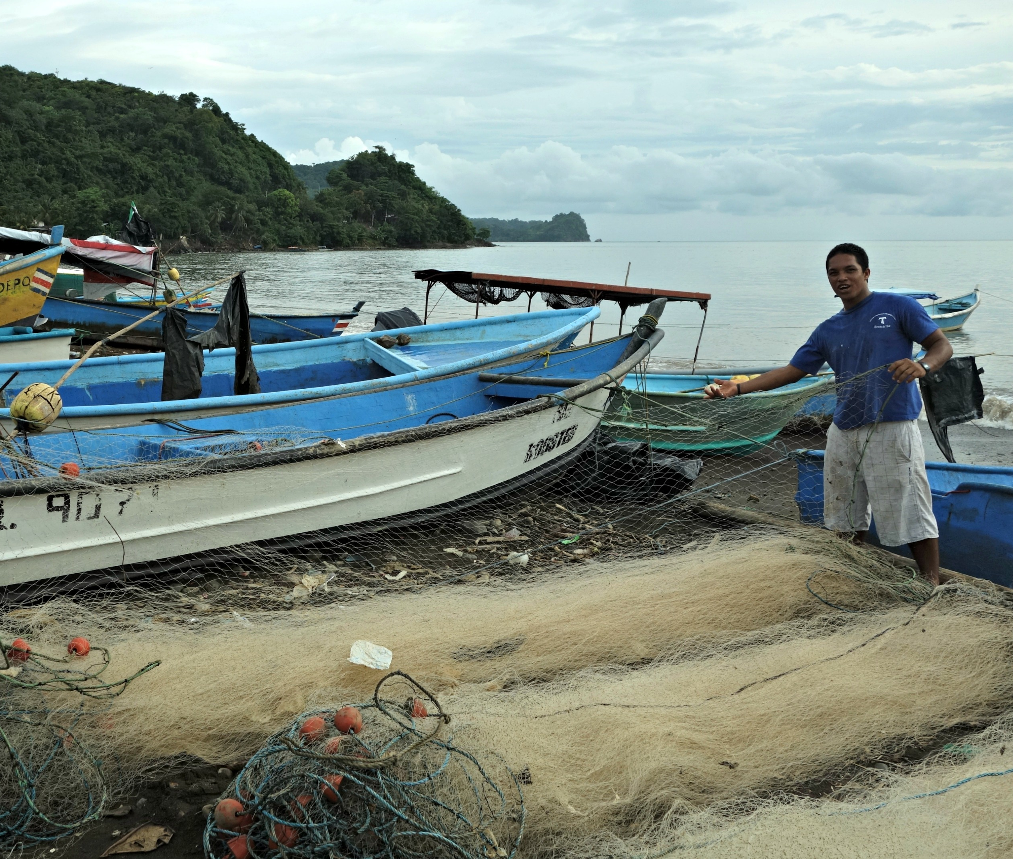
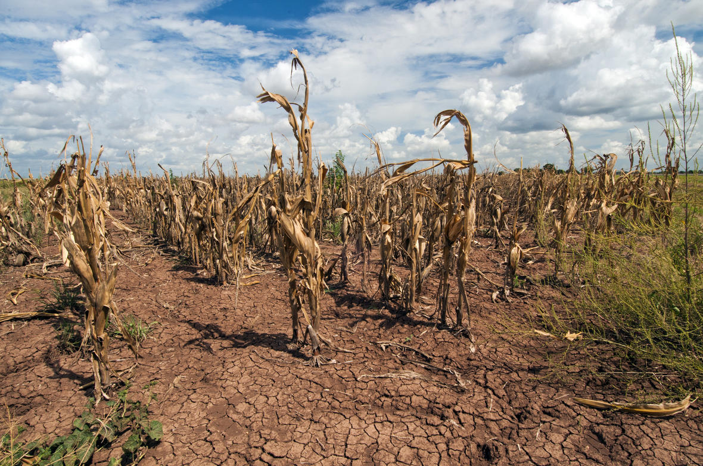
Positive Or Negative? You Decide!

