Slide 1
Latin America
Governments

Slide 2
Review: War and Nation Building in Latin America

Slide 3
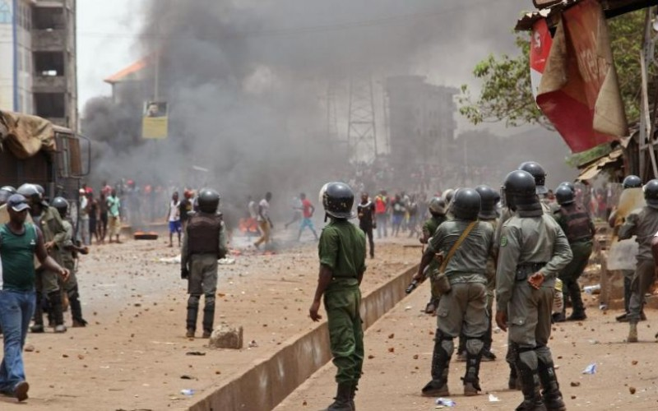
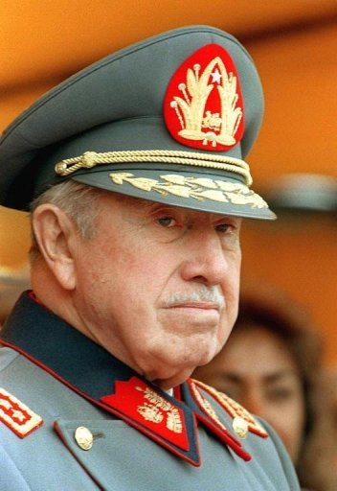
Governments in Latin America
In Latin America, most countries have a history of:
1. POLITICAL INSTABILITY
2. CORRUPTION
3. MILITARY RULE

Slide 4
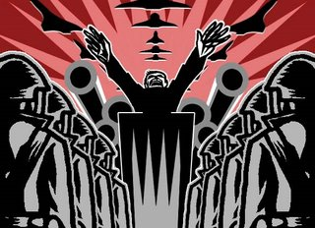
Totalitarian Systems
At the conclusion of Spanish rule during the 1800’s Latin America was ruled by small groups of Spanish Colonists (Oligarchies/Caudillo)
This system of government limits freedoms, censors speech, and harshly punishes dissenters of the government.
This is the beginning of Totalitarian Systems in South America

Slide 5
Examples of Totalitarian Regimes
Mexico – Controlled by the Institutional Revolutionary Party for over 71 years through fraud and corruption.
Argentina: Juan Peron (Caudillo/Military Leader)
Cuba- Dictatorship (Castro Regime)
Venezuela – Federal Republic? (Hugo Chavez)
Chile- Under military rule of Pinochet (1973 coup d'état)

Slide 6
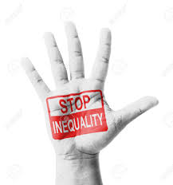
20th Century Rebellions (Reasons)
Many rebellions in the 1970’s and 1980’s were a result of people/groups protesting what they see as unjust societies.
Income gap
Slums- lack access to opportunities
Education systems (focus on wealthy)

Slide 7
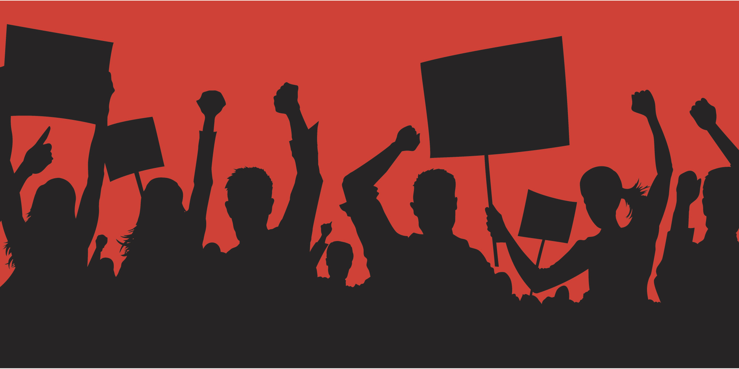
Return to Democracy
After decades, dictatorships across Latin America started falling in the 1980s and 1990s. Moderate civilian politicians put an end to military rule, and began a series of political and economic reforms.
1. Failures of Dictatorships
Many failed to achieve social, economic reforms
Poverty, malnutrition, infant mortality remained high
2. High Number of Poor
Landless poor streamed into cities, searched for work
“Brazilian miracle” miracle for military, landowners, wealthy business people only
3. No Security
Dictatorships did not bring stability
Death squads, civil rights repressed, mysterious disappearances, torture, killings
People began to demand change

Slide 8
Republic/Democratic Systems
Many Countries throughout South America are pushing for more democratic systems of government.
Three things need to be done to create a stable democracy
Political Reform: change in government policies and directives
Economic Reform: Reduction of government spending
Land Reform: Breaking up large land holdings into smaller pieces for peasant farmers

Slide 9
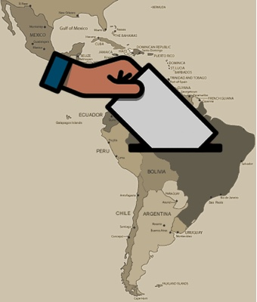
New Civilian Governments
By the 1970’s countries like Brazil, Argentina, and Chile were moving towards democracy.

Slide 10
Cuba

Slide 11
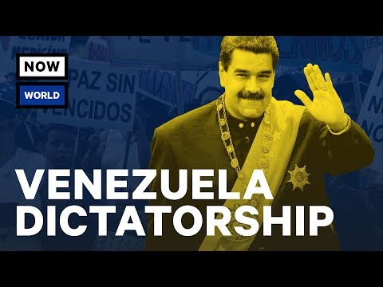
Venezuela

Slide 12
Nicaragua

Slide 13
Brazil

Slide 14
Closure
What five words would you use to describe the historical trend of governments in Latin America?
Explain and justify your choices using examples from today’s lesson.

