Slide 1
Free Trade Agreements
NAFTA, CAFTA, & Mercosur

Slide 2
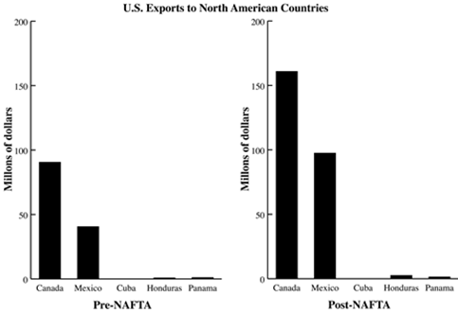
Warm Up
Based on the graph what can you conclude about the impact of NAFTA? Make sure you reference both bar graphs.

Slide 3
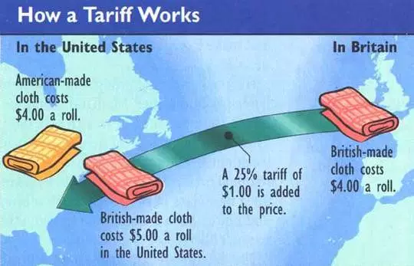
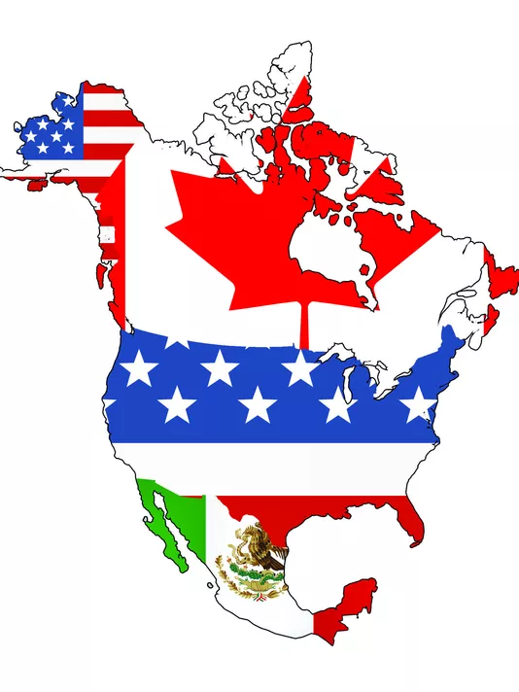
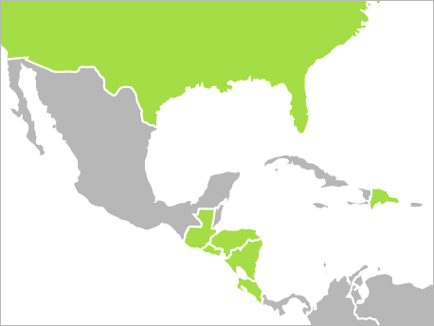
Definitions
Tariffs - taxes on imported goods
Free Trade Zone - a zone without tariff/Tax or any other trade restrictions
NAFTA
DR-CAFTA
Mercosur

Slide 4
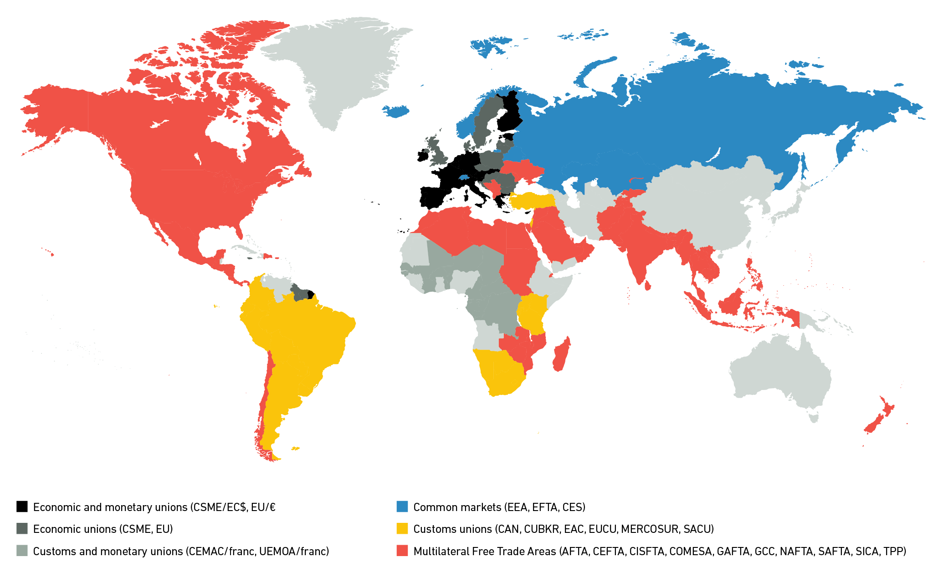
Free Trade Agreement Goals
Unrestricted Trade (no tariffs)
Boost economies of member countries
Help member countries become more powerful on the global market
Encourage competition (Free-Market Economy)
Increase political ties and stability

Slide 5
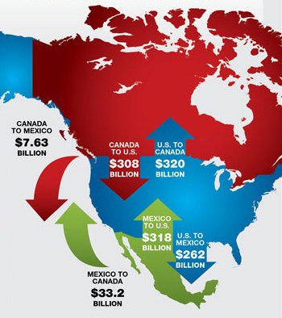
NAFTA
North American Free Trade Agreement
Began January 1, 1994
Goal was to eliminate barriers to trade and investment between the U.S., Canada and Mexico.
$1 trillion of trade each year.
First comprehensive trade agreement of its type, it has brought economic growth and rising standards of living for people in all three countries.
Member Countries:
Mexico, Canada, USA
This has overall impacted the business culture in the US because some American companies have outsourced labor to Mexican Maquiladores.

Slide 6
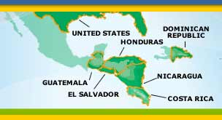
DR-CAFTA
Dominican Republic-Central American Free Trade Agreement
Began January 1, 2009
Purpose of creating new and better economic opportunities by opening markets, eliminating tariffs, reducing barriers to services.
With U.S. exports of more than $15 billion, it makes up the second largest market for U.S. exports in Latin America.
Estimated over $50 billion in trade results from CAFTA-DR per year.
Member Countries- Central America
Honduras
El Salvador
Costa Rica
Nicaragua
Guatemala
Dominican Republic
United States

Slide 7
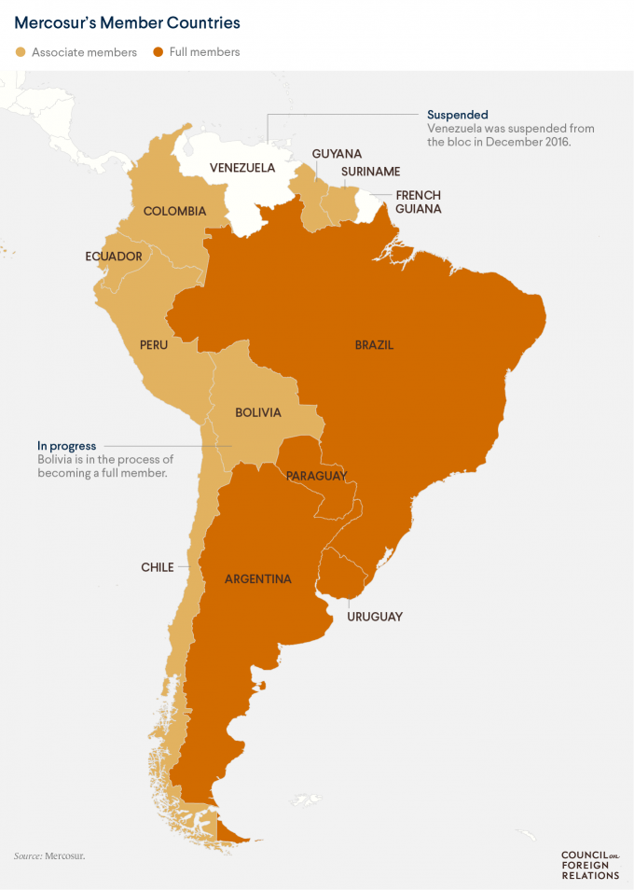
Mercosur
Members: South America
Full Member Countries:
Argentina
Brazil
Uruguay
Paraguay
Venezuela (suspended since 2016)
Associate Member Countries:
Bolivia
Chile
Colombia
Ecuador
Guyana
Peru
Suriname
Mercado Comun del Sur (in English: Southern Common Market)
Began January 1, 1991
More than 250 million people and more than ¾ of the economic activity on the continent.
Creates tariff policies to regulate imports and exports and the bloc can arbitrate in trade disputes among its members.
It’s goal is to bring about the free movement of goods, capital, services and people among its member states.

Slide 8
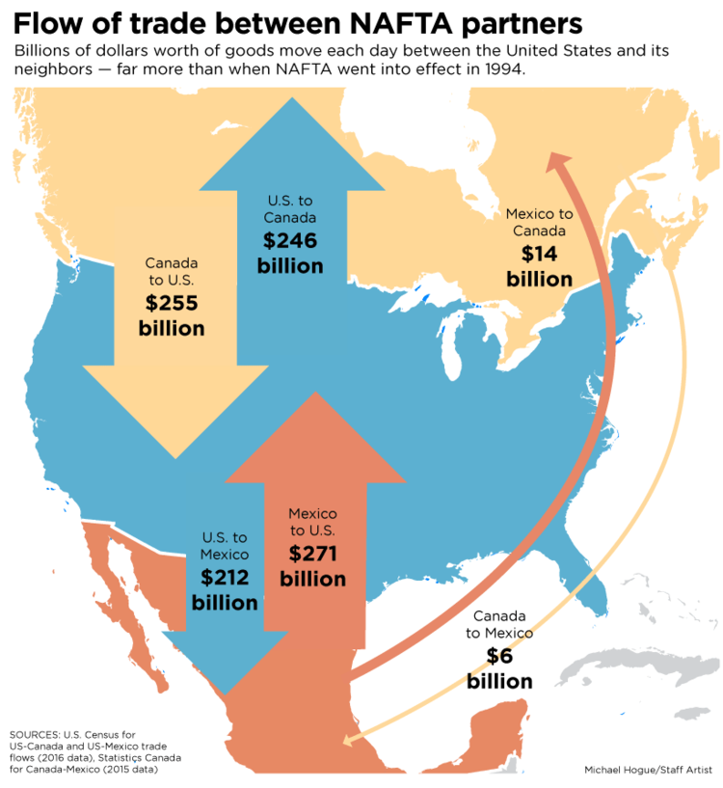
Directions:
Color your map to show the amounts of trade between the US, Canada, Mexico.
Make your arrow size reflect the amounts (bigger arrows more $)
Create a key for your notes.
Add a “NAFTA” as your title.

