Slide 1
Warm-up 12/6
What is the difference between private and public industry?

Slide 2
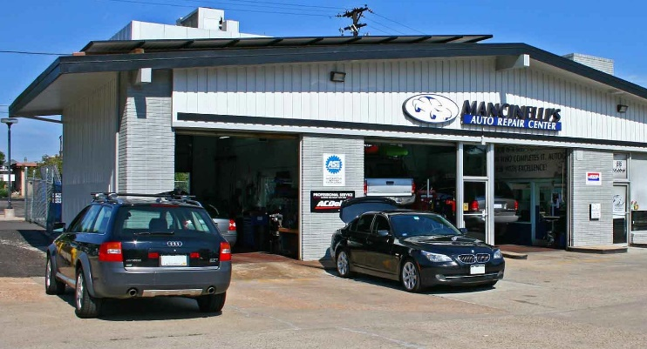
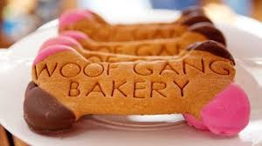
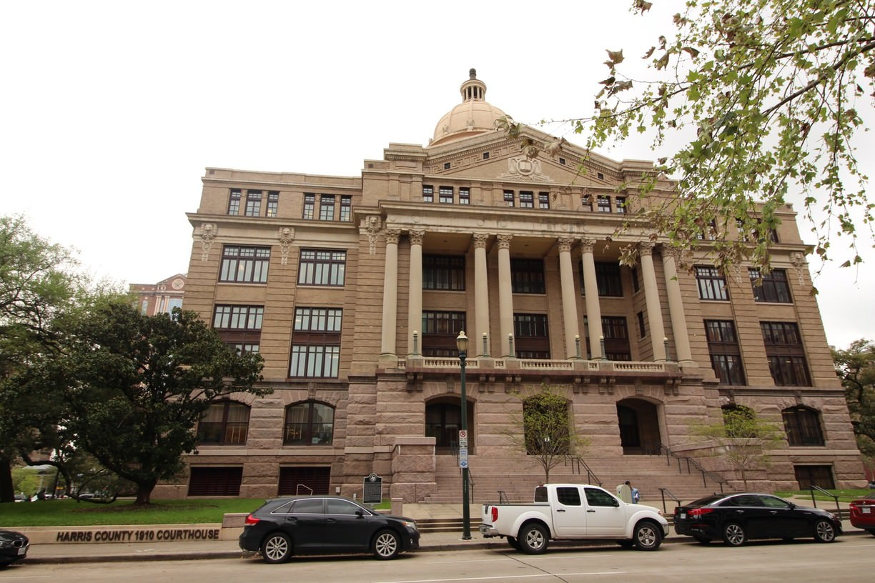
Who owns it?
Private Sector- Anything owned by an individual with little to no government regulation.
Public Sector- Anything run or regulated by Government!

Slide 3
Vocab
You and your partner will work together to fill out the 6 vocab boxes
Neither of you may look at the other’s paper
You will describe the image to your partner and they will have to draw it
Once you have ALL pictures completed, create definitions for each word!

Slide 4
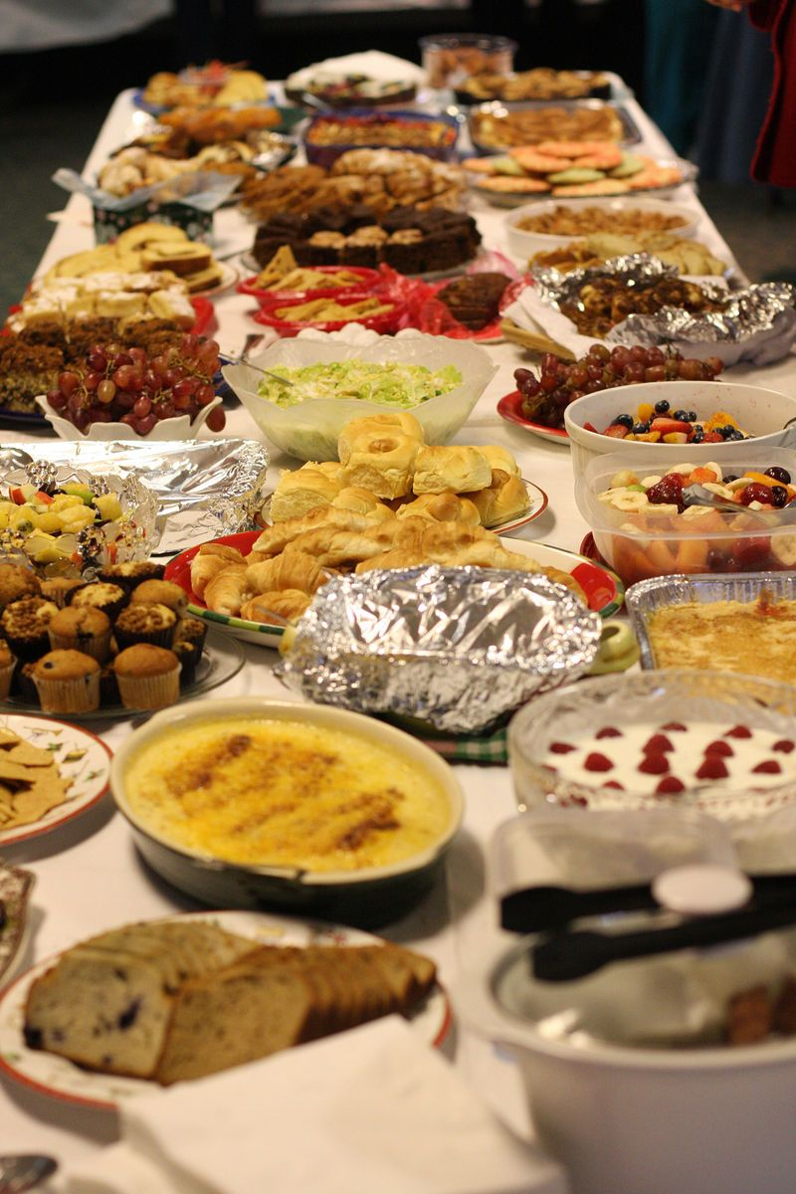
Surplus
an amount of something left over; an excess of production.

Slide 5
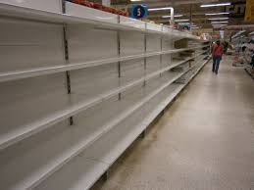
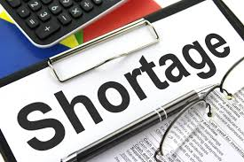
Shortage
a state or situation in which something needed cannot be obtained in sufficient amounts.

Slide 6
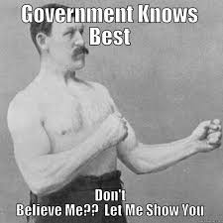
Command Economy
an economy in which production, investment, prices, and incomes are determined by a government.

Slide 7
Socialism
means of production, distribution, and exchange should be owned or regulated by the community as a whole (everyone is equal)

Slide 8
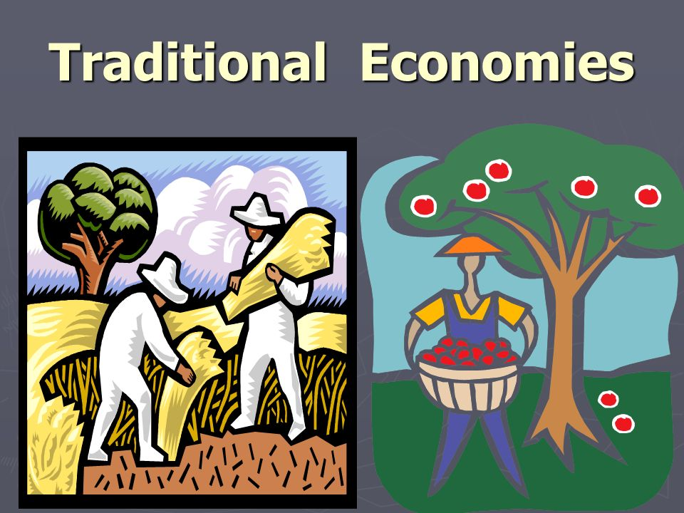
Traditional Economy
A system of barter and trade that relies on culture and historical exchanges

Slide 9
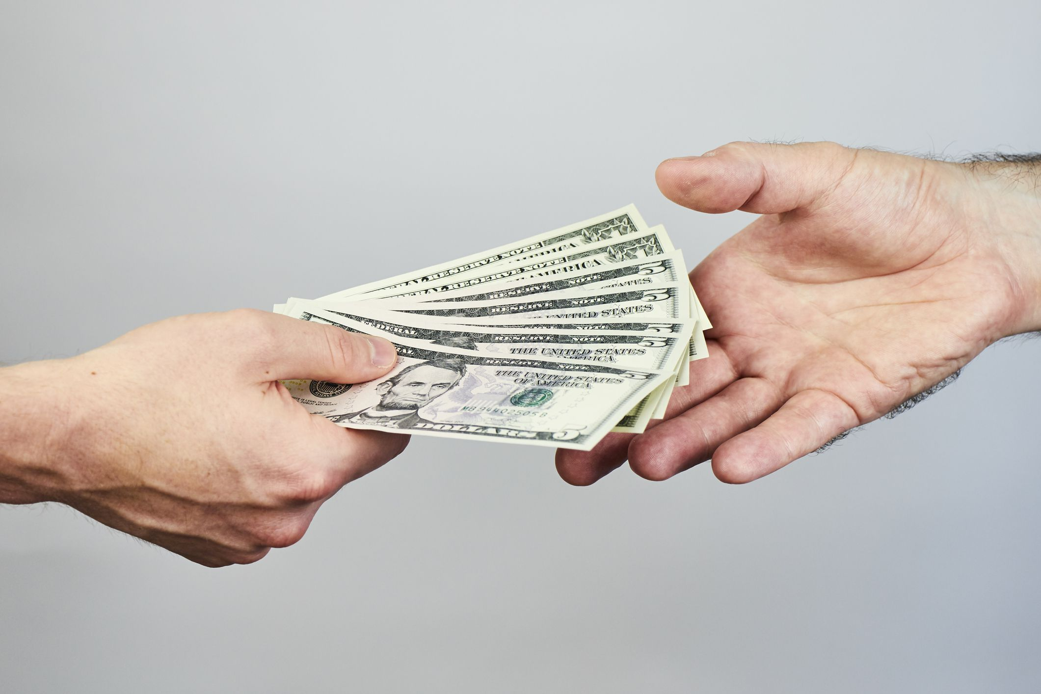
Market Economy
Where what to make, and how much to sell it are determined by supply and demand, and have little government regulation.

Slide 10
Economic Spectrum

Slide 11
Where does it go?
In Sweden, some businesses are owned by the government while others are owned by the people. The national government owns many public services, including free health care, retirement benefits, and a university education.

Slide 12
Where does it go?
State planners in Russia meet to decide what the country should focus on producing. These officials pass their decision down to factories, and allocated to them raw materials, workers, and other resources needed to produce goods. The factories are told how much they should produce with these resources and who the final products should be shipped to.

Slide 13
Where does it go?
In Germany, business owners decide what to produce, how much to produce, and who to produce for. If they produce a good that people don’t want, they will not make a profit.

Slide 14
Where does it go?
In Nigeria, people rarely engage in market transactions. For the most part, they do not need to. Families grow their own vegetables and raise their own animals or hunt to get meat. Certain times get tough for people in Nigeria, like when the winters are particularly cold or animals change their migration patterns. For this reason, it is important that families stock up in “good times” and develop relationships with neighbors with whom they can share or trade.

Slide 15
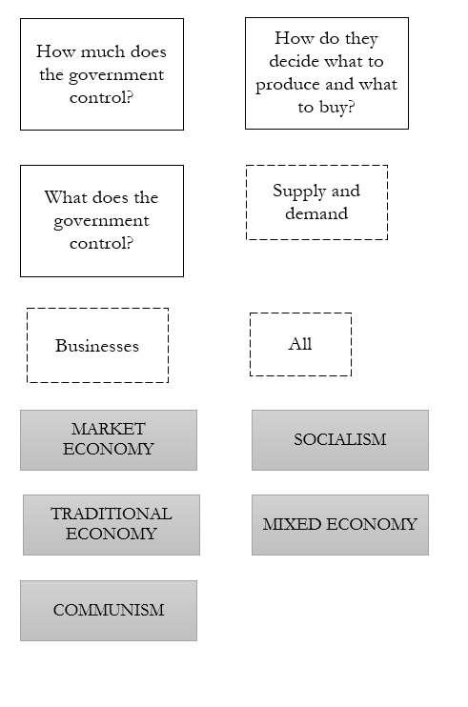
Flowchart
Use these words to fill in your flow chart on the back.

