Slide 1
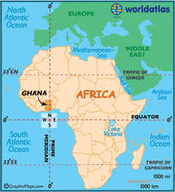
African Natives (Red)
Before Europeans stepped foot on African soil, Native Africans had many diverse groups.
Most West Africans lived in small villages and identified primarily with their extended family or clan, rather than an ethnic or national identity.
The first major empire to emerge in West Africa was the Ghana Empire when Soninke farmers gained wealth from trade.
Under the leadership of Sundiata Keita, Mali replaced Ghana as the leading state in West Africa.

Slide 2
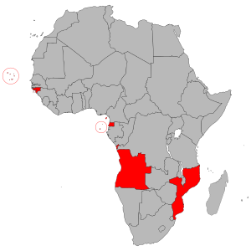
Portugal (Yellow)
The European slave trade began with Portugal’s exploration of the west coast of Africa in search of a sea trade route to the Orient.
Portuguese traders built Elmina Castle in present-day Ghana, on the west coast of Africa. Originally built as a fortified trading post, the castle had mounted cannons facing out to sea, not inland toward continental Africa because they were more worried about European invaders.
During the Berlin Conference of 1884, Portugal gained control over the modern day countries of Angola and Mozambique.

Slide 3
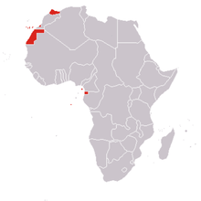
Spain (Brown)
During the 19th century, Spanish interests expanded into regions of Africa, such as Western Sahara and the Gulf of Guinea.
North Morocco was the first area Spain conquered, and Spanish Western Africa was the last.
During the Berlin Conference of 1884 Spain takes control of small coastlines in modern day Cameroon and Morocco.

Slide 4
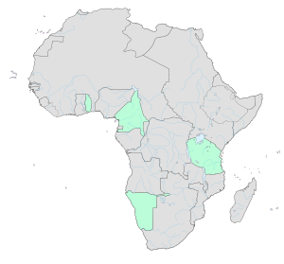
Germany (Orange)
Germany lagged behind smaller and less-powerful nations, so their colonial power was less than other European nations at the beginning.
By the 1880’s Germany became the third-largest colonial power in Africa. Nearly all of its overall empire of 2.6 million square kilometers and 14 million colonial subjects. In 1914 Germany possesed areas of Southwest Africa, Togo, Cameroon, and Lake Tanganyika.
During the Berlin Conference of 1884 Germany gained control of the modern day countries of Tanzania, and Namibia as well.

Slide 5
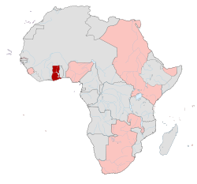
Great Britain (Blue)
The British moved aggressively into South Africa while looking for a lucrative trade route. The British acquired the Dutch Cape Colony in 1806. By 1820, more and more Brits were immigrating to South Africa, pushing out the Dutch who had been living there. The British knew these Dutch territories were rich in gold and diamonds, which would lead to big profits. In 1902 after two bloody wars, the British occupied the Cape Colony and the Dutch republics.
During the Berlin Conference of 1884, Great Britain gained control of the modern day countries of Egypt, Sudan, Nigeria, Ghana, Sierra Leone, Uganda, South Africa, Botswana, Zimbabwe, Zambia, Malawi, and Kenya, and the northern part of Somalia.

Slide 6
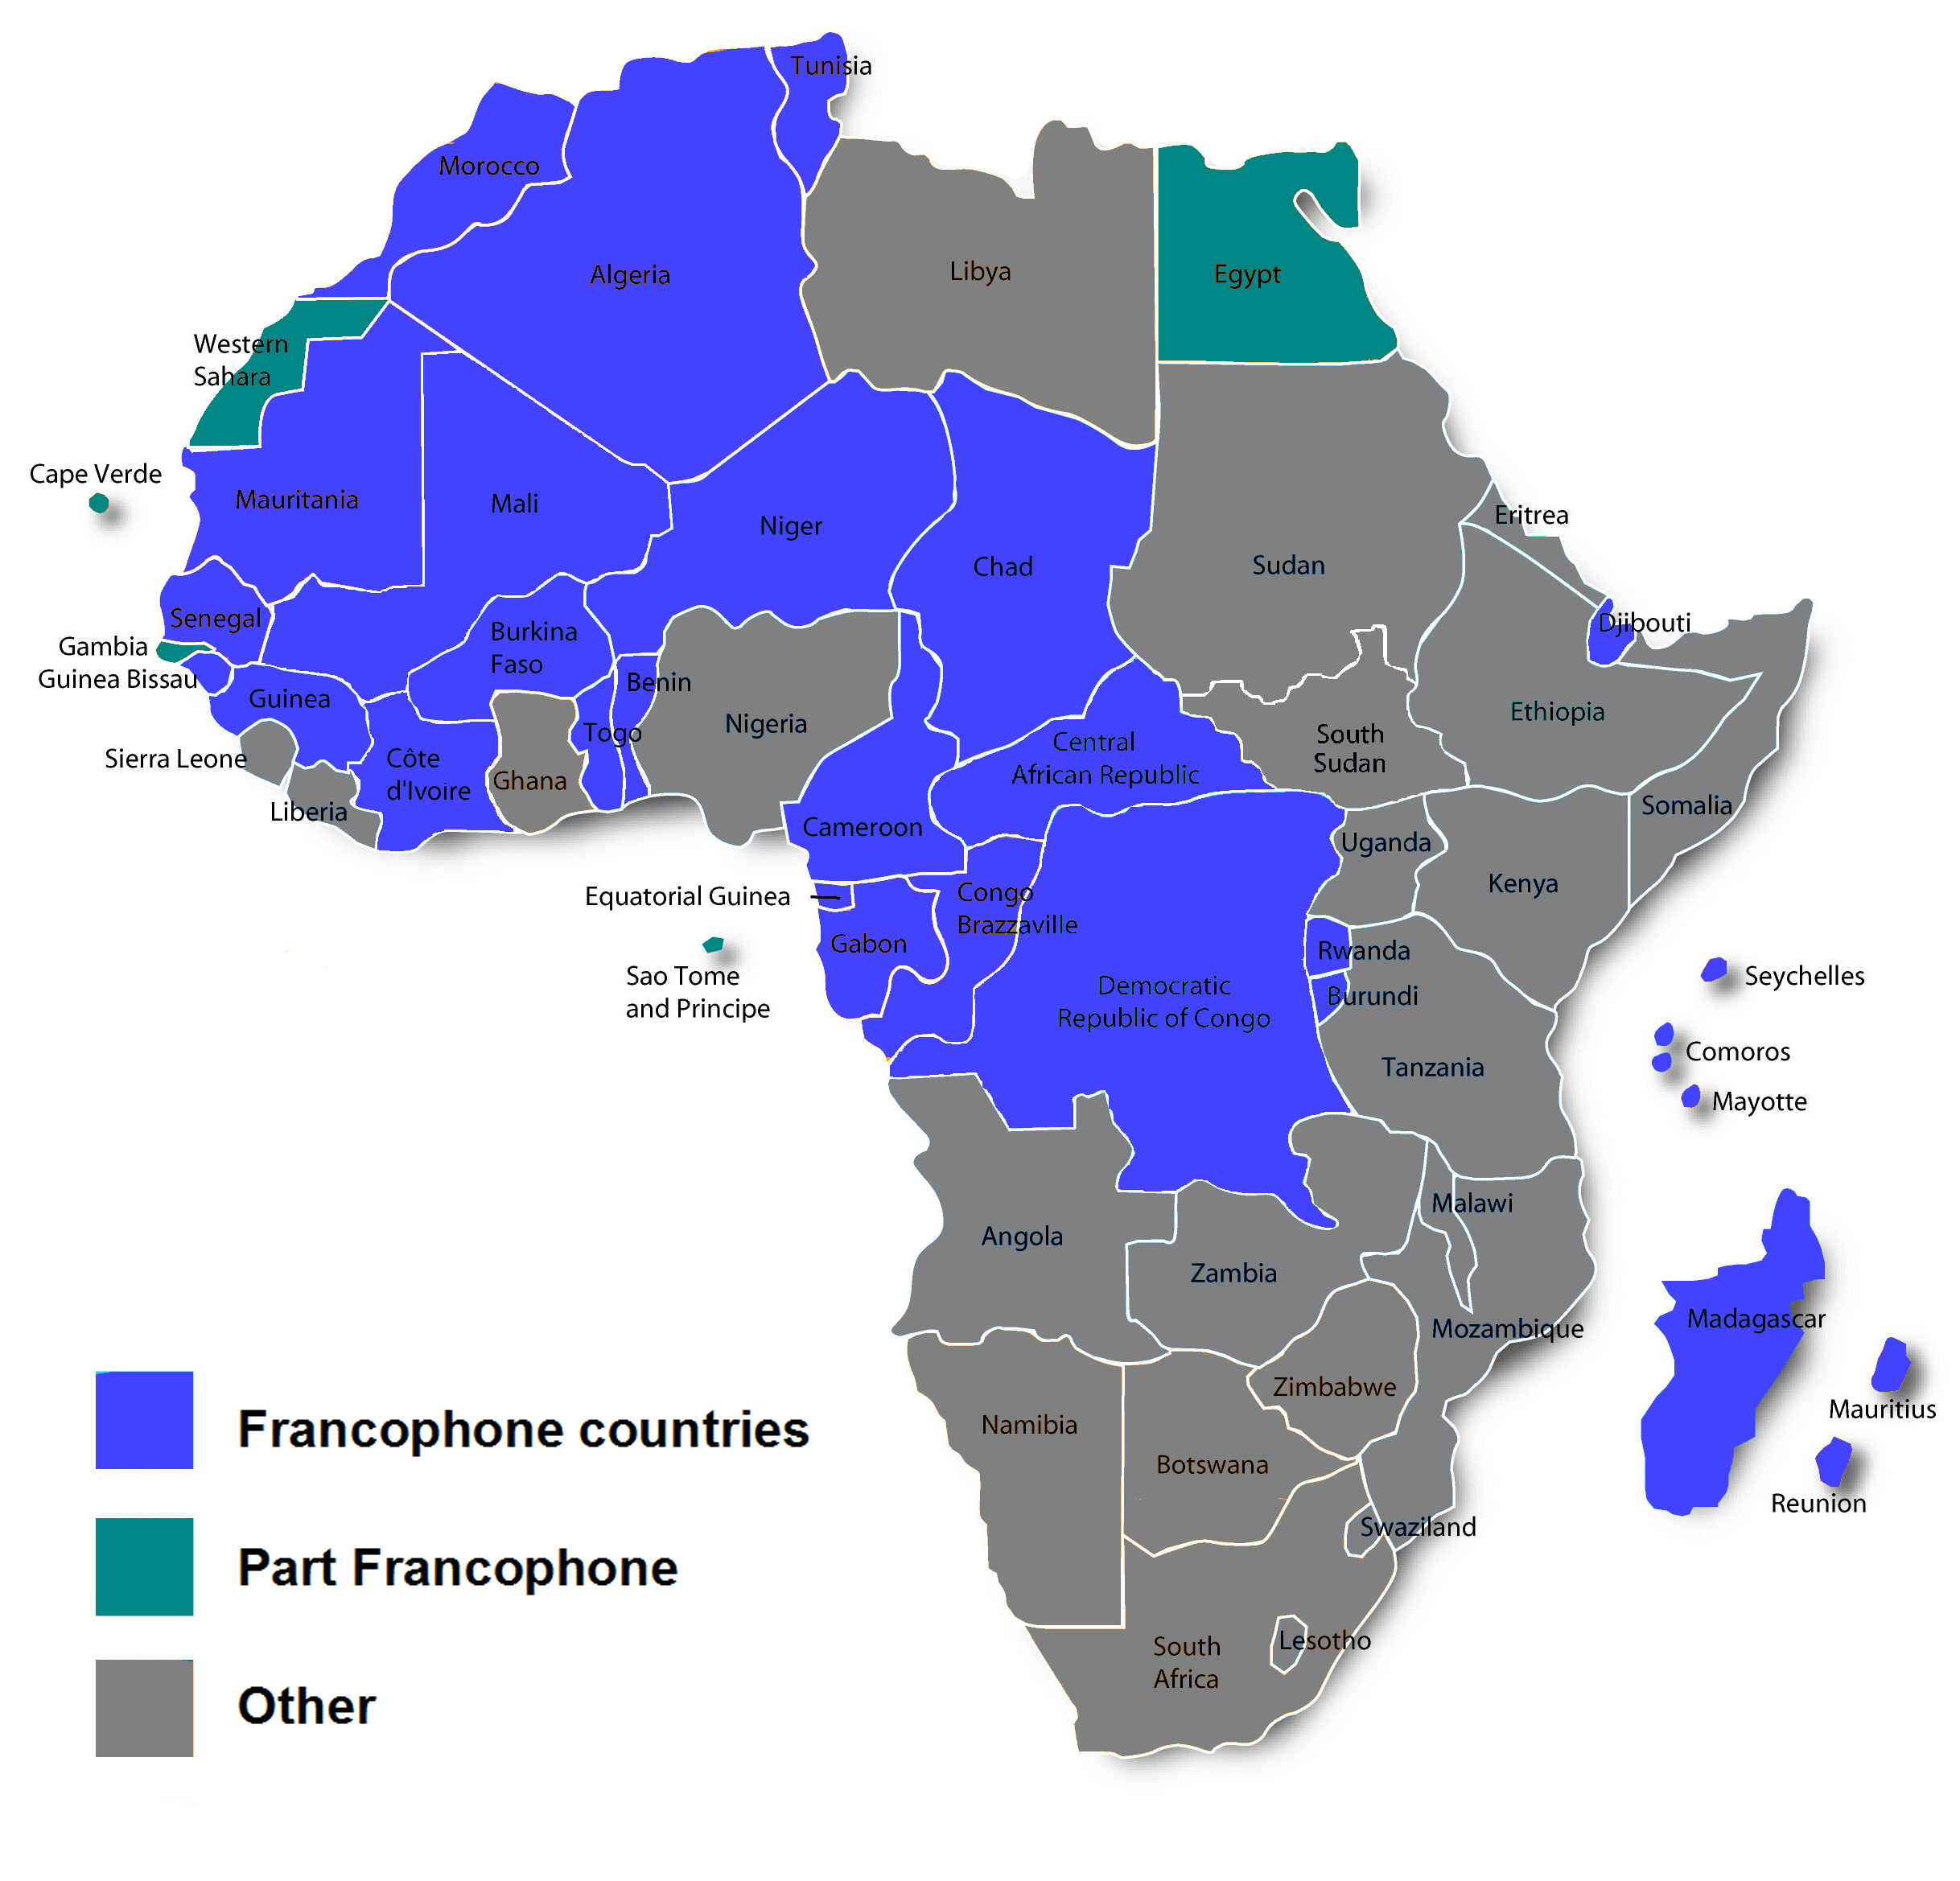
France (Green)
Although the French had established a trade port on the West African coast as early as 1659 at St. Louis (present day Senegal), their participation in West Africa did not increase substantially until later in the nineteenth century.
Although the French had contact in other areas of coastal West Africa their efforts were most clearly focused on the Senegal River area.
During the Berlin Conference of 1884, France gained control of the modern day countries of Algeria, Mauritania, Mali, Niger, Chad, The Central African Republic, and Madagascar.

Slide 7
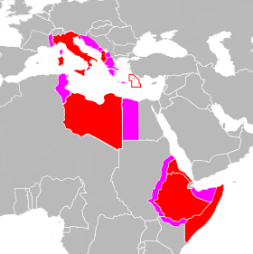
Italy (Purple)
Italy eyes the African continent with the Italian colonization of Eritrea, and continues with the acquisition of Libya and Somalia, and the invasion and occupation of Ethiopia.
During the Berlin Conference of 1884, Italy gained control of the modern day countries of Libya and Somalia.

Slide 8
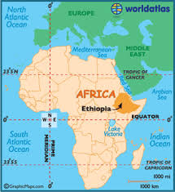
Ethiopia (Grey)
Modern day Ethiopia is a unique case for the continent of Africa. This area, originally under the kingdom of D’mt was established in 700BC. For thousands of years Ethiopia has faced many different occupations and invasions, but has lasted as an independent nation.
During the Berlin Conference of 1884, Ethiopia was given control over their own country, the only African peoples allowed independence over itself.

