Slide 1
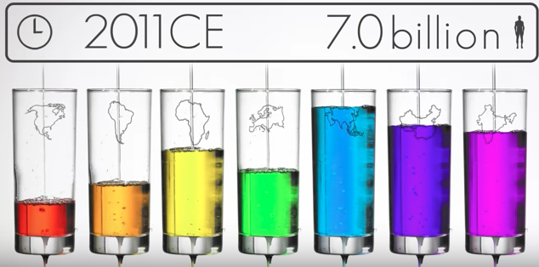
Population in Asia
Watch the Population Video

Slide 2
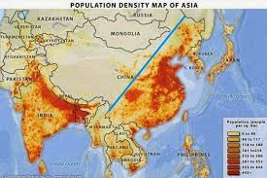
A. Populations of Asia
1. Asia is the largest and most populous continent.
~30% of land on earth but 60% of the worlds population

Slide 3
A. Populations of Asia
2. Asia has the highest growth rate in the world.
3. The two most populous countries in the world are India and China, both Asian countries.

Slide 4
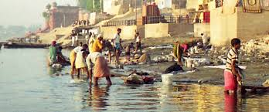
A. Populations of Asia
4. Asia has the space for continued growth, but not the resources.

Slide 5
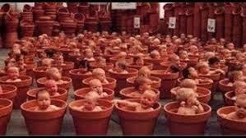
A. Populations of Asia
5. Some Asian countries are expected to double by the year 2050, but they are also the poorest nations in Asia.
Visit Population Projections Here

Slide 6
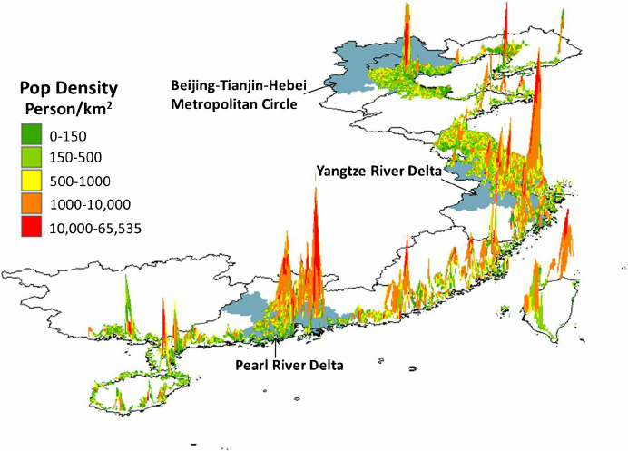
A. Populations of Asia
6. The highest densities are located along major waterways used for manufacturing and trade.
~Ganges River, Yangtze River, Yellow River and Eastern Pacific Coast

Slide 7
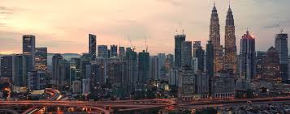
B. Overcrowding in Asia
1. Due to the enormous human populations, Asia is running out of room, so the cost of living is increasing.

Slide 8
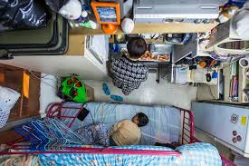
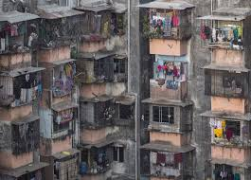
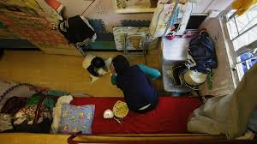
B. Overcrowding in Asia Here
2. Micro-Apartments and Tiny Homes are the last resort for some families. These spaces combine all living needs into one room, about the size of the average American bedroom.

Slide 9
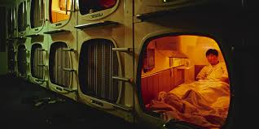
B. Overcrowding in Asia
3. Capsule hotels are also popping up around China and Japan so that people can avoid traffic and stay near work during the week.

Slide 10
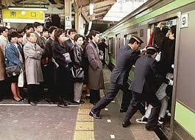
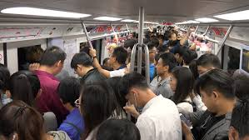
B. Overcrowding in Asia
4. Train stations hire people pushers to fit as many people onto a single train as possible.

Slide 11
B. Overcrowding in Asia Here
Capsule Hotels in Japan
Japanese People Pushers
Click on both boxes above to watch the videos

Slide 12
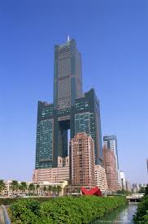
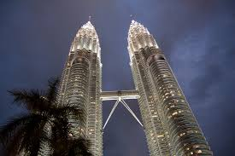
B. Overcrowding in Asia
5. Countries like Japan and China have started building ‘up’ and underground for more room.
~Sky Towers have housing, malls, doctor offices, schools, and jobs so that people don't have to travel far but have all they need.

Slide 13
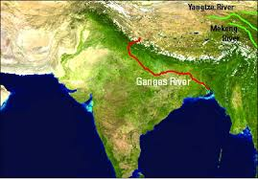
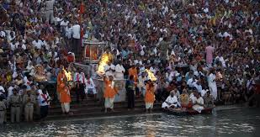
B. Overcrowding in Asia
6. The Ganges River of India has the highest population density in the world, with over 1,250 people per square mile (Harlingen has about 85 people per square mile).

Slide 14
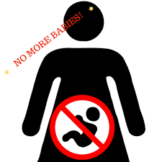
C. Population Control
1. Many countries have tried to slow population growth to ensure there is enough food and resources for all people.

Slide 15
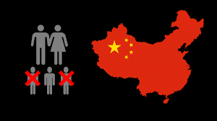
C. Population Control
2. China instituted the One Child Policy, which fined parents if they had more than one child.
~With many low paying wages throughout the country, people could not afford to have multiple births.

Slide 16
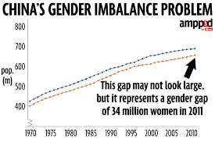
C. Population Control
3. This led to a huge gender gap, since culturally families wanted boys over girls for almost 3 decades.
~Baby girls were aborted, abandoned, and put up for adoption in the millions.

Slide 17
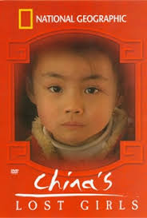
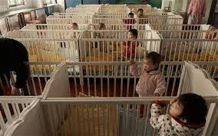
C. Population Control
4. Although in 2016 the One Child Policy was lifted, it has created a society where there are not enough girls to marry, and men are left to be alone.
~Some families have kidnapped women as brides for their sons

Slide 18
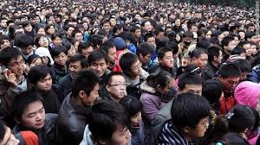
C. Population Control
5. Social unrest due to the gender gap is just beginning, and time is the only way to correct it. (click on the icon to the right for video)

Slide 19
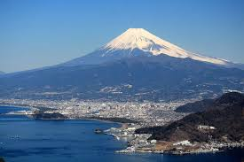
D. Aging Population
6. Due to the high cost of living on the mountainous island of Japan, families have chosen to have smaller families, with one child or less.
*They don’t have a
Gender preference*

Slide 20
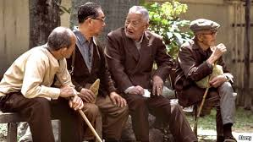
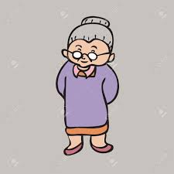
D. Aging Population
2. Japan is now facing the problem of having an aging population, due to the low birth rates.

Slide 21
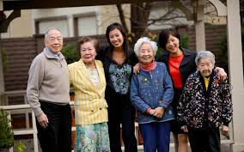
D. Aging Population
3. With less of a work force, jobs are not being filled and there are fewer people to care for the elderly (which is customary in Asian countries).
~Example: Too many elementary schools and not enough Nursing Homes.

Slide 22
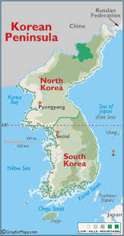
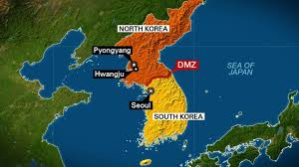
E. Korean Peninsula Populations
1. Almost everywhere in Asia we are seeing more and more overcrowding, with the exception of the northern part of the Korean Peninsula.
~North and South Korea are the two countries located on the peninsula

Slide 23
E. Korean Peninsula Populations
2. South Korea is a thriving nation, with growing populations and industry.
~Home to the past winter Olympics!

Slide 24
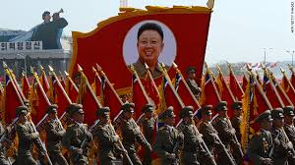
E. Korean Peninsula Populations
3. North Korea, due to its extreme totalitarian government led by Kim Jong-un, has cut off the country to all political, cultural, and economic opportunities outside of North Korea.

Slide 25
E. Korean Peninsula Populations
4. Due to these policies, North Korea is stagnating in terms of population.
5. North Korea is also considered a homogenous population, with 99.98% of the population claiming they are of Korean descent and .02% claiming “Other”.

Slide 26
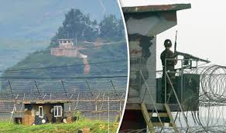
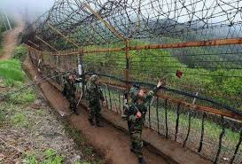
E. Korean Peninsula Populations
6. Reasons for a homogenous society is that North Koreans are not allowed to leave for work, travel, or leisure out of the country, and unless under extremely special circumstances, outsiders are not allowed entrance to the country.

Slide 27
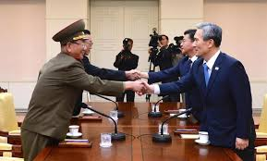
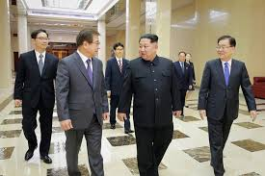
E. Korean Peninsula Populations
7. Due to very recent dialogue between North and South Korea, we may see a change to these policies in the near future.

