Slide 1
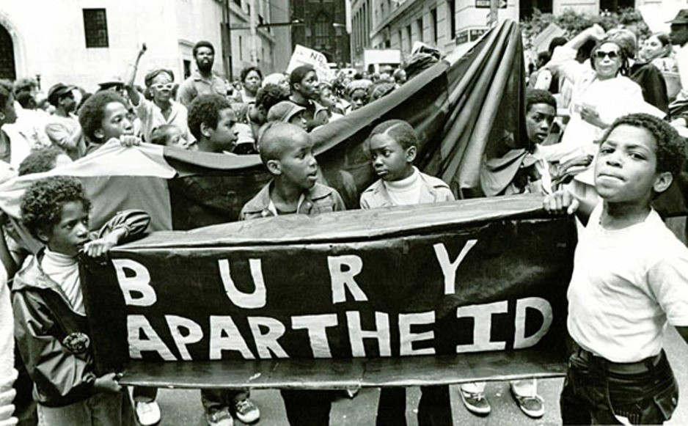
Apartheid in South Africa
Examining the Outlasting Effects

Slide 2
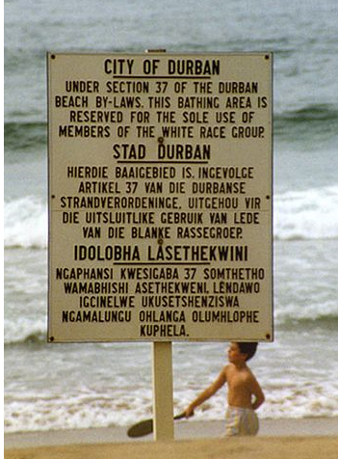
Warm Up
Do First:
On the top of your handout, write down your thoughts/feelings about the posted law.

Slide 3
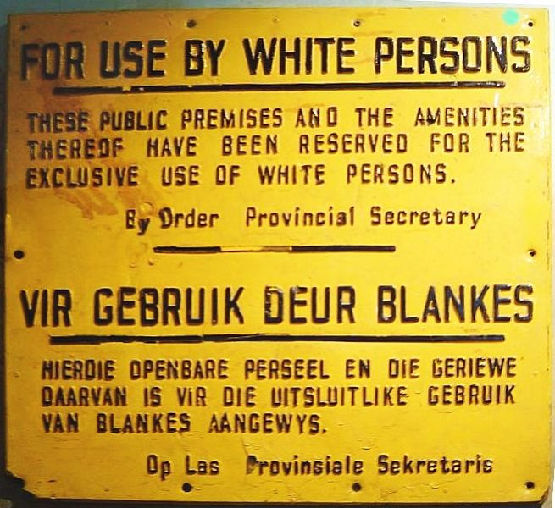
Apartheid- What is it?
An official policy of racial segregation formerly practiced in the Republic of South Africa, involving political, legal, and economic discrimination against nonwhites from 1948-1991

Slide 4
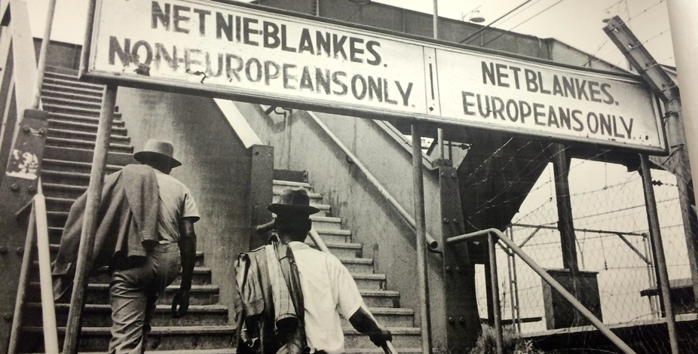
Apartheid- What is it?
Used by the South African government to exploit and dominate the country’s black population
Separate the privileged white minority from the black majority

Slide 5
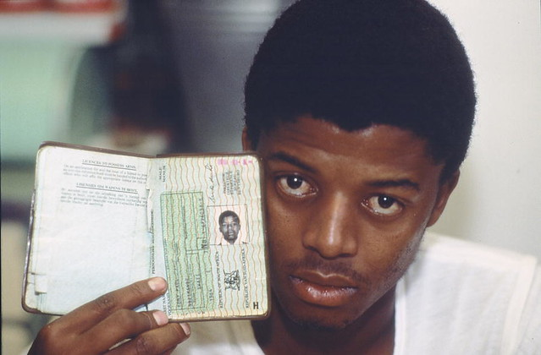
Apartheid- What did it do?
Separated whites from non- whites
Forced non- whites to carry pass books as identification
Limited movement b/c they specified where non-whites could be
Created separate residential areas for whites and non- whites
Forbade social contact between races

Slide 6
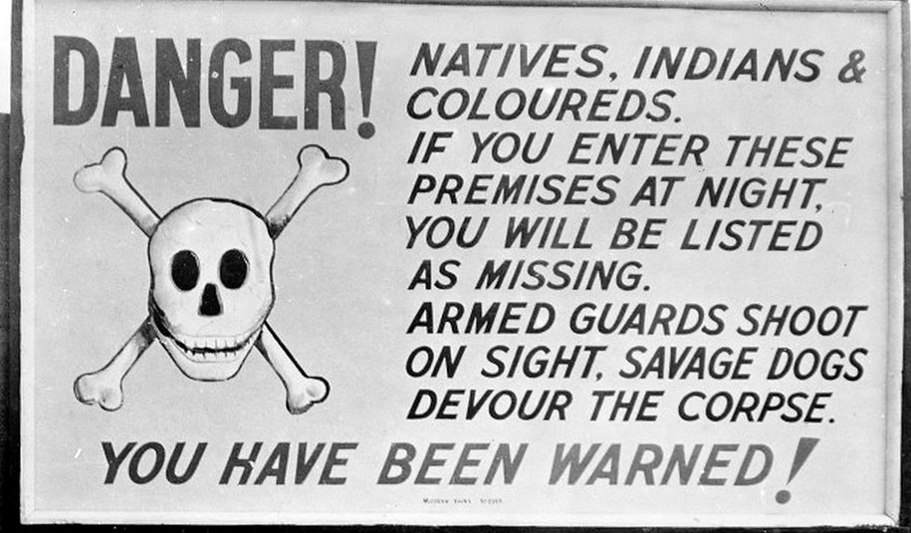
Apartheid- What did it do?
Segregated public facilities
Established separate educational standards- non-whites received less education
Denied non-white participation in the government
Restricted races to certain jobs
Whites received the best jobs and land

Slide 7
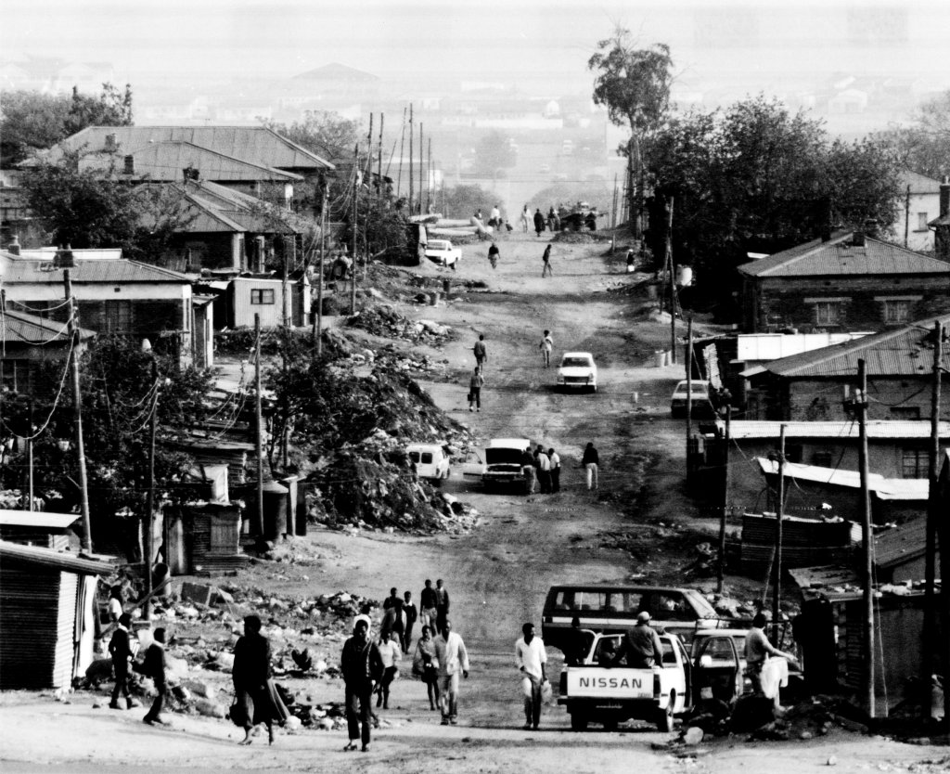

Slide 8
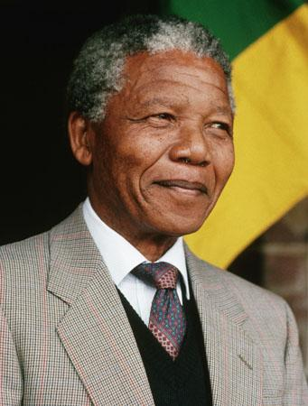
Apartheid- Resistance
While watching the short video, give examples you see for the following...
Nelson Mandela- leader in the struggle to end apartheid
Strikes
Boycotts
Nonviolent demonstrations
Civil disobedience
Occasional violent acts

Slide 9
Apartheid- Examples of Resistance

Slide 10
While you watch the video..
Right There Questions: Literal questions whose answers can be found in the video.
Locate and Search Questions: Answers are gathered from several parts of the video and put together to make meaning.
Author and You: These questions are based on information provided in the video but the you are required to relate it to your own experience/knowledge.
On My Own: These questions do not require you to have seen the video, but you must use your background knowledge to answer the question.

Slide 11
Trevor Noah - A Personal Account

Slide 12
Closing Questions
What impact did the Dutch and English colonization of South Africa have on the indigenous people (San and Khoikhoi) during the seventeenth century?
What is apartheid and how and why did apartheid come about?
What evidence supports the fact that apartheid existed in South Africa before 1948?
How did the Africans resist discrimination in South Africa?

Slide 13
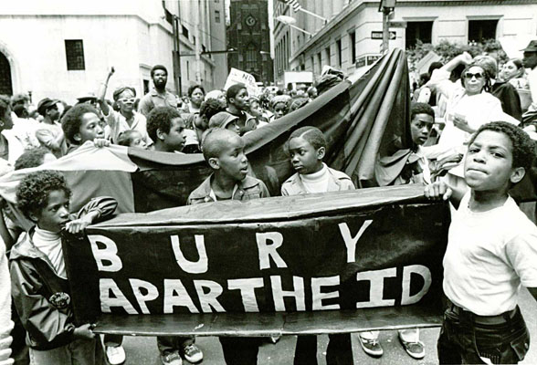
Apartheid Videos
Apartheid Takes Hold
The End of Apartheid

