Slide 1
Human Environment Interaction
Adaptation and Modifications

Slide 2
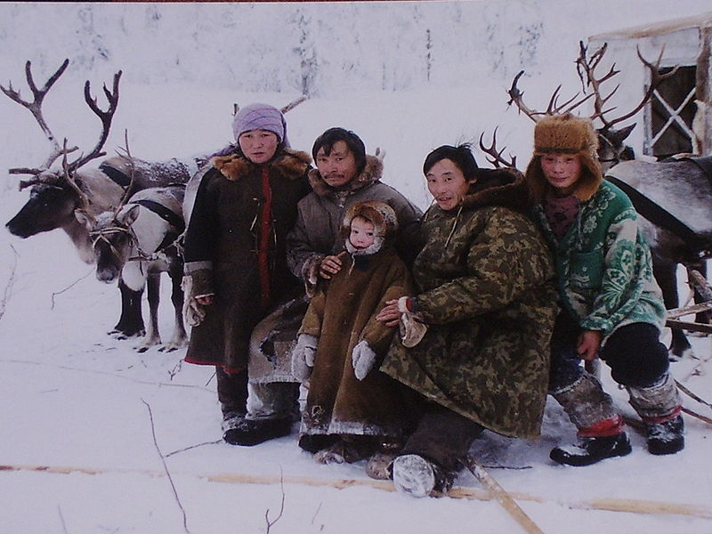
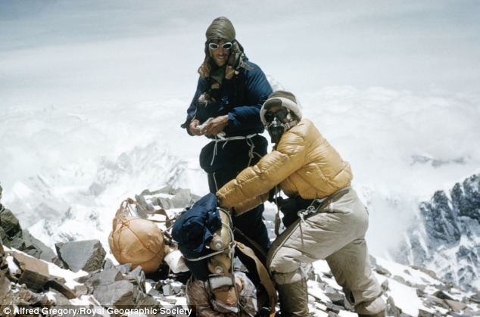
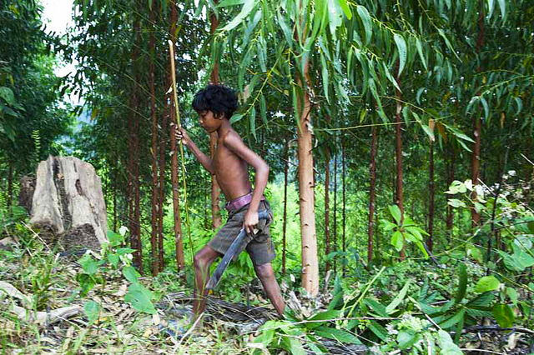
Adaptations
1. Human Adaptation: when humans change, or ‘adapt’ to survive in a specific environment.

Slide 3
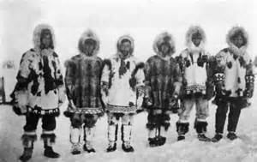
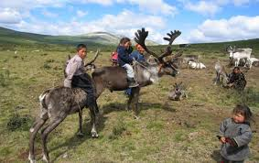
Adaptations
2. Native groups of Mongolians and Russian have shorter limbs than the rest of the world.
This helps them stay warm in Siberia Winters.

Slide 4
Adaptations
3. Tropical peoples of Thailand are taller and leaner than most Asians.
This helps them live, climb, and hunt in dense forests.

Slide 5
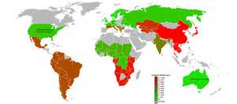
Adaptations
4. Until cows were commonly domesticated, most adult humans were lactose intolerant. Today in China, 94% of the adult population is lactose intolerant.
There is very little room for livestock in China, so Cows Milk is uncommon.

Slide 6
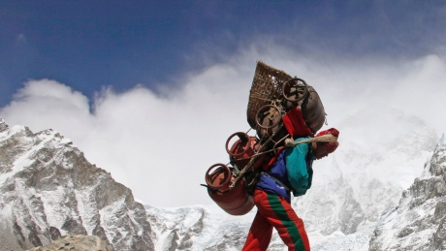
Adaptations
5. Sherpa’s of Mount Everest and the Himalayas require less oxygen than the rest of the world’s population to breath.
Their red blood cells are actually a different shape, and carries more oxygen.

Slide 7
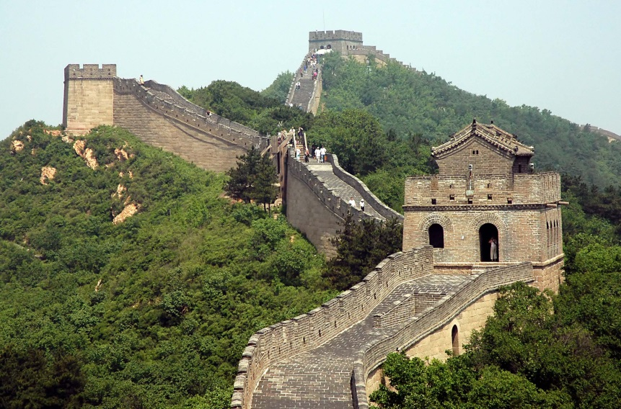
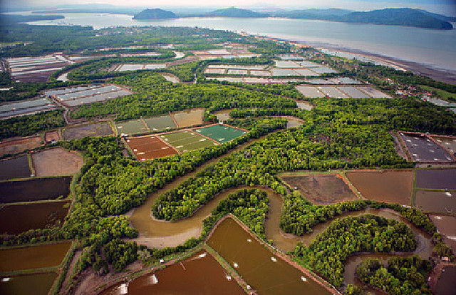
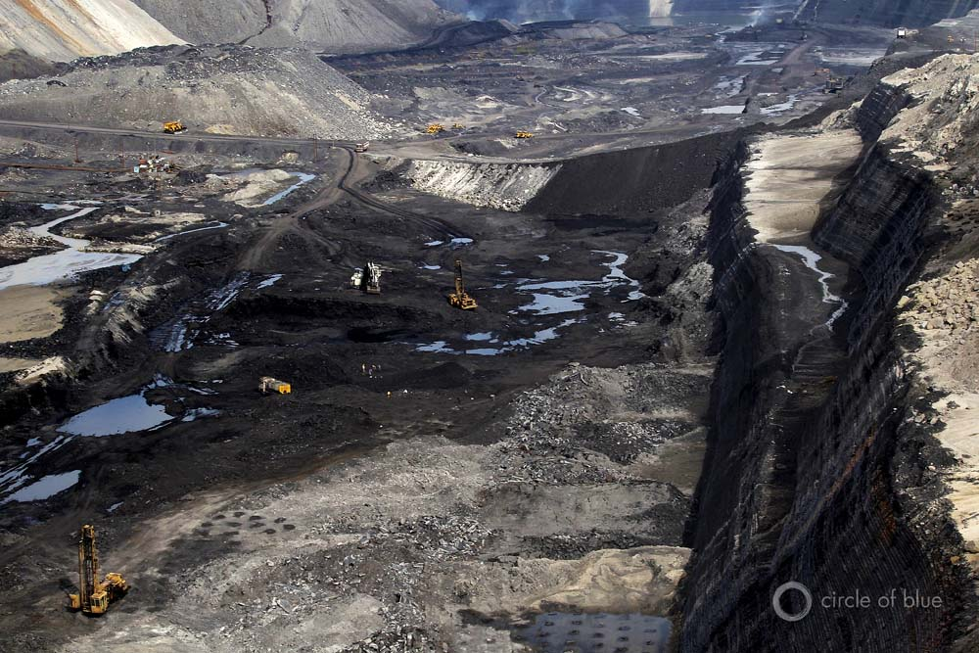
Modifications
1. Modifications: When we change the environment, or our way of life, to meet survival needs and to enhance longevity.

Slide 8
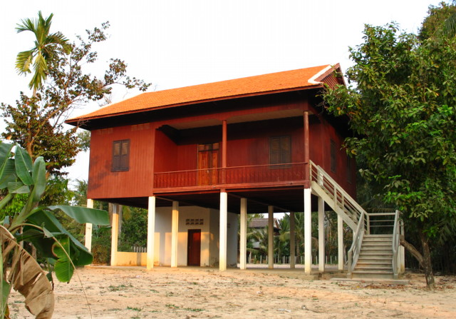
Modifications
2. Houses in Monsoon stricken Bangladesh have been built on stilts.
Annual flooding, which is needed for Rice, would sweep away anything on the ground.

Slide 9
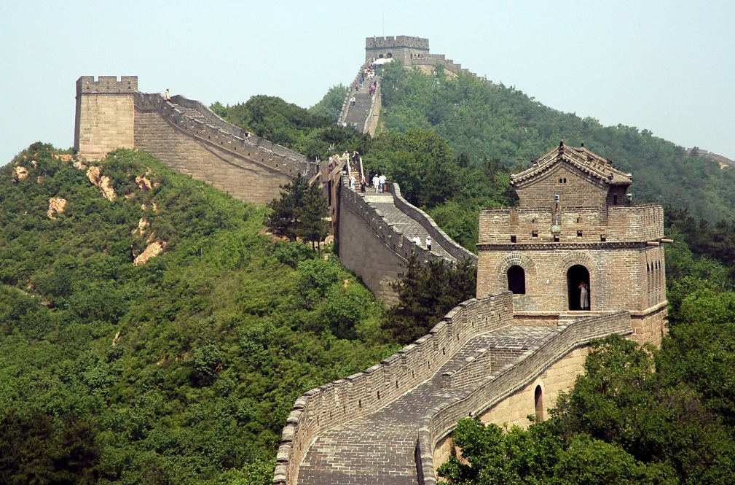
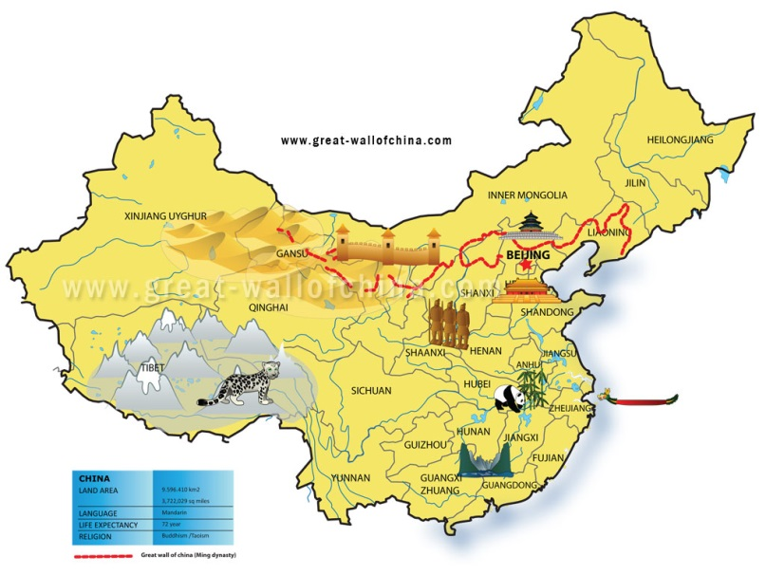
Modifications
3. The Great Wall of China was used as a large scale source of protection from invading enemies.
It has changed the environment and caused social divisions with once connected peoples.

Slide 10
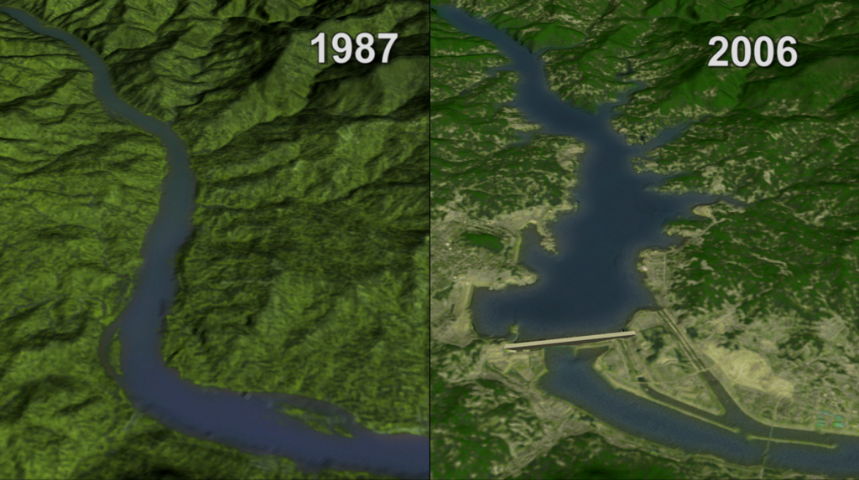
Modifications
4. The Three Gorges River Dam is the largest in the world.
It controls flooding in some areas, causes floods in other places, and is the largest energy source in China. Millions of people were forced to move for it to be built. Entire towns now are under water.

Slide 11
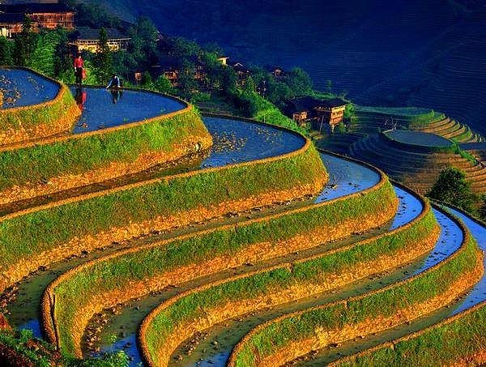
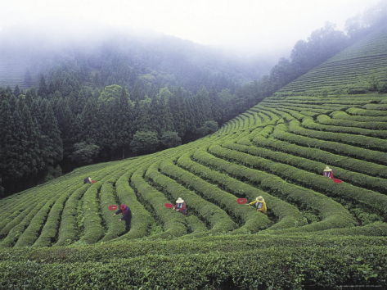
Modifications
5. Terrace Farming uses a series of ‘steps’ to farm tea and rice in China and Japan.
This saves space, and allows areas with high or dense populations to produce more crops.
Especially important on the small mountainous island of Japan.

Slide 12
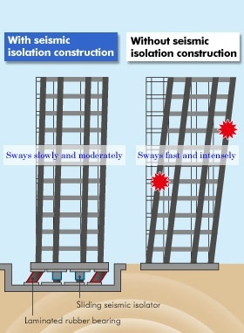
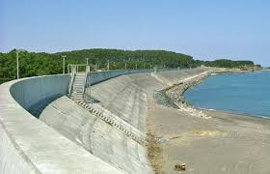
Modifications
6. Due to the Ring of Fire, Japan has created many new building adaptations to withstand major earthquakes.
Flexible structures, energy absorbent bases, 40 foot high wave walls and various other techniques to protect the country.

Slide 13
